Slide 1
Industry Overview

Slide 2
Industry Overview
Agricultural production is implicitly linked to climate. NSW is unique in that it features a wide range of climate variability across the state.
Ranging from topical rainforests in the north east, the rugged mountains in the south; lush pastures in the east, to semi-arid rangelands in the west.
The climate comprises a number variable but the important ones to agriculture are rainfall and temperature which both dictate the types of plants and animals that will thrive in a region.
This range of climates leads to an extensive range of agricultural industries.

Slide 3
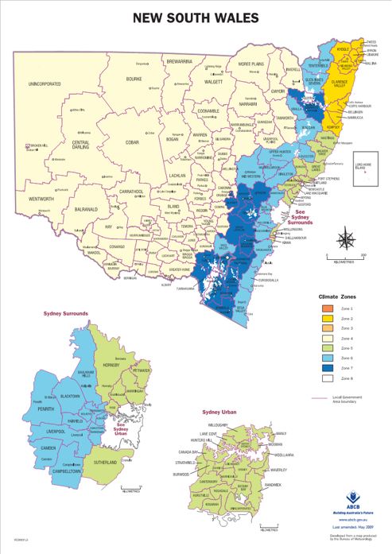
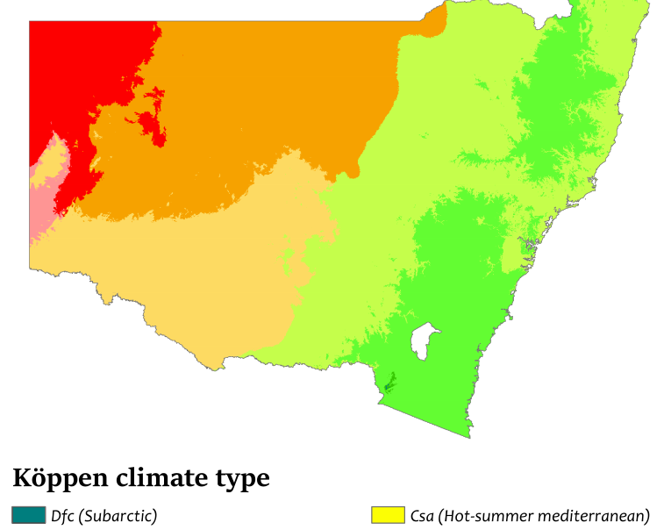
Industry Overview
These two maps show the climate variability across the state.
The map on the left is less detailed but shows how the climate becomes drier and hotter the further west and north you go.
The map on the right shows the eastern part of the state in more detail, The yellow indicate a mild winter and humid summer. Light blue is a generally mild with good rainfall and dark blue cool with good rainfall.
Reference - https://goo.gl/cV5Yf8

Slide 4
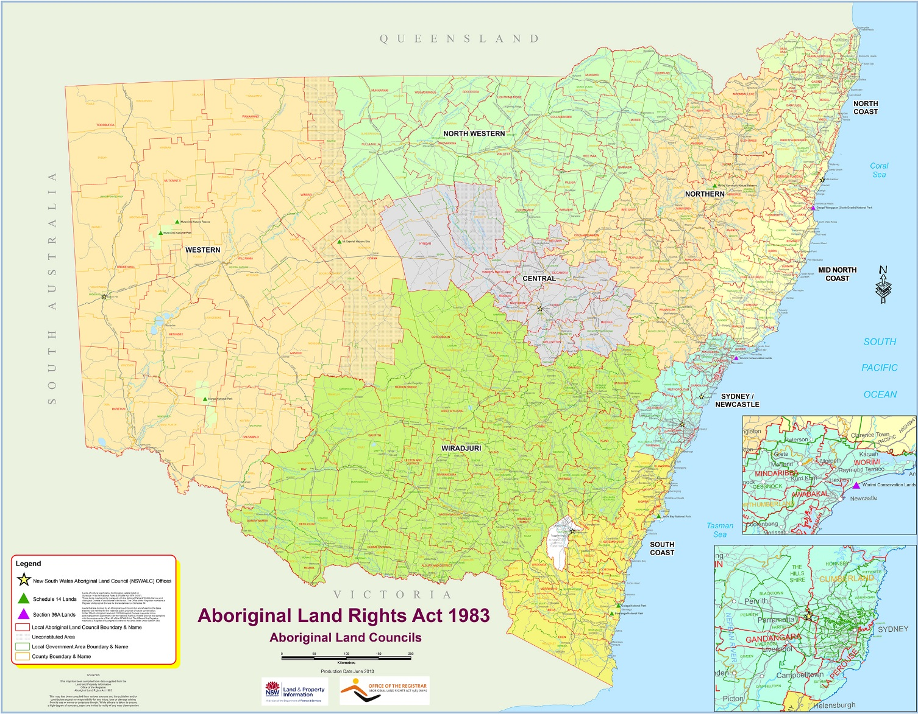
Local Aboriginal Land Council Regions
This map shows the 120 Local Aboriginal Land Councils (LALCs) grouped into their 9 major regions.
The major regions correlate well with the climate regions on the previous page and from this the industries most suited to each LALC can be determined.

Slide 5
Industries By Region
LALC Region | Climate Zone | Common Agricultural Industries
North Coast | Warm/Wet | Dairy, Beef, Horticulture, Nuts, Fruit, Fishing, Summer Crops
Mid North Coast | Mild/Wet | Dairy, Beef, Horticulture, Eggs, Fruit, Fishing, Summer Crops
Sydney/Newcastle | Mild/Wet | Dairy, Beef, Horticulture, Eggs, Fruit, Fishing, Vineyards
South Coast | Cool/Wet | Dairy, Livestock & Wool, Horticulture, Fruit, Fishing, Winter Crops, Forestry
Wiradjuri | Warm Temperate | Dairy, Livestock & Wool, Horticulture, Fruit, Summer Winter Crops, Irrigated Crops
Central | Cool Temperate | Livestock & Wool, Fruit, Winter Crops
Northern | Warm/Dry | Livestock & Wool, Summer Crops, Winter Crops, Irrigated Crops
North Western | Warm/Arid | Livestock & Wool, Livestock (rangeland), Summer Crops, Winter Crops
Western | Warm/Semi-arid | Livestock & Wool, Livestock (rangeland), Summer Crops, Winter Crops, Summer Crops, Winter Crops, Irrigated Crops, Citrus, Vineyards

