Slide 1
Investment Analysis
Case Study 1

Slide 2
Investment Analysis – Case Study 1
Case Study
The following slides provide a brief investment case study on a fictional indigenous owned property in NSW.
The aim of the analysis is to see if the business can afford to borrow $500,000 to start a new sheep enterprise with a focus on wool and store lamb production. Rangeland goats are also harvested.
The lender is IBA and the funds will drawn down over two years with repayments commencing in year three,
The property has good fences and water. Some of the livestock handling facilities need updating.

Slide 3
Investment Analysis – Case Study 1
Example Table of Contents
The following slides shows some key aspects of the investment analysis starting with a table of contents.
The table of contents will vary for different investments but the overall structure will remain.
The subsequent slides show an example of how to tabulate assumptions and then to structure cashflows and the balance sheet.

Slide 4
Investment Analysis – Case Study 1
Investment Analysis
Example Table of Contents
Production | Economic
Title information – title searches, title plans, easements, native title… Water licencing Property Information Location Land Systems and Topography Vegetation, Weeds and Pests Fences and Water Access Rainfall Services Production Information Livestock/Crop Carrying Capacity Historic Production Records Infrastructure Plant and Equipment | Business Model Ownership Entity Operating Entity Others Involved Leases/JV/etc Goals and Objectives Enterprise Assumptions Livestock Crop Other Other Assumptions Labour Capital Financing Other | Financial Analysis Cashflow/Profit and Loss 3-5 yrs Balance Sheet 3-5 yrs Repeat CF and BS for different options/enterprises/assumptions Tables/Charts to compare/demonstrate performance Summary

Slide 5
Investment Analysis – Case Study 1
Investment Analysis
Production Assumptions

Slide 6
Investment Analysis – Case Study 1
Investment Analysis
Production Assumptions

Slide 7
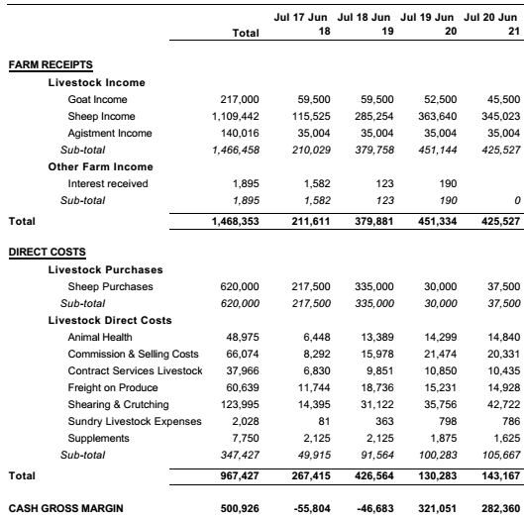
Investment Analysis – Case Study 1
Investment Analysis
Cashflow Report - 1 of 4

Slide 8
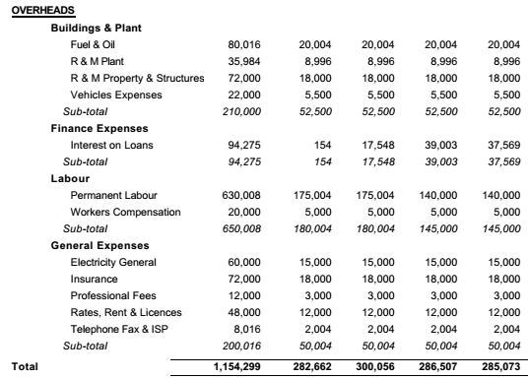
Investment Analysis – Case Study 1
Investment Analysis
Cashflow Report - 2 of 4

Slide 9
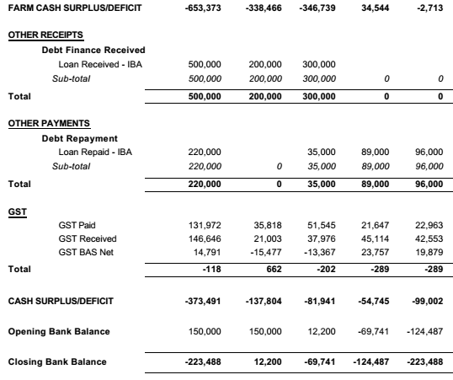
Investment Analysis – Case Study 1
Investment Analysis
Cashflow Report - 3 of 4

Slide 10
Investment Analysis – Case Study 1
Investment Analysis
Cashflow Report - 4 of 4

Slide 11
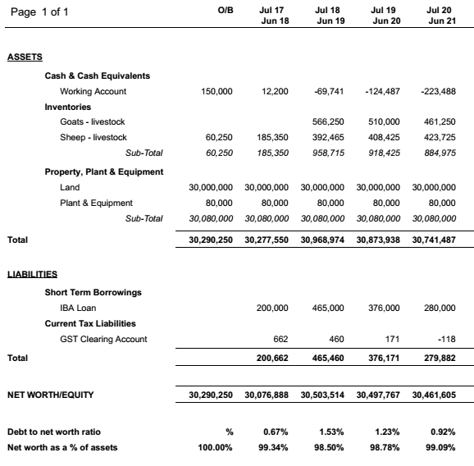
Investment Analysis – Case Study 1
Investment Analysis
Balance Sheet 1 of 1

Slide 12
Investment Analysis – Case Study 1
Summary
This analysis shows that the proposal was not profitable. There are several reasons for this including;
Cost of sheep is high in current market. High depreciation cost.
Finance structuring is very demanding on the business i.e. all debt was to repaid in five years. Interest and finance ratios are poor.
Losses from predation are high.
The land is under utilised. Turn over ratio is poor. Return on capital and return on equity are both negative.
Although not a good outcome one of the positive is that the loss is getting smaller each year, so fixing some of the issue above may turn this proposal around.

Slide 13
Investment Analysis – Case Study 1
Summary
Although this proposal may appear unfeasible there are a number of options worth exploring including;
Longer term debt structuring. Taking the loan terms from a 5 year interest and principal to a 15 year interest only facility would have a significant impact on cashflow.
Leasing or selling unused land to reduce debt requirements.
Establishing a sharefarming or JV arrangement where a third party provides the livestock and capital can be accumulated over time.
This case study is just an overview of the agri-investment analysis process. If unsure about analysing an investment talk to your accountant or a qualified adviser.

