Slide 1
Investment Analysis
Case Study 2

Slide 2
Investment Analysis – Case Study 2
Case Study 2 - Overview
  This case study is of a cattle business in the Central West region of NSW.
  The property is a dryland grazing/farming property with a land area of approximately 1,243 hectares (3,070 acres).
  The purchase price of the property is $1,050,000 which will be funded by IBA with a 15 year loan at 6.90%.
  The purchaser owns a cattle herd that is being run on lease country and this herd can be moved to the purchased property.

Slide 3
Investment Analysis – Case Study 2
Case Study 2 - Assumptions
Notes:
This business is assumed to be a going concern and therefore has a significant inventory of around 1,500 head on hand which have been run on a lease property prior to the purchase of this property. The herd structure was comprised of around 600 breeders which are a self replacing herd. The progeny as weaners at around 280-320 kg.
The assumptions above show the expected sales and values for a 4 year window. In reality prices have strengthened well above the levels budgeted on and therefore the actual results would have been significantly better than the projections.

Slide 4
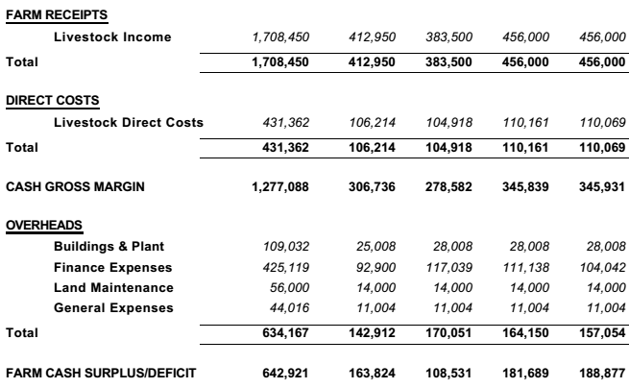
Investment Analysis – Case Study 2
Case Study 2 – Cashflow
Notes:
The cashflow is reasonable straight forward as there is only a single cattle enterprise. The assumptions behind the livestock income can be see in the previous slide.
The direct and overhead costs are typical for this size cattle business and the ratios are within normal ranges - DC Ratio 25% and OH Ratio 30%. The finance costs not within normal parameters with the finance ratio getting as high as 30% in year two. Our target is under 15%. This is due to the high gearing and the fact that the business had outstanding debt prior to purchasing the property. Compounding this is the same issue discussed in the previous case study where IBA requires rapid repayment of debt.
Despite the high finance costs the analysis shows very healthy operating cash surpluses. As always the trends are important and the overall cash surplus trend is upward. Its very common to see a dip in cash surplus in the initial years of a new project as there is usually a high demand for capital while the business is still not operating at full capacity.

Slide 5
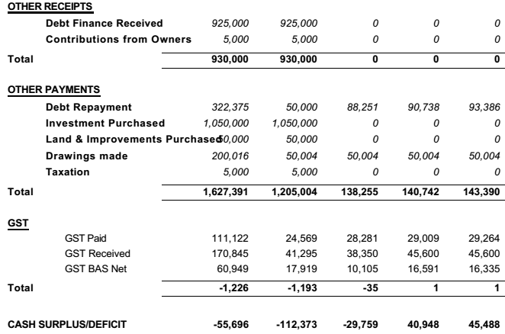
Investment Analysis – Case Study 2
Case Study 2 – Cashflow
Notes:
Where the first section of the cashflow dealt with the operating income and expenses, this section deals with the capital flows. Capital flows are those that occur outside of normal business activities. It can be seen in the Other Receipts that the business has borrowed $925,000 to fund the deal.
In Other Payments there is the $50,000 debt repayment in year 1 from the pre-existing debt and then this climbs as there are repayments for both the new and old debt.
The Investment Purchased is the new property.
Land and Improvements Purchases of $50,000 is Stamp Duty and there are Drawings of $50,000 and Tax of $5,000. There is no allowance made for tax in subsequent years as due to the business structure used (a trust), the number of beneficiaries, and the losses in the initial years there would not be a tax lability for some time.
Again, the trends in the surplus is important and in this instance it is trending upwards. This demonstrates the importance of modelling over a 3 to 5 year window. If this was down over two years it may assumed that years 3 and 4 would also be losses and the project may be shelved.

Slide 6
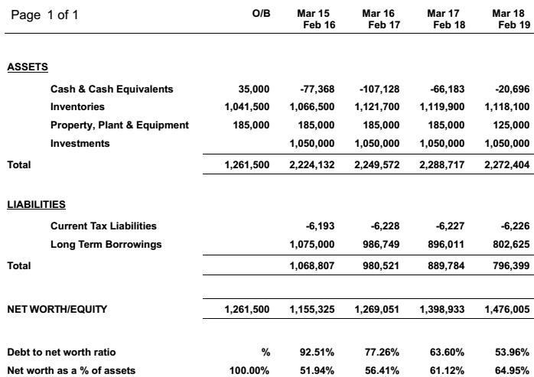
Investment Analysis – Case Study 2
Case Study 2 – Balance Sheet
Notes:
The balance sheet is important for showing whether the project is having a positive or negative impact on Net Worth.
Assets
The Cash and Cash Equivalents show the business starts with $35,000 on the bank. If we refer back to the cashflow we can see that in year 1 there was a loss of $112,373 leaving a closing balance of -$77,368.
Inventories is the value of the livestock on hand. This would be calculated in the Livestock Trading Account.
Property Plant and Equipment is the value of plant and equipment that is not fixed to the property (such as vehicles and tractors) and it excludes livestock.
Investments is the purchase of the property.
Liabilities
Current tax liabilities are the GST amounts payable.
Long Term Borrowings is the debt to fund the new purchase ($925,000) plus the existing debt ($150,000).
Net Worth
The net worth is the assets less the liabilities and this is telling a positive story. As always the trend is important but so is the total. In this scenario the net worth increases around $320,000. Importantly most of this increase is not in “cash” but is a result of debt repayment.
The equity of the business is low in the initial year at 52% and this outside the desirable zone for this type of business. However, by year 4 the projections indicate that equity has increased to 65%. In reality, due to high cattle prices, the increase in equity would be much greater.

Slide 7
Investment Analysis – Case Study 2
Case Study 2 – Summary
  This analysis shows a proposal that is quite risky but has potential to be profitable.
  Long term trends in modelling are positive.
  It would be worth “stress testing” the proposal.
  Overall a positive result but the level of risk may need moderating before the project has appeal to traditional lenders.
Notes:
High risk as equity drops to nearly 50% and interest and repayment commitments make up around 50% of the gross income. This model would not work in a lot of business but as the other costs are well within acceptable standards there is enough surplus to support the model.
Even with the conservative assumptions the modelling was trending in the right direction and there are significant increase in net worth.
Stress testing is worthwhile to see how resilient the business is and can it endure shocks like a drop in commodity prices or a drought. This is done but varying the commodity prices or production figures in the model. Usually the most vulnerable period is the first years after establishment of the business.
Even though the metrics are good, the risk is still an issue and this may cause problems with sourcing financing from traditional lenders. The options are to reduce the risk (borrow less) or explore other options such as non-traditional lender like IBA, or grants and government loans.

