Slide 1
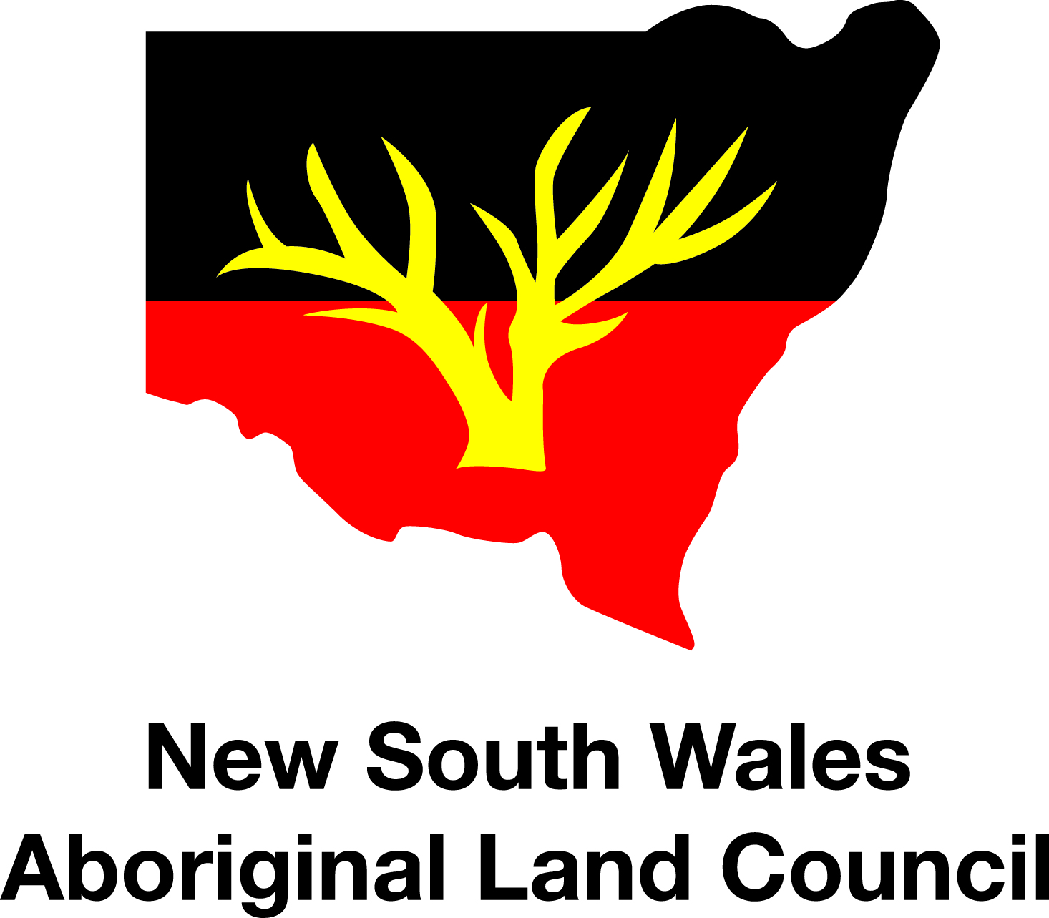

Cultural Tourism
An overview presented by Kotahi Tourism August 2017
Notes:
Outline program: Over the next 2 hours, we’ll be presenting an overview of Cultural Tourism, with aim of providing you with relevant information to assist in decision making for those of you interested in starting up or investing in Cultural Tourism.

Slide 2
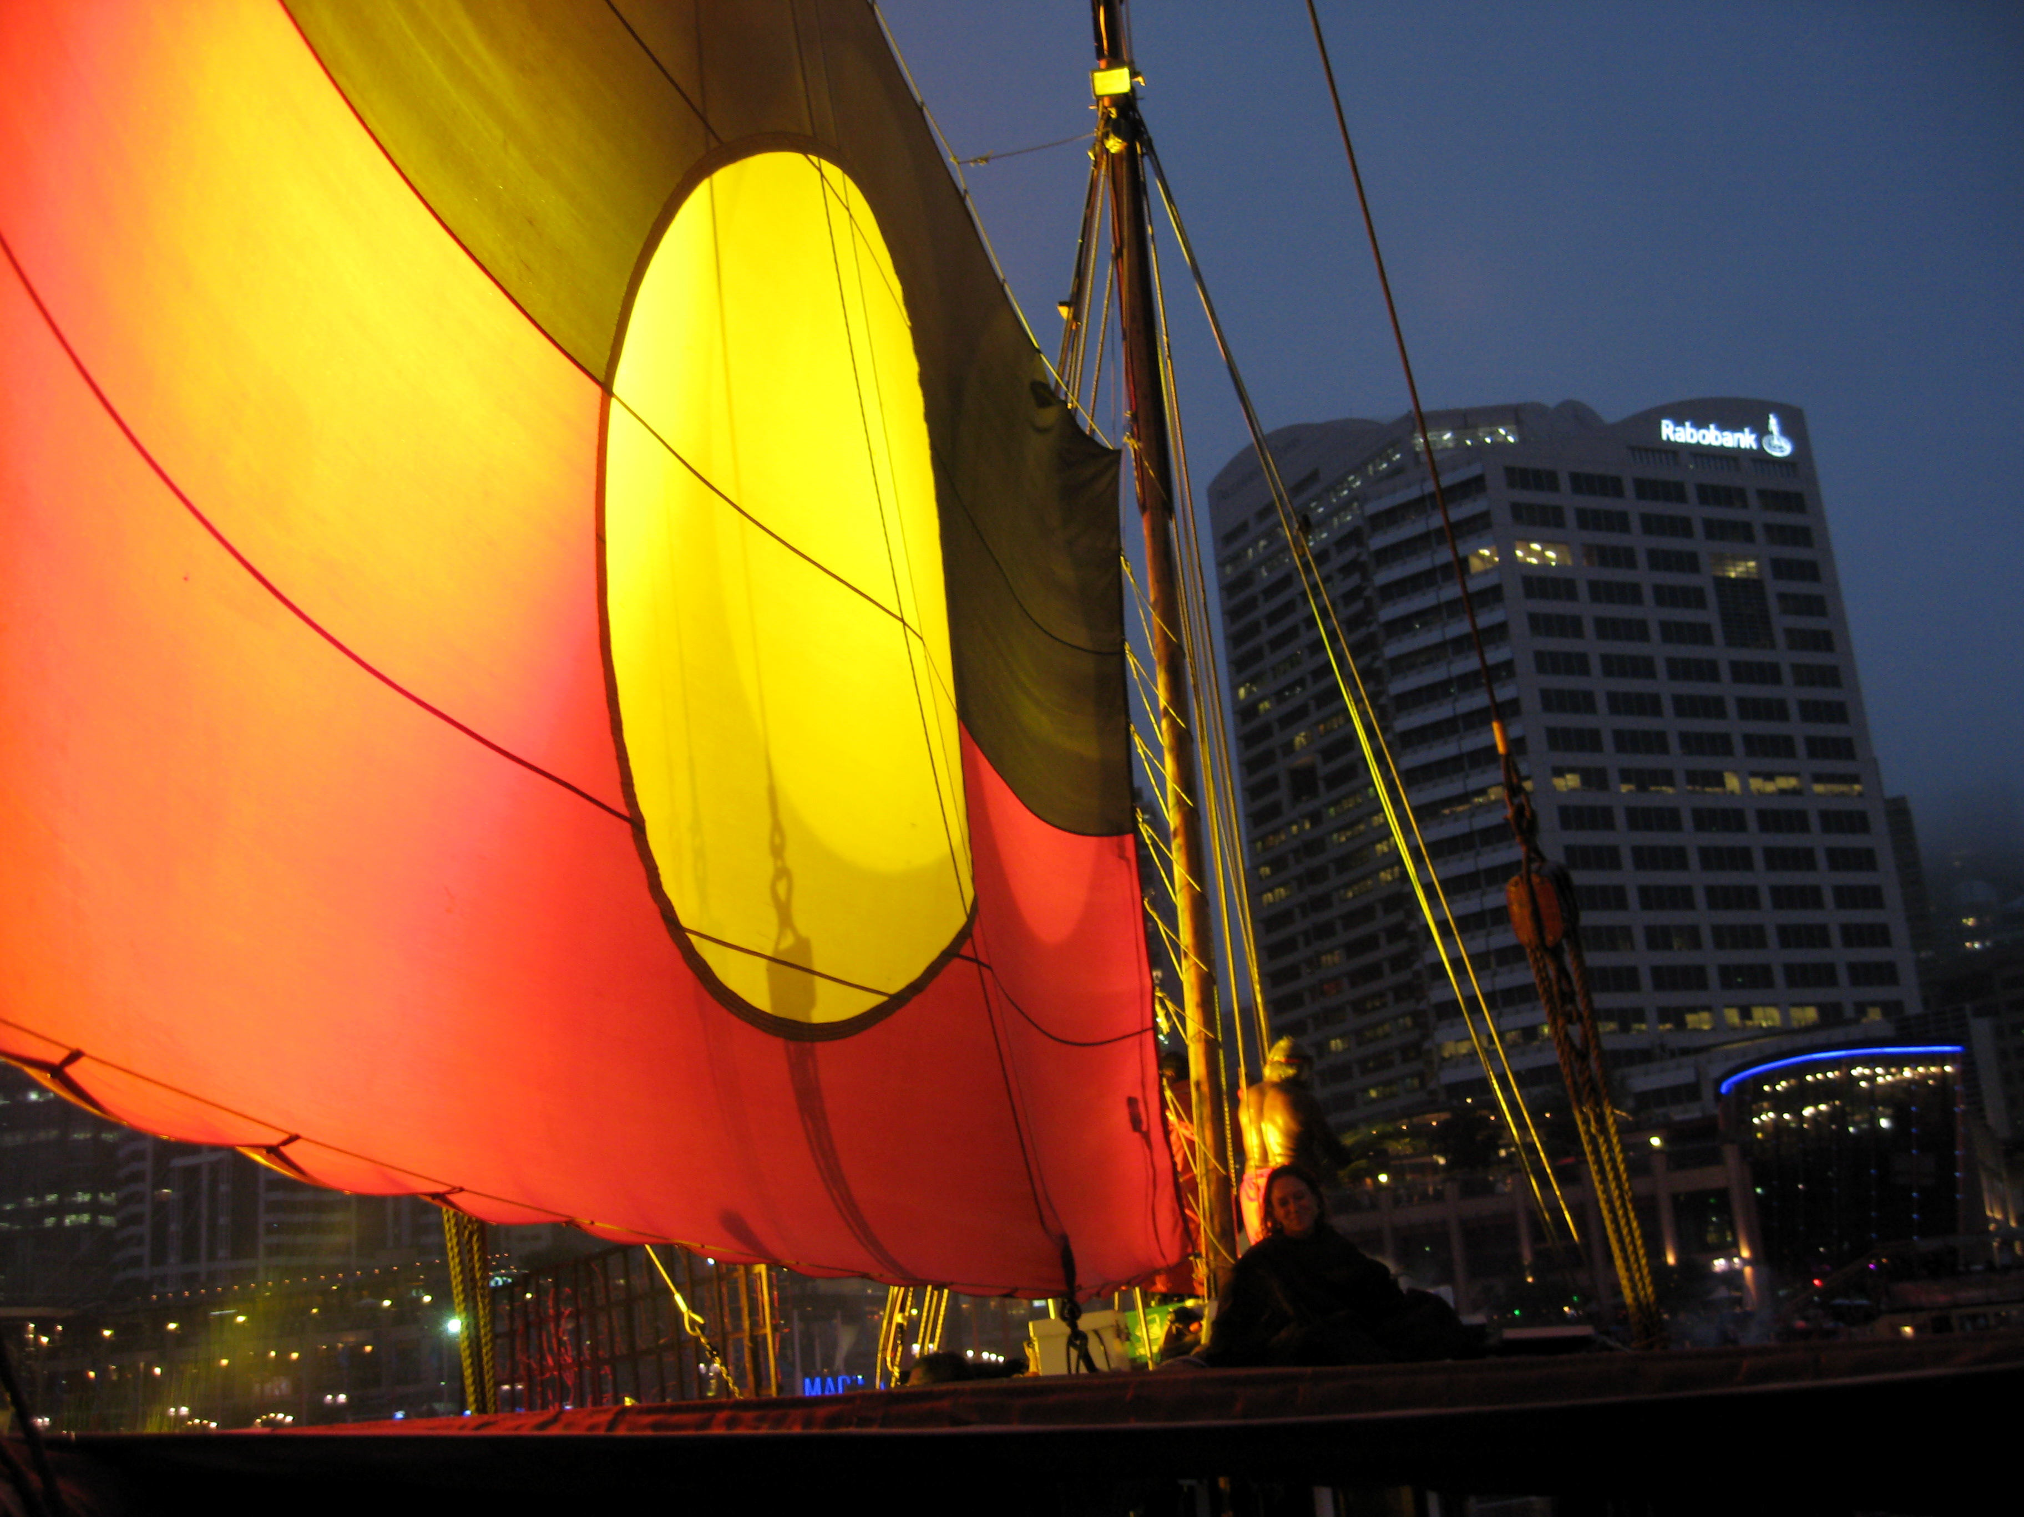
Notes:
Acknowledgement.
Introduction – Kotahi Tourism Directors.
Outline program: Over the next 2 hours, we’ll be presenting an overview of Cultural Tourism, with aim of providing you with relevant information to assist in decision making for those of you interested in starting up or investing in Cultural Tourism.
Photo: Tribal Warrior, Darling Harbour, Australia Day 2010.
Photo credit: Kotahi Tourism
Mihi (introduction) translation
“Cease The Winds From The West. Cease The Winds From The South.
Let The Breeze Blow Over The Land. Let The Breeze Blow Over The Ocean.
Let The Red - Lipped Dawn Come With A Sharpened Air. A Touch Of Frost. A Promise Of A Glorious Day.
Allow Ones Spirit To Exercise It's Potential, To Guide Us In Our Work, As Well As In Our Pursuit Of Our Ancestral Traditions.
Take Hold And Preserve It. Ensure It Is Never Lost. Hold Fast. Secure It. Draw Together, Affirm.”

Slide 3
Cultural Tourism definition
“Visitor engagement with a country or regions culture – i.e. lifestyle of people that live there”
Notes:
Cultural Tourism is defined as “visitor engagement with a country or regions culture – i.e. the lifestyle of the people that live there.
“Culture” – a transfer of knowledge and skills from generation to generation.
Lifestyle: past & present – history, art, language, architecture, music, food, rituals, dance etc

Slide 4
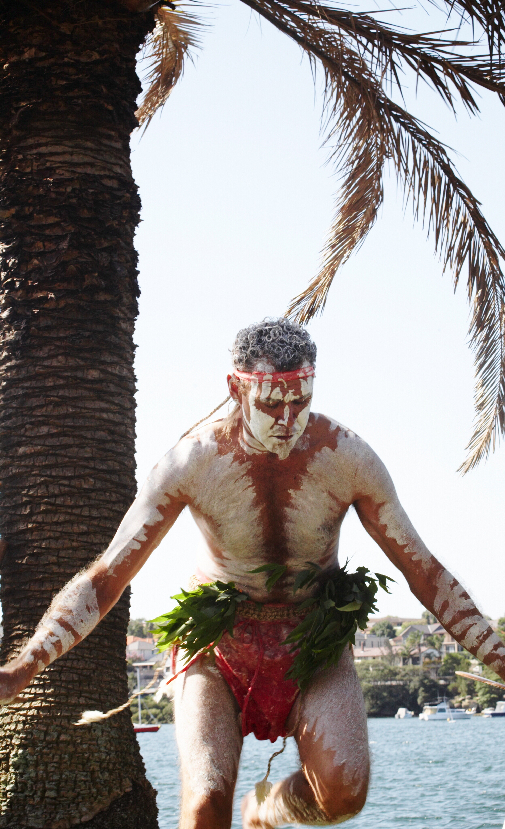
Indigenous Tourism “ Owned, operated, guided by Indigenous people and/or Indigenous content”
Notes:
More specifically today, we’ll be looking at Indigenous Tourism (‘Indigenous” - First Nations People) that is- Cultural tourism that is “Owned, operated, guided by Indigenous people and/or has Indigenous content”
We’ll start a short video produced by Tourism Australia that showcases some of Australia’s Indigenous Tourism experiences. It shows you what’s possible and what’s out there in the tourism marketplace – both as benchmarks and competition. (Video: 3.20)

