Slide 1
Benefits of Indigenous Tourism
Employment
Revenue
Telling our own stories
- Culture and history interpreted by Indigenous people
Continuous culture - stories passed on
Notes:
There’s many benefits of Indigenous Tourism.
1. It provides Employment and revenue opportunities for our communities
Be realistic - casual work/tourism is seasonal and the challenge of finding balance between providing enough work to make it a viable job is a real one, which we’ll talk some about later.
2. Indigenous tourism also gives us a chance to tell our own stories, and means our stories as passed on – tour guides become ‘guardians’ of stories. It can be a chance to show that our culture isn’t static – it’s past, present and future.

Slide 2
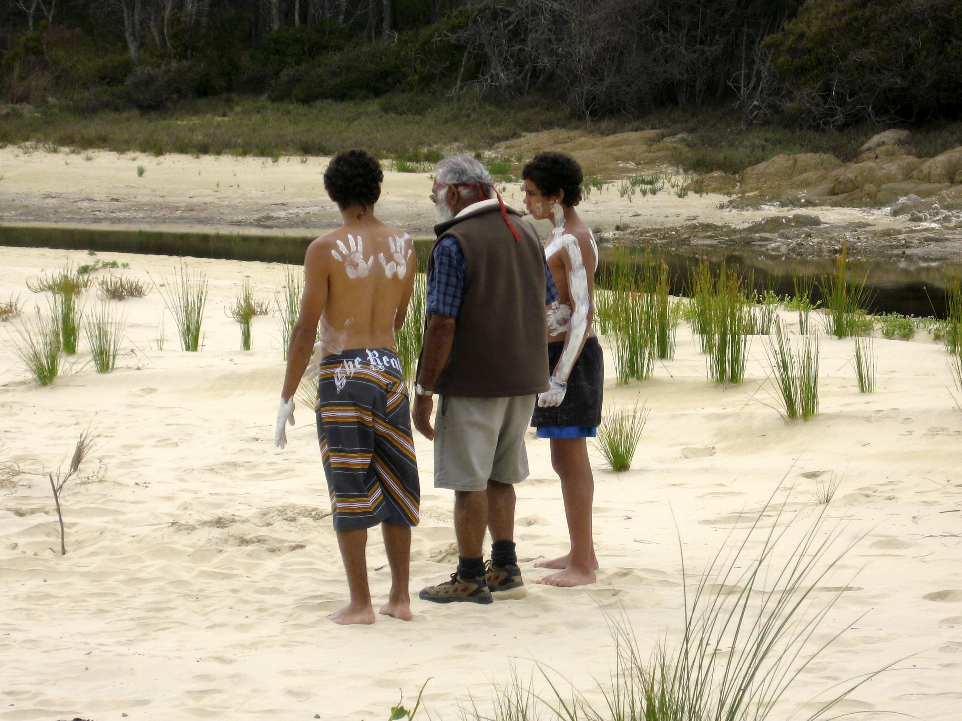
“You have to give it away to keep it” Uncle Max Dulumunmun Harrison
Notes:
“Continuous Culture”
The introduction that I (Hohepa) gave reflects this key benefit –keeping culture, heritage and language strong and making sure stories of Country are heard. Indigenous Cultural tourism generates connection to Culture – not only for our visitors but also for guides – generating in turn cultural pride – and employment – and keeps the stories strong, handing them down and sharing them so future generations will know them. Yuin Elder Uncle Max says ‘you have to give it away to keep it” ….keeping Culture strong is part of the vision for most Indigenous Cultural Tourism providers.
Photo: Uncle Max Harrison with grandsons, Narooma.
Photo credit: Kotahi Tourism

Slide 3
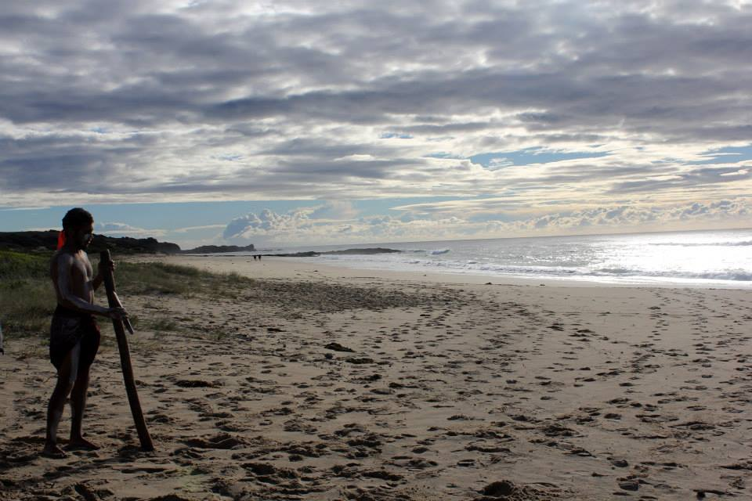
Cultural Tourism – possibilities…
Notes:
Cultural tourism is a broad term and there’s many different forms it can take (next slide)
Photo: Max Harrison III – Gulaga Creation Tour, Yuin.
Photo credit: Kotahi Tourism

Slide 4
Cultural Tourism
Cultural tours
Education programs
Schools
Corporate (Cultural Awareness)
Accommodation
Catering
Cultural Center
Retail/gallery
Performance
Mainstream tourism product- Indigenous operated & content
Any combination of above
Notes:
Culture can shared in many ways! E.g tours, education, performance, food, art – or any combination. It might also be a ‘mainstream product’ such as a kayaking trip that includes Indigenous content and is operated by Indigenous people. To look at some of the possibilities of combinations (next slide)

Slide 5
PRODUCT COMBINATIONS – EXAMPLES
Tours
EDUCATION
Cultural Centre
Mainstream product
TOURS
CATERING
ACCOMMODATION
PERFORMANCE
TOURS
EDUCATION
CATERING
PERFORMANCE
GALLERY
RETAIL
ACCOMODATION
CATERING
RETAIL
EDUCATION
Notes:
Here’s some examples of product mixes.

Slide 6
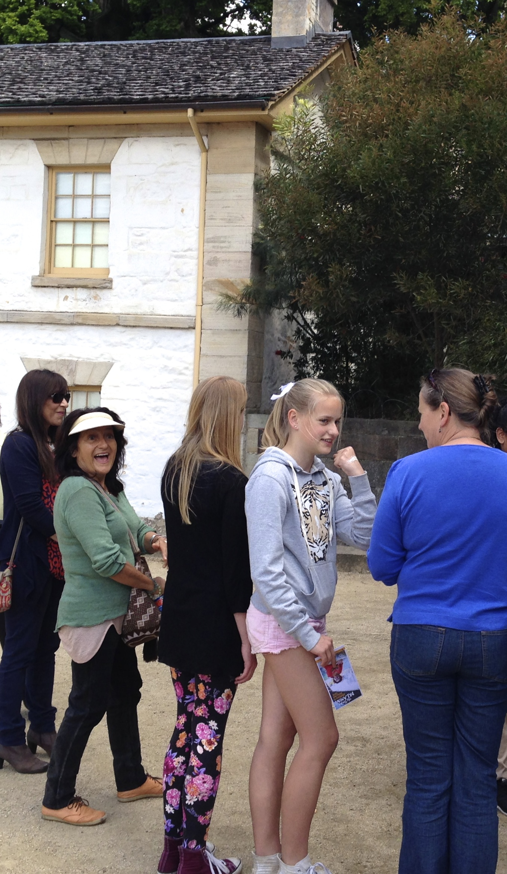
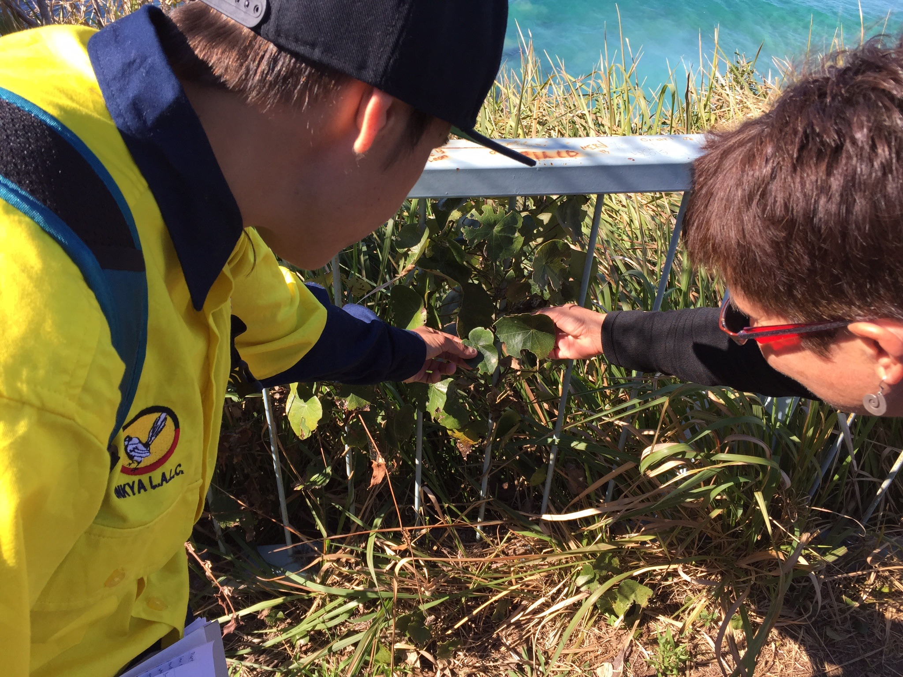



Tourism industry…
Notes:
Let’s go into a bit more detail about the tourism industry (Who’s who in the zoo)
Tourism Operator – a business that operates a tourism product – whether it be a tour, accommodation or any of the of the options we’ve just seen.
To use the 2 tourism businesses you can see of the top right and left hand side of the slides as examples of urban-based and regional based tourism operators…
Photo Top Left - Visitors on The Rocks Dreaming Aboriginal Heritage Tour, Dreamtime Southern X
Photo credit: Kotahi Tourism
Top Right- Belinda Donavan – Guide, Unkya LALC Cultural Tours with visitor
Image credit: Kotahi Tourism

Slide 7
Tourism Operators
Unkya LALC Cultural Tours
Dreamtime Southern X
Notes:
e.g. Dreamtime Southern X –in their 17th year of operations, in The Rocks, Sydney
Unkya Lalc Cultural Tours, who’re in their second year of operation and run tours at Scotts Head and Gaagal Wannggaan National Park on the North Coast.
Photo (left): The Rocks Dreaming Aboriginal Heritage Tour visitors (Dreamtime Southern X)
Photo credit: KotahiTourism
Photo (right): Guide & visitor – Gurruja Juun Tour (Unkya Lalc Cultural Tours)
Photo credit: Kotahi Tourism
(We’re also tour operators (link to Kotahi Tourism), with Poihākena tours: stories of Māori in Sydney in The Rocks and Conjola tours at Lake Conjola on the NSW Coast.)

