Slide 1
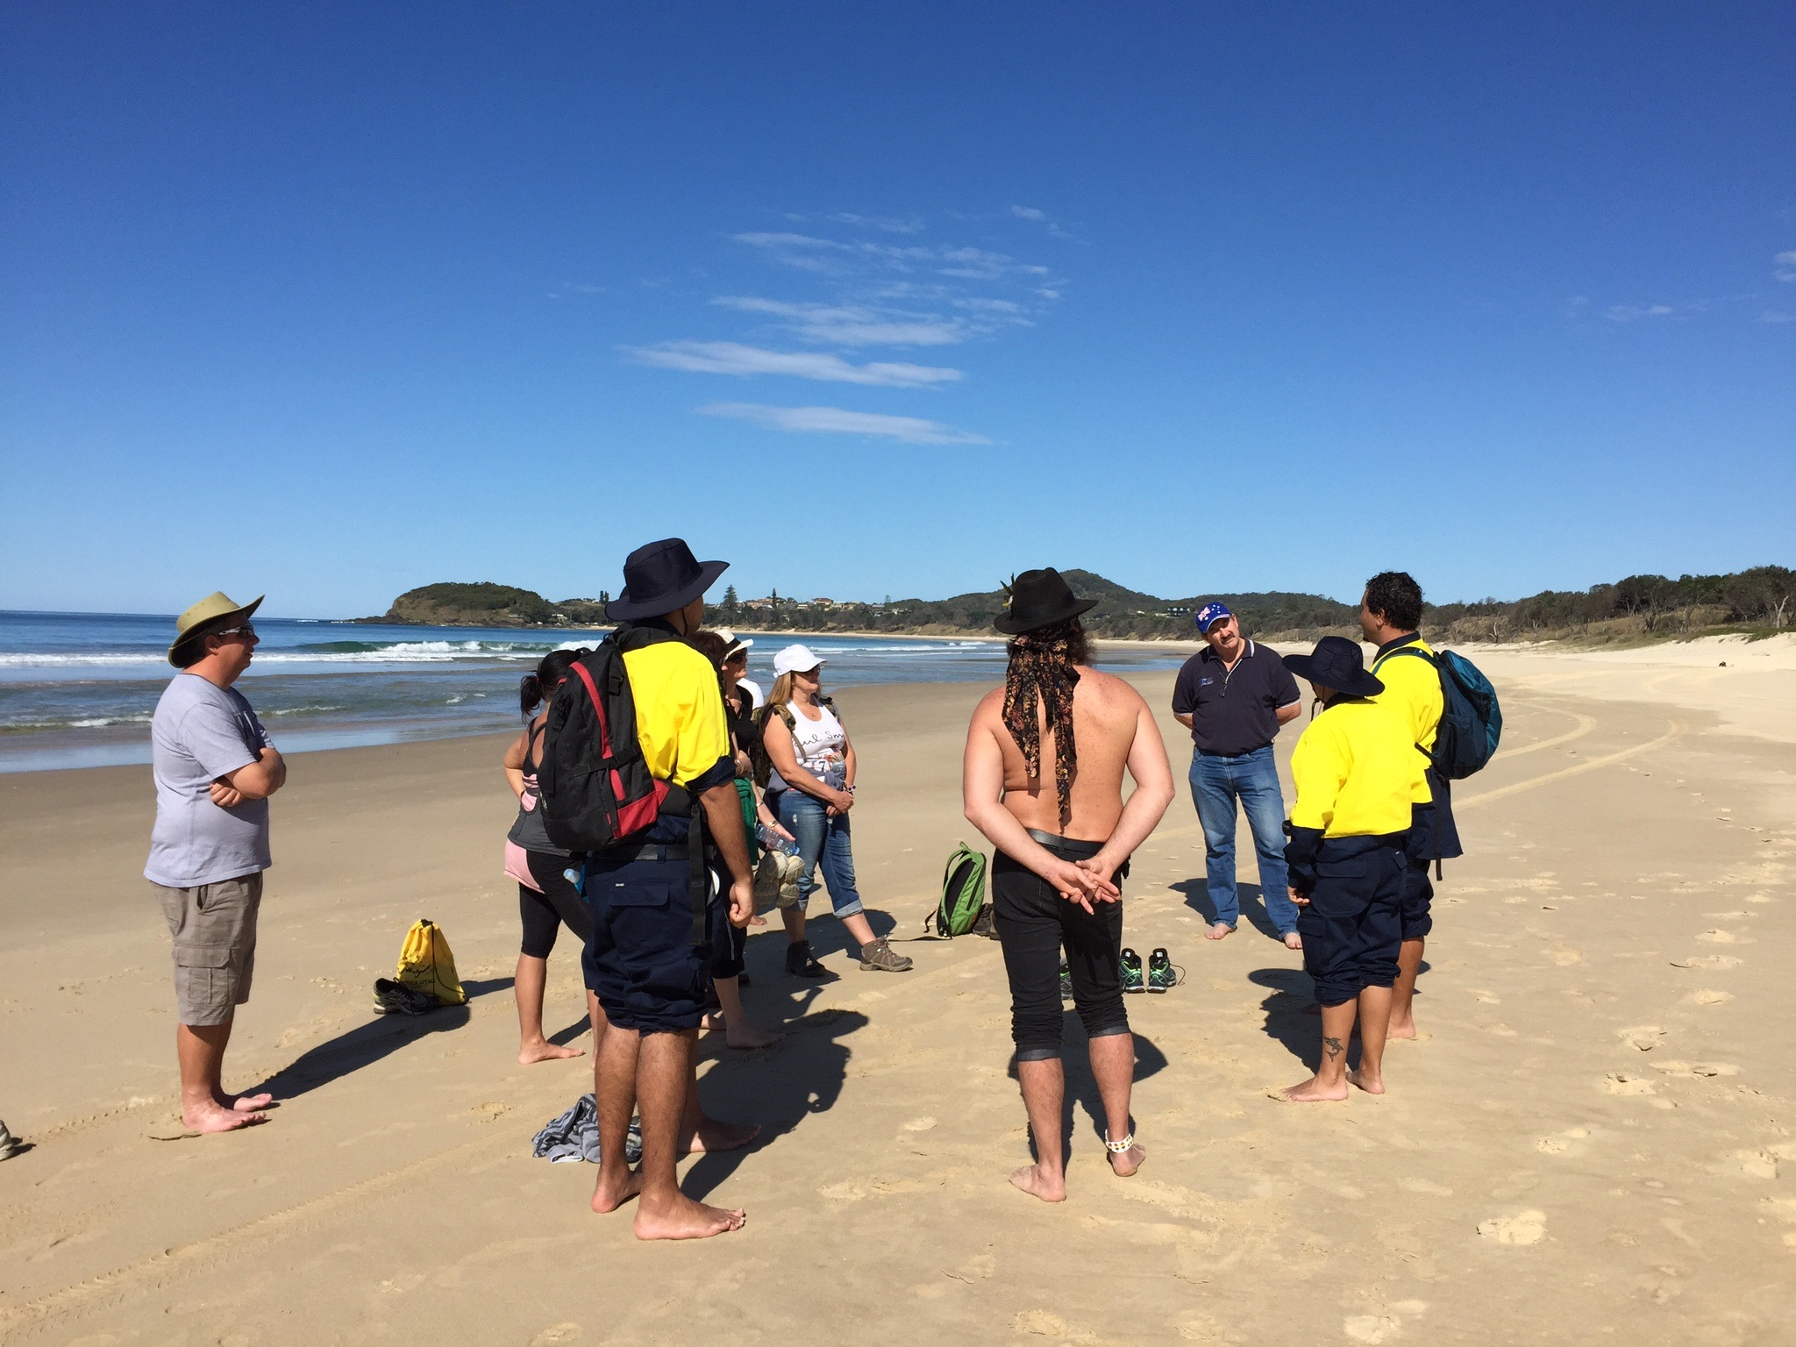
Visitors Local, Domestic and International
Notes:
Most important to a Cultural Tourism business – Visitor. These could be locals, domestic (Australian – interstate & intrastate) or international.
Using Unkya Lalc Cultural Tours as an example (started 2015), they have a mix of all 3, but at this stage mainly local and domestic.
Photo: Unkya Lalc Cultural Tours- Gaagal Wanggaan National Park Tour
Photo credit: Kotahi Tourism

Slide 2
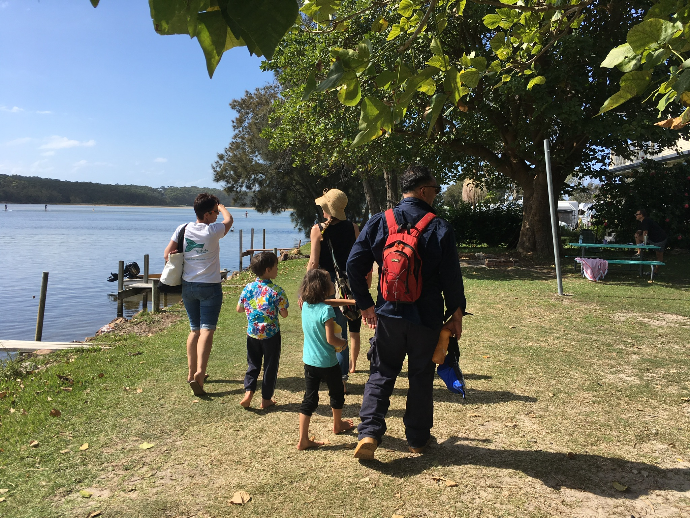
Visitors
Local
Domestic
- Intrastate
- Interstate
International
Notes:
Recap: Local (often bring visiting friends and family); schools, local businesses, special interest groups
Domestic
- Intrastate (ie within NSW)
- Interstate (from another state)
International – Europeans and US key target for Indigenous product; EMERGING Chinese market – mainstream product (big groups); NZ market largest Inbound – travel for leisure + heritage & culture.
Visitor economy – revenue generated by visitors (tourism). There’s all sorts of statistics and research undertaken around the visitor economy. (Hand out regional statistics – if possible match participant with region). Research includes the reasons people visit. (By the way VFR is “visiting friends and relatives’). Visitors will either be ‘day visitors’ or ‘overnight stays’.
Photo: Conjola Tours
Photo credit: Kotahi Tourism

Slide 3
Types of visitors (tourists)
Eco-tourist
Adventure tourist
Cultural tourist
Leisure tourist
Backpacker/youth tourist
Special Interest tourist
Business tourist
Incentive tourist
Education tourist
Sports tourist
Health or medical tourist
Religious tourist
Notes:
There’s many different classifications of visitors (tourists) - this list is one of them and covers most types.
e.g. sports tourist – Lions supporters over for a test series; Religious Tourist e.g. World Youth Day in Sydney 2008 when then Pope visited. Young people from all over the world were in Sydney. Not all tourists will be looking for a Cultural Tourism, or Indigenous Tourism experience. Let’s looks at a bit more at some of the different types.

Slide 4
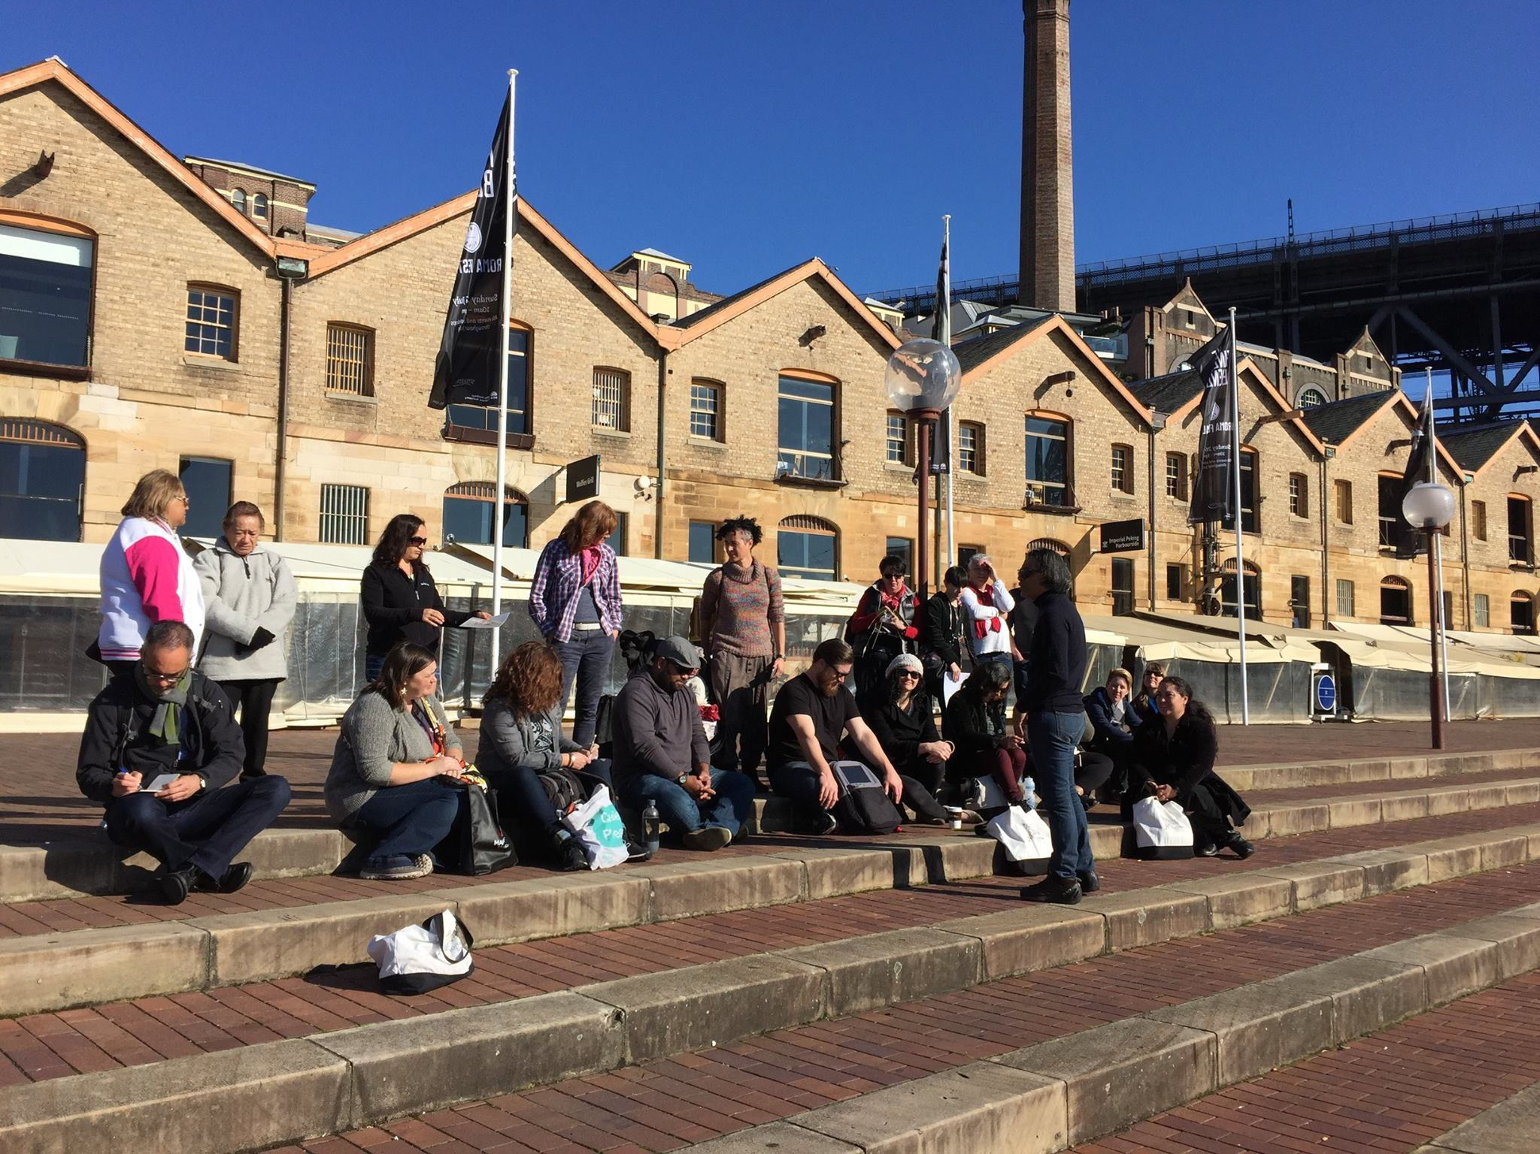
Special Interest ‘tourists’
Notes:
Special interest tourists – e.g Poihākena tours – Māori historians, weavers, Māori language schools.
Unkya lalc Cultural Tours e.g Gagaal Wanggaan National Park Tour - bird watchers (or ”twitchers” as they’re known in the UK)
Your market research should include identifying which kinds of special interest group will be interested in your product, that is which special interest groups you should target.
Photo: Te Pouhere Korero - Māori History Conference 2015, Sydney.
Photo credit: Kotahi Tourism

Slide 5
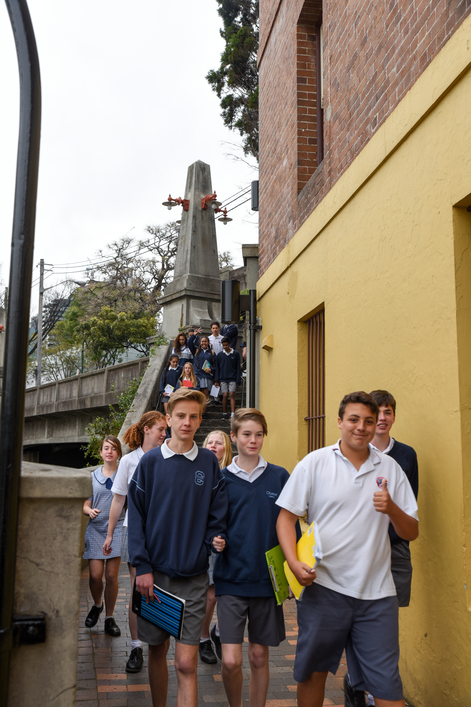
Education ‘tourists’
i.e.
STUDENTS
Notes:
Education tourists –this includes school students; University students, ESL Schools and International Students (Inbound). Pricing and minium numbers per booking are generally different for education groups.
EG Case study – pricing for education groups - Dreamtime Southern X
Schools and private tours can book a tour anytime
$13 a head for minimum 20 students (compared with $44 and minimum 15 adults for a private tour).
International students - $33 a head – minimum 15.
Photo: students on Poihākena tour
Photo credit: Teowai Ratahi for Kotahi Tourism

Slide 6
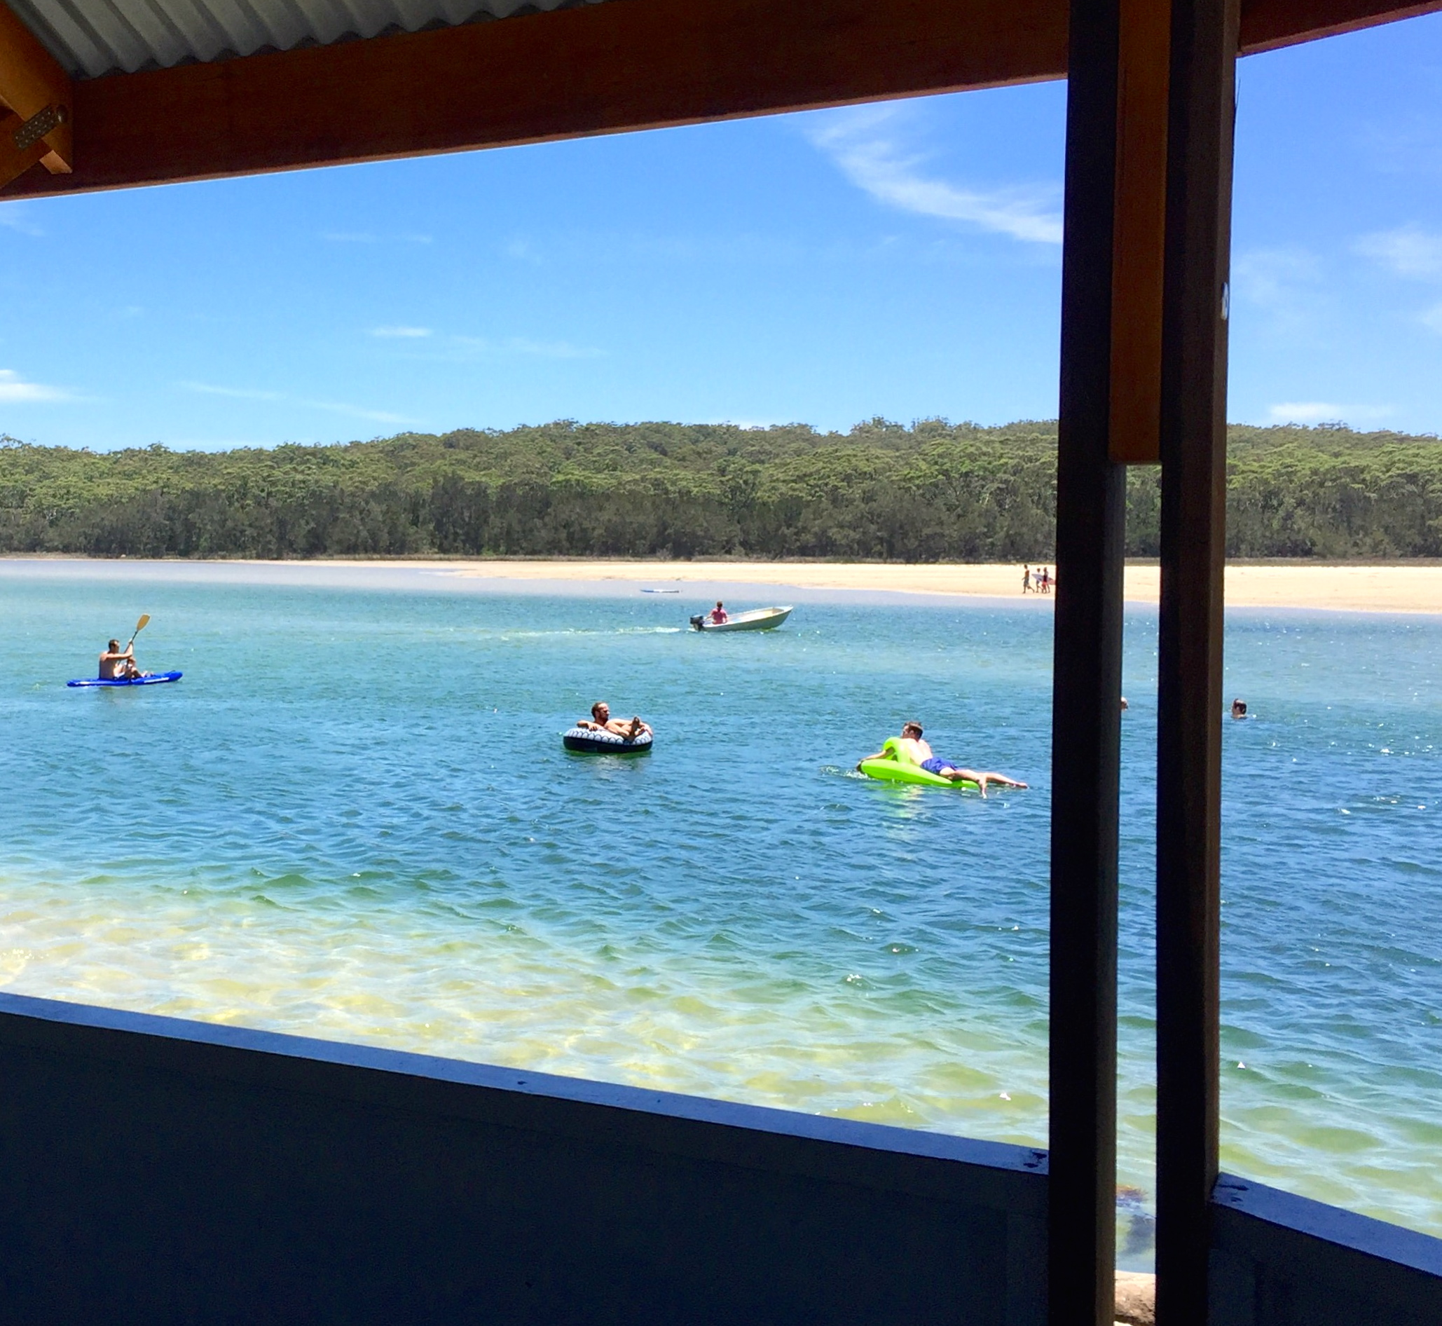
Leisure ‘tourists’
Notes:
Leisure tourists – these will be the ones on regional snapshot sheets that have identified their reason for coming as a ‘holiday’. For a tourism experience, you’re also competing for visitor share with our stunning NSW natural environment - and the lure of a relaxing with a good book.
During Peak season (summer) on the NSW Coast - Intergenerational ‘annual holidays” repeat visitation – looking for rainy day activities, but mostly enjoying the beach/lake/rivers (not so interested in a Cultural experience).
Photo: Lake Conjola, NSW South Coast
Photo credit: Kotahi Tourism

Slide 7
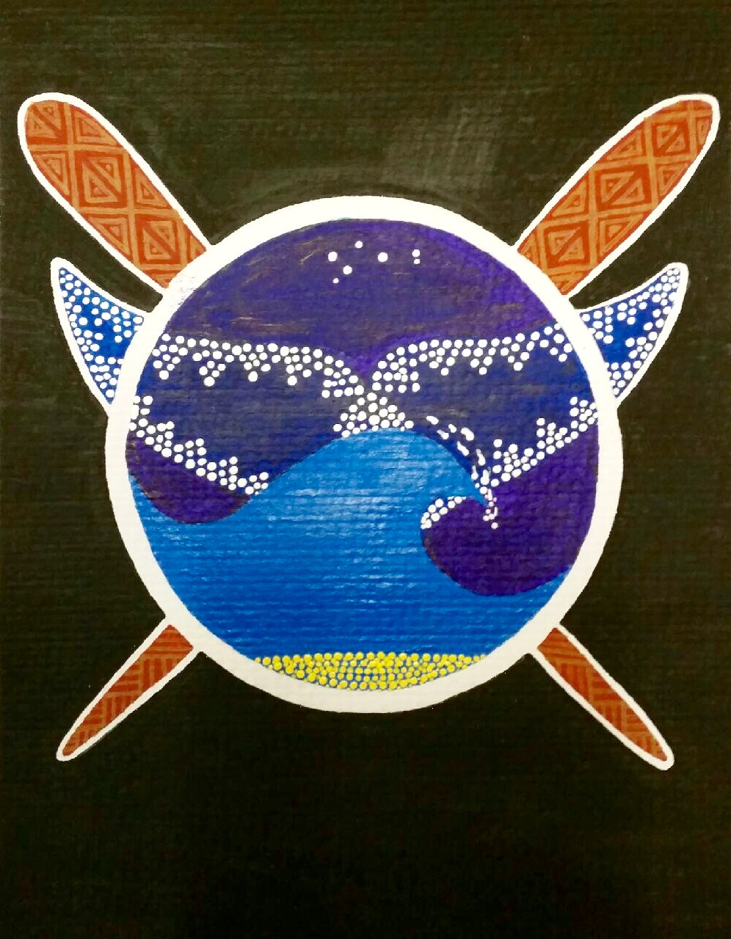
Know who your visitors are!
Cultural Tourism advice from UNKYA Lalc
CEO, Michele Donovan.
Notes:
What advice do you have for NSW LALC thinking of investing in Cultural Tours? (visitor relevance)

