Slide 1
Tourism Industry Stakeholders
Agents
  Visitor Centres
  On-line Travel Agencies
  Wholesalers
  Inbound Tour Operators
Tourism Organisations
  Destination NSW
  Tourism Australia
  Tourism Research Australia
  NSW Aboriginal Tourism Operators Council
Notes:
As well as visitors and Tour Operators, other tourism industry stakeholders include Agents and Tourism Organisations.
Agents – sell tourism product for a commission. Tourism Organisations each have their own role, but essentially they’re there to support Tourism Operators, promote destinations and/or facilitate interactions between Operators and Agents. That will all become a bit a clearer when we break it down a bit…Let’s start by looking at Visitor Centres.

Slide 2

Visitor Centres
Promote and sell local tourism product
Commission 10% (regional) – 25% (Sydney)
Brochures, web site, visitor advisors, kiosks, visitor guide
Run by Councils or out-sourced (e.g. Best of Australia)
AGENT
Notes:
Promote and sell tourism product e.g tours, accommodation, experiences
Commission varied e.g.10% Shoalhaven & Nambucca (regional) – 25% (Sydney)
Only sell/promote local product
Provision of visitor information and resources – both on-line and hard-copy, with collateral including brochures, web site, visitor advisors, kiosks, visitor guide
Run by Councils or out-sourced (e.g. Best of Australia)

Slide 3
OTA: Online Travel Agency
On-line sales only
Commission 10% - 30%
Widen market reach e.g. translate into other languages
To get paid: invoice or auto-payment
E.g. Red Balloon, Leezair
AGENT
Notes:
OTA – rising growth in % of bookings via OTA’s and new agencies launching all the time. For example LEEZAIR – start-up initiative through Fishburners in Sydney, launched a couple of months ago. (DSX, Kotahi Tourism and Tribal Warrior Association have all listed with them – no sales yet though!)
Need to be paying GST to be able to sell on some OTA sites e.g Red Balloon, Viator

Slide 4
Wholesaler
Groups and individuals
Commission 20% - 25%
Sell only ‘export ready’ product
E.g. About Australia
AGENT
Notes:
DSX % deals with over 20 agents – just one Wholesaler. Wholesalers buy tours for inclusion in itineraries so when a customer goes into a travel agency, and books a tour, it’s most likely been sourced through a wholesaler.

Slide 5
ITO: Inbound Tour Operator
Groups and individuals
Commission 25% - 30%
Sell only ‘export ready’ product
E.g. A&T Kings, Swain Destinations, Go Way Travel
AGENT
Notes:
DSX % sales from ITO’s – approx 40% of business after 17 years in operation. Operators need to be ‘export ready’ before selling to ITO and Wholesaler’s. including sending out rate sheets approx 18 months ahead of a ‘tourism year’ – I’ll come to timing of tourism years soon…
There’s campaigns and ‘expos’ held through-out the year with the largest being ATE – Australian Tourism Exchange – a kind of ‘expo”, which is held annually. (It was at the new Convention Center at Darling Harbour this year and will be in Adelaide 2018 with over 2500 delegates expected.

Slide 6
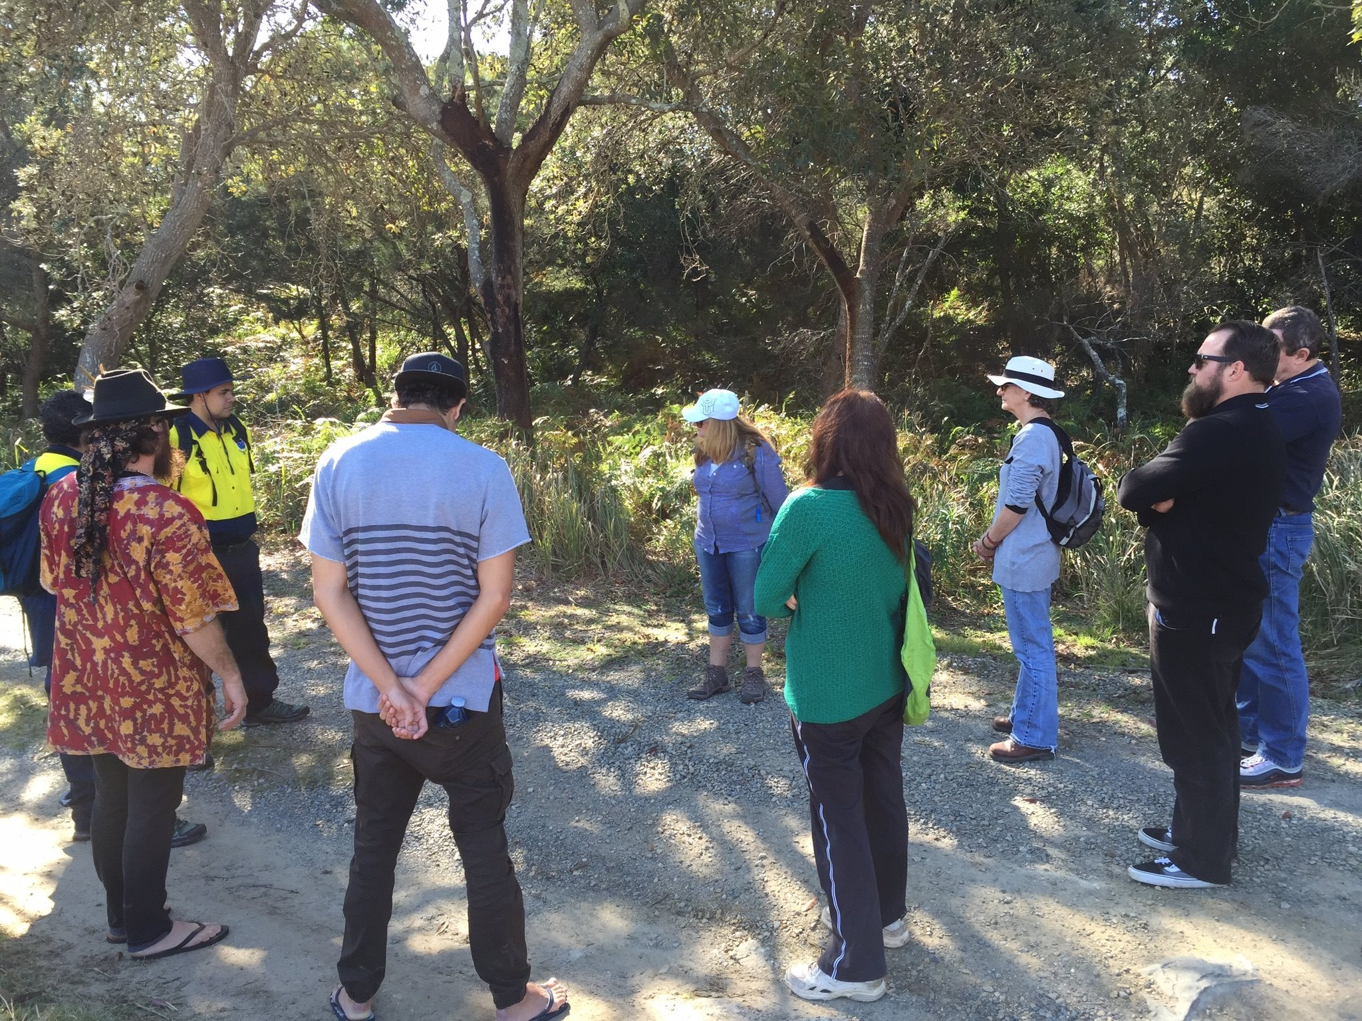
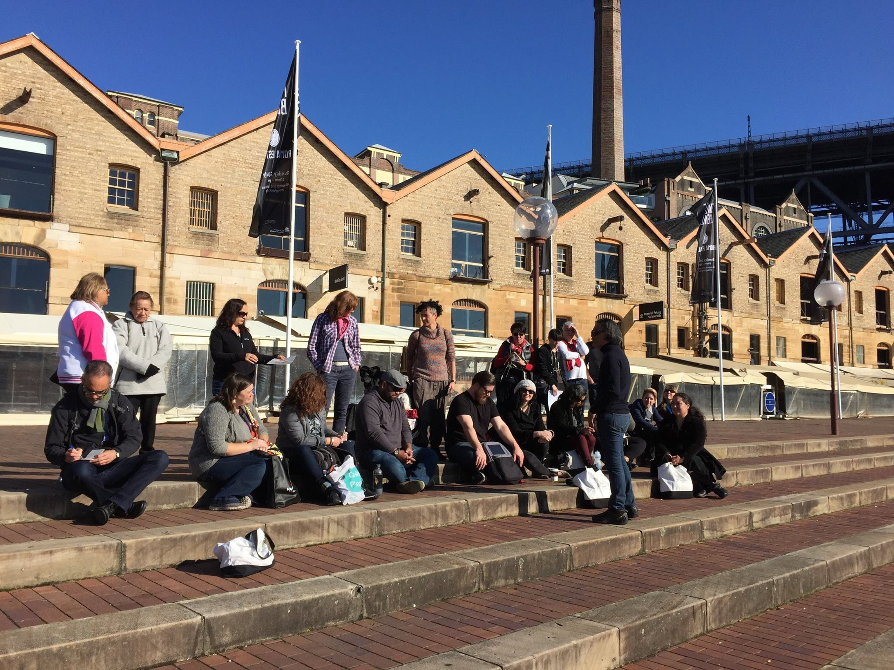
Famil – free experience for tourism industry
Notes:
Where possible, invite people who sell your experience (AGENTS) on a famil.
Be prepared though to wait for sales – it can be 2-3 years from agent famil to actual bookings!

Slide 7
Tourism Organisations

Slide 8

Destination NSW
Promote NSW
Tourism Business Development resources
Regional Tourism Organisations
Notes:
Destination NSW primary objective is to promote NSW. KPI’s are measured in visitor numbers, numbers overnight stays and visitor spend
Promotion is across a number of different platforms e.g. DNSW manages “Get Connected” – web listing (free) that links to the Australia Tourism Data Warehouse – a data base of Operators that Agents from all over the world can draw on. As well as being available tointernational agents, it’s generally also the source of all listings on local Tourism websites in NSW (e.g. Shoalhaven). Other promotion is done via social media, visiting journalist famil programs, TV, publications and email campaigns.
As well as ‘Head Office’ on Cumberland St, in the The Rocks, Destination NSW also have Regional Tourism Organisations – more about them in our next slide.
Destination NSW role includes supporting operators and they are great provider of Tourism Business Development resources e.g. an on-line Tool-Kit with everything you need to know about starting up or running a Tourism Business (there’s a link in your resource kit); webinars and workshops.
In resource book:
Links to Aboriginal Tourism Action plan, DNSW website, Tourism Business Toolkit + Shane’s contact details (Aboriginal Product Coordinator).
Tourism Business Toolkit: http://www.destinationnsw.com.au/tourism/business-development-resources/tourism-business-toolkit

Slide 9
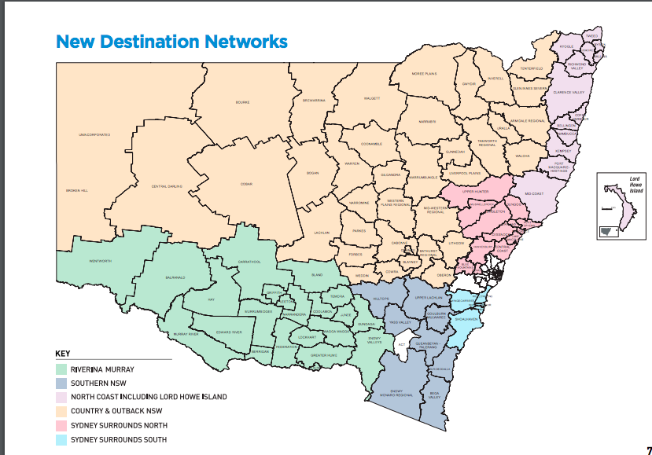
Regional Tourism Organisations
Notes:
Important to be aware of what region you fit in, and who the key contacts are. Your product will be promoted by the RTO, alongside other regional product so it’s a good to include regional as well as local product competitors and potential partners in your business planning.

Slide 10
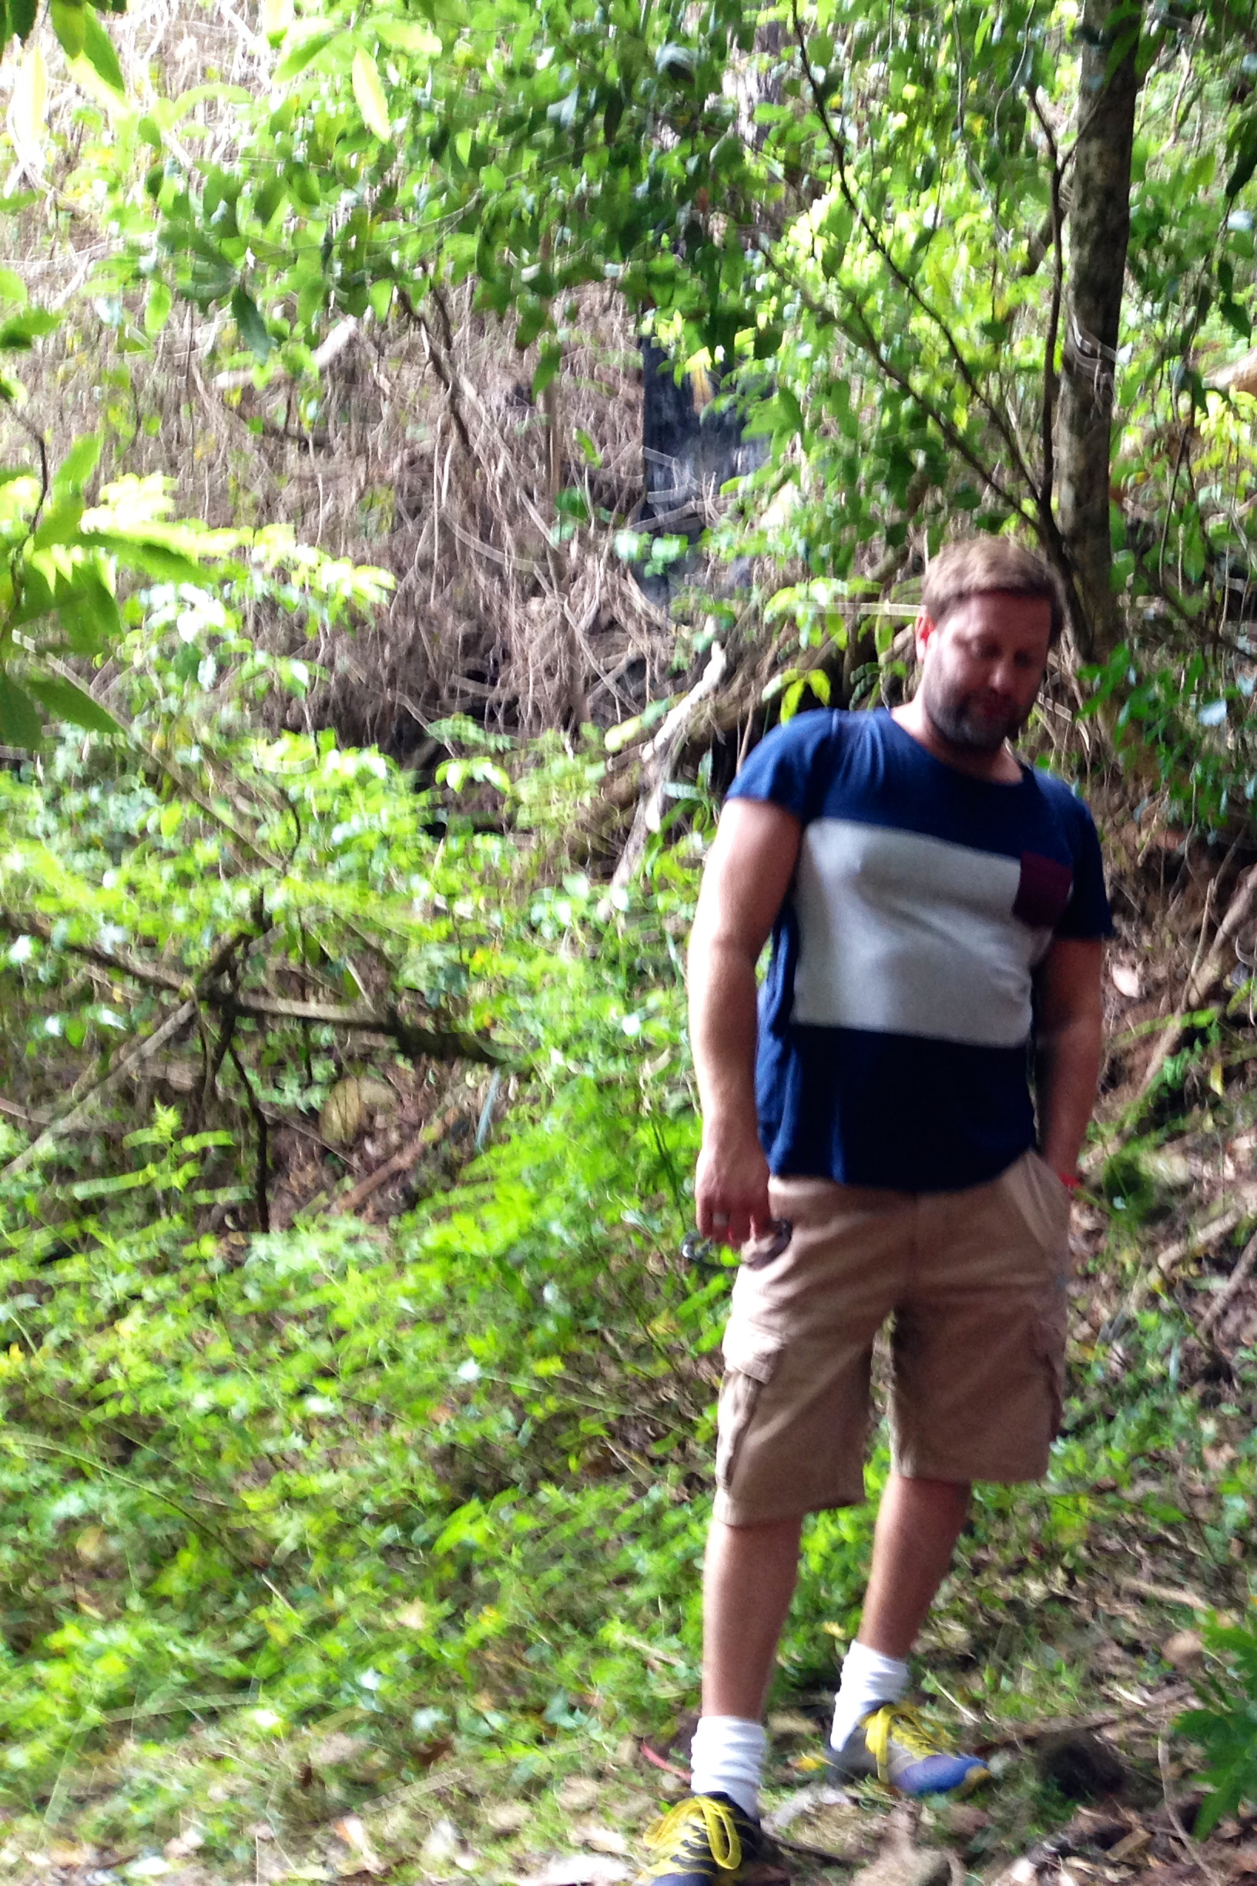
Aboriginal Tourism Action Plan
Bi-annual Aboriginal Tourism workshop
Sector specialist – Aboriginal Tourism
Aboriginal Tourism Toolkit
Notes:
Aboriginal Tourism Action Plan - Destination NSW are also responsible for development and implementation of NSW Aboriginal Tourism Action Plans. Running from 2013-2016, the most current plan was developed after years of consultation with Industry stakeholders and Aboriginal operators. There’s a review of it underway and then work will begin on the next action plan. There’s there’s been some really positive outcomes from the initial plan which have been identified as on-going.
1. Bi-annual Aboriginal Tourism workshop – held in different parts of NSW. (We met Edwina at one in Sydney). The last one, in June 2017 was held at Wagga Wagga. The workshops bring together Aboriginal Tourism Operators at all stages of product development from across NSW, and include product famils, presentations (from Operators and Industry stakeholders), and in reviewing the last action plan, the workshops are an action that will be on-going.
2. Sector Specialist - Aboriginal Tourism role – currently held by Shane Dredge. That’s him in the right-hand corner, taken at an Aboriginal Tourism Workshop, Narooma, 2014. (Shane’s not Indigenous by the way). His role is facilitate Aboriginal Tourism Action Plan ‘actions’; provide advice and support for Aboriginal operators and to be an advocate for Aboriginal Tourism within the industry. As well as organising the workshops, he’ll come out and experience your product and give you feedback; provide advise e.g. on developing rate sheets, and do things like let visiting journalists know about Aboriginal product they can experience.
3. Another outcome of the plan was the development of the Aboriginal Tourism Toolkit. Designed for ITO’s and other agents interested in selling Indigenous product, the Tool Kit was developed with input from the NSW Aboriginal Tourism Operators that it promotes. We were lucky to get a copy for you (hand out) and if you flick to the end, you’ll find a very handy list of Aboriginal Tourism Operators listed, that will help in sussing out your competitors – and potential partners.
Photo: Shane Dredge, Aboriginal Tourism Workshop, Narooma, 2014.
Photo credit: Kotahi Tourism
In resource book:
Link to Aboriginal Tourism Action plan and Shane’s contact details (Aboriginal Product Coordinator)
Tourism Business Toolkit: http://www.destinationnsw.com.au/tourism/business-development-resources/tourism-business-toolkit

Slide 11

NSW Aboriginal Tourism Operators Council
  Liaison with Destination NSW
    Aboriginal Tourism workshops
    Input/review of Aboriginal tourism publications
  Support network for Aboriginal Operators
  Advocacy
Notes:
Another outcome of the Aboriginal Action Plan was the establishment of NATOC – the NSW Aboriginal Tourism Operators Council
Launched in AUGUST 2015 NATOC Acting Chair Margret Campbell said at the time: 'I envisage NATOC becoming a strong industry led voice for Aboriginal tourism in NSW. NATOC will aim to partner with key stakeholders and trade to ensure authentic NSW Aboriginal tourism products are developed and marketed in a culturally acceptable manner.’
The 3 main objectives are
Liaison with Destination NSW – mainly through Shane’s role e.g input to workshops, review of Abourignal Tourism collateral – give advice/feedback from an Indigenous perspective. etc
Support network – for businesses at all stage of product development
Advocacy (e.g. currently advocating for ‘competitive with some Government Agencies such as National Parks who are competing with local Aboriginal operators on product. With a much bigger budget to tap into for marketing and promotion, higher hourly salary rates for Guide, and no pressure to break even, Government Agencies are serious competition. We’ll talk more about this later.
Back to NATOC – now it’s established, exactly how NATOC is going to work moving forward is still being worked out There isn’t a website at this stage, but there’s a Facebook page if you’d like to stay in touch with what’s happening – you’ll find a link to it in your resource kit.

Slide 12

Tourism Australia
Promote Australia
National marketing and promotion
e.g. “Where the bloody hell are you?”
Visitor research
Indigenous Tourism Signature Experiences
Notes:
The primary objective of Tourism Australia (TA) is to promote Australia as a destination. This is done through marketing campaigns, facilitation of the Australia Tourism Data Warehouse (that Destination NSW ‘Get Connected’ links into); organising trade shows (e.g. ATE – Australian Tourism Exchange) and supporting operators and other Tourism organisations.
In conjunction with Tourism Research Australia, TA provide all sorts of visitor research. In your resource kit you’ll find an example – “NZ market snapshot”. These are available for most countries, as well statistics on visitor numbers and a myriad of other research results.
Latest Tourism Forecasts (August 2nd): https://www.tra.gov.au/tra/forecasts/2017/
TA also run the Indigenous Tourism Signature Experiences –this is a new ‘classification’, formerly ITCP (Indigenous Tourism Champions Program) and all the operators your saw in the Welcome Australia video are Indigenous Tourism Champions, and we’ll talk a bit more about it soon. Let’s take a look now at the tourism seasons.

