Slide 1
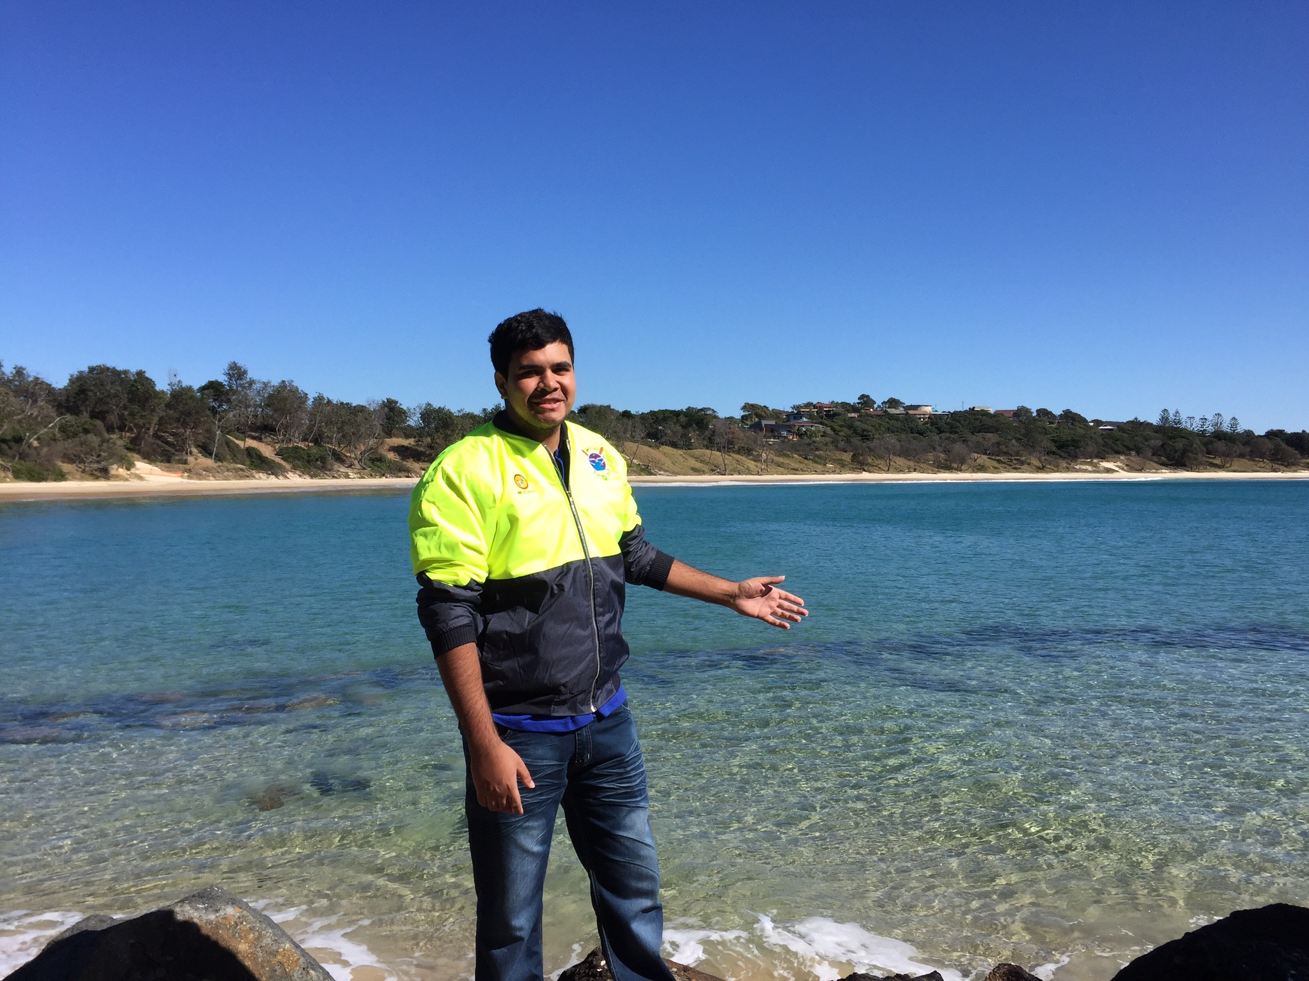
Unkya LALC Cultural Tours
Notes:
Using Unkya Lalc as an example…
Reasons for Unkya LALC to invest in Cultural Eco-tours - Joint management of Gaagal Wannggann National Park; Scotts Head a popular destination; known stories to shares -fish traps, middens, flora, fauna and landscapes to interpret; environmental education need identified.
Photo: Unkya LALC Cultural -Tours Guide Dominic
Photo credit: Kotahi Tourism

Slide 2
Indigenous Product development – what’s needed?
Cultural Knowledge
Location
Resources
Visitors
Notes:
(Apply Unkya LALC start up to this model).
Cultural Knowledge – Gumabynggir
Location – Scotts Head and Gaagaal Wangaan National Park
Resources – midden; fish traps, flora and fauna
Visitors – holiday destination; schools; business tourism

Slide 3
Start up/investing in Cultural Tourism
Who are your Visitors?
Who are your stakeholders? Potential partners? Competition?
How will you sell your product?
How will you operate?
Costs? Capital investment? Fixed & variable operational costs
Notes:
Starting up and operation - we’ve already looked at visitors.
Discuss examples of stakeholders, potential partners & competition (including working with competitors)
In the next few slides, we’ll look at sales, operations and costs.

Slide 4
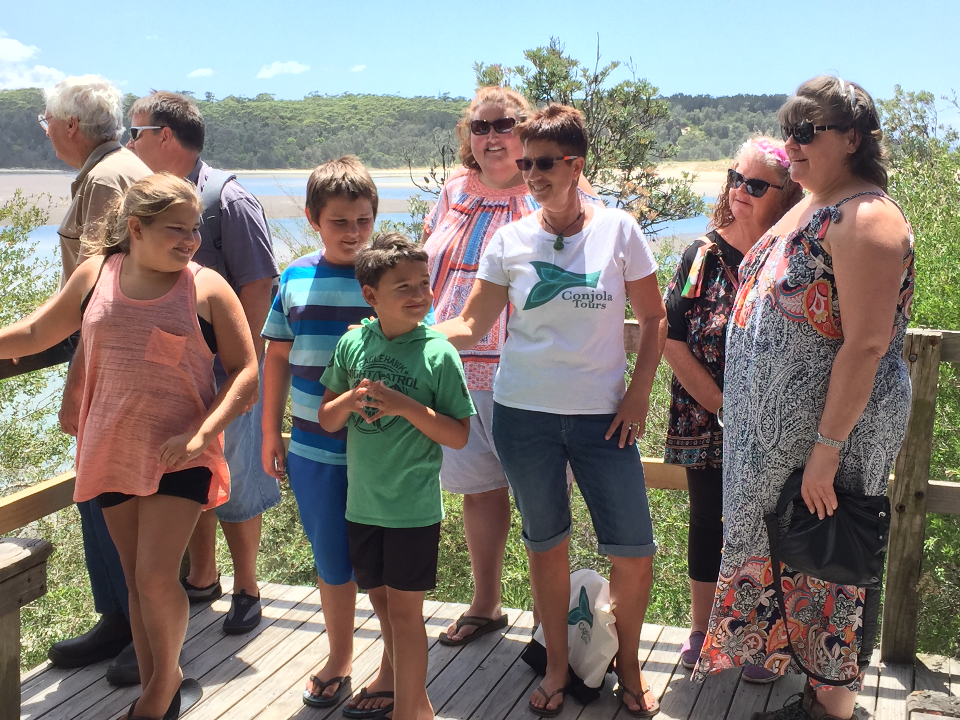
Tourism Operator (Website , email, phone, point of service)
Credit card service provider
Visitor Center
Wholesaler
On-line Tour Agent
e.g. Red Balloon
ITO (Inbound Tour Agents)
Tourism sales
Notes:
Summary – sales (introduction to pricing)

Slide 5
Selling Cultural Tourism products
Sales – on-line, point of service or via agent for a commission
Commissions need to be built into ticket price
10% - 25% Visitor Centers
10 - 25% OTO
20% - 25% Wholesaler
25% - 30% ITO
Credit card surcharges e.g stripe
Notes:
Sales can be on-line, point of service (like at the start of the tour or an office), or via agent for a commission.
Commissions need to be built into ticket price – as we mentioned, generally:
10% - 25% Visitor Centers
10 - 25% OTO
20% - 25% Wholesaler
25% - 30% ITO
Another consideration is credit merchant fees - are you going to pass a surcharge on?

Slide 6
Tour Pricing example - $50 a head
PAX | GST | 25% Commission | Guide | Catering | After costs
1 | 5.00 | 12.50 | 90.00 | 10.00 | - 62.50
2 | 10.00 | 25.00 | 90.00 | 20.00 | -35.00
3 | 15.00 | 37.50 | 90.00 | 30.00 | -7.50
4 | 20.00 | 50.00 | 90.00 | 40.00 | 0.00
5 | 25.00 | 62.50 | 90.00 | 50.00 | 22.50
6 | 30.00 | 75.00 | 90.00 | 60.00 | 45.00
7 | 35.00 | 87.50 | 90.00 | 70.00 | 67.50
8 | 40.00 | 100.00 | 90.00 | 80.00 | 90.00
9 | 45.00 | 112.50 | 90.00 | 90.00 | 112.50
10 | 50.00 | 125.00 | 90.00 | 100.00 | 135.00
20 | 100.00 | 250.00 | 90.00 | 200.00 | 360.00
25 | 125.00 | 312.50 | 90.00 | 250.00 | 472.50
Notes:
Example of basic tour “profit and loss” (excluding other costs such as booking system and marketing) with tour pricing of $50 per head
Wages: $30 per hour for Casual Guide – 3 hour ‘call-out” .

Slide 7
Cultural tourism – costs
Capital investment e.g. bus, office fit out
Marketing
Fixed operational costs e.g. staff, rent, booking system, insurances
Variable costs e.g. catering, park entry
Notes:
What does it cost to run a Cultural Tourism business? No one business is the same. Capital costs will vary according to the type of Cultural Tourism enterprise you are starting up e.g bus, kayaks (Inan Tours) boat (Tribal Warrior Association). Also consider office fit outs (computers, phones etc).
Marketing costs are on-going and include websites, brochure, banners, signage. Good idea to also include costs for ‘launch events’ – invite local tourism industry; media. Great photography and video are essentials – invest in training/equipment or budget for a professional. Re: websites – range from DYI sites such as WIX, to 30K+ websites. Note: Being able to make changes in-house can be a huge saving on on-going overhead.
Operational costs – we’ve discussed most of these. To note though – these days technology allows the provision of running a business without a physical office and even if you have one, it may not need to be open to the public for sales. Many/most visitors will book on-line or locally through a Visitor Center which will be generally be situated in a visible and convenient location for ‘tourists.
Variable costs will change with booking numbers – such catering costs (like we just saw in the previous slide) or per head costs for park entry.

Slide 8
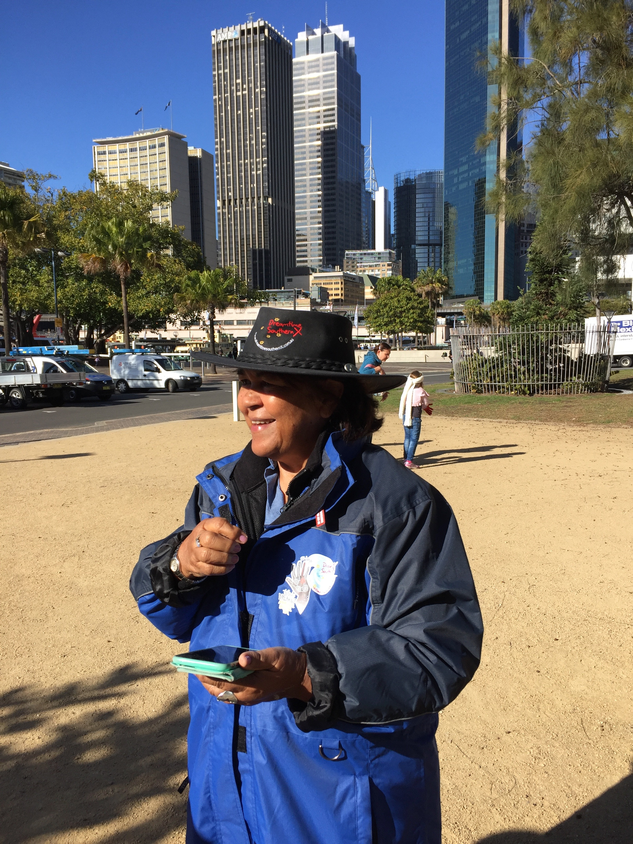
Cultural tourism - operations
Booking system
Accounting system
Human Resources
Guides
Reservations
Sales
Marketing
Book-keeper
Notes:
Key to Tourism operations are systems and people.
Re: booking system – Either commission based or monthly/annual fee. Ideally your system will have connectivity with OTA’s; access to manifests for Guides and be compatible with your book-keeping (accounting) system.
HR - Roles needed include Guides (or front of house staff for Cultural Centres, accommodation); reservations/bookings staff; sales & marketing staff and a book-keeper. (In smaller businesses or sole-operators, one person will most probably be undertaking all/most of these roles)
Photo: Dreamtime Southern X Managing Director Margret Campbell – checking in visitors via REZDY booking system on an i-phone ap
Photo credit: Kotahi Tourism

Slide 9
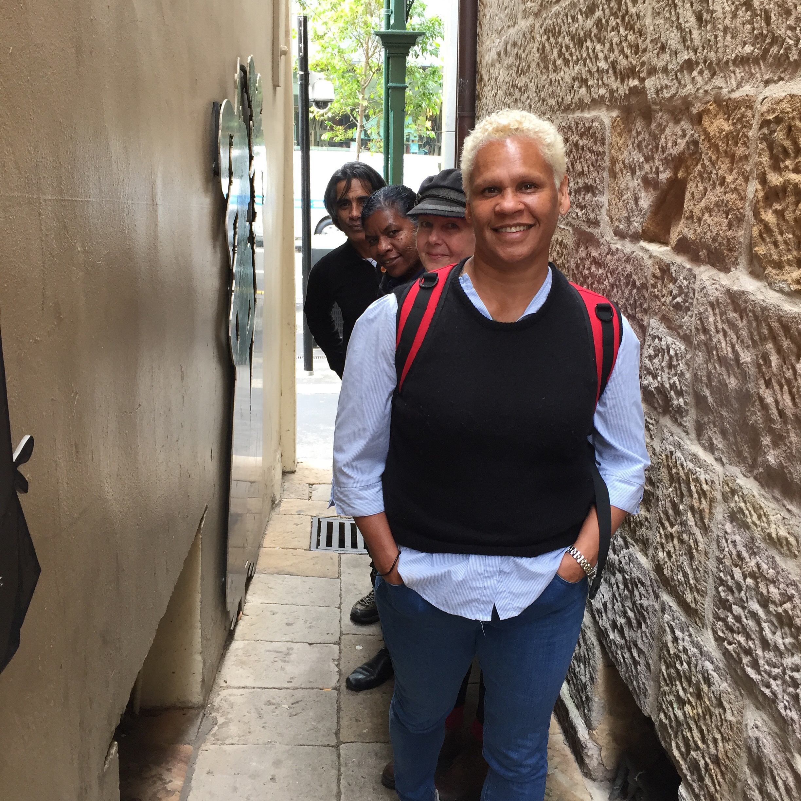
Cultural tourism - employment
Training
Team building
Skill development
Empowerment
Casual vs Permanent
Succession planning
Notes:
Invest in staff team building and skills development. Empower staff so they can can make timely decisions – Guide need to be able to think on their feet, so employers need to make sure their Guides are empowered to make the decisions they will – or might – need to make.
Casual vs Permanent is a big consideration. Obviously it’s much easier to operate with full time staff on hand – though at the end of the day, budget will most probably be a factor in making the decision.
In order to provide more hours for casual staff (e.g .in low season), some operators employ casual guides to work on other aspects of the business – e.g. bookings, marketing, sales, book-keeping. This can work but keep in mind guiding is a different skill set to office work. If you’re going to introduce new aspects to a role, make sure staff are given training.
While Casual work fits best with the peaks and lows of Tourism seasons, it doesn’t offer much job security. Guides/ staff need to see a future beyond their day-to-day role – it’s likely most of them will go on to work for themselves or someone else in future, so succession planning is important – don’t rely on the personality of one guide.
Photo: “Tour Guides of The Rocks” - Dreamtime Southern X and Kotahi Tourism Tour Guides.
Photo credit: Kotahi Tourism

Slide 10
Insurances, licenses and registrations
Insurance
Public and Product Liability Insurance
May require staff to hold First Aid Certificates
Licenses
Eco-pass (if operating in National Park)
Registration
Business Registration
Working with Children Checks
Notes:
The Legal side of things - What insurance, licenses and registration do you need?
PLI (Public and Product liability insurance) – this is an essential. Not only does it provide peace of mind, but also many agents request to see a Certificate of Currency (CoC) before selling your product; and some organisations will request a copy at time of booking.
If you’re operating in a National Park (even if it’s jointly managed), you’ll need an eco-pass. Essentially this is a NPWS ‘approval’ of your business capability to run a sustainable, safe tourism product. You’ll need to provide insurances, marketing, interpretation and risk management plans etc. There’s a link to the process in your tourism resource kit; as well as the contact details of the NSW National Parks & Wildlife Cultural Tourism Coordinator (Shannon Mallison) who can provide support.
Business Registration - you’ll need to register your business; and if you’re thinking of applying for IBA funding, you’ll need to make sure your Cultural Tourism enterprise is registered separately from Land Council business. The Business Development Resource links on Page 4 of your Resource Kit provide more information about business registration (as well as the contact details of the Brian Findlay, in IBA who is the contact for Cultural Tourism Operators – just in case you’re looking for funding).
All staff working with children need a WWCC number – you can ask new staff to provide one (or budget for staff registration once they are employed). Some schools and Vacation care Centres require the numbers prior to booking as part of their risk management processes.

Slide 11
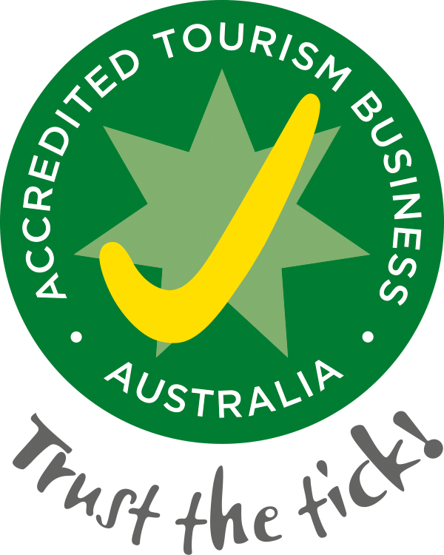
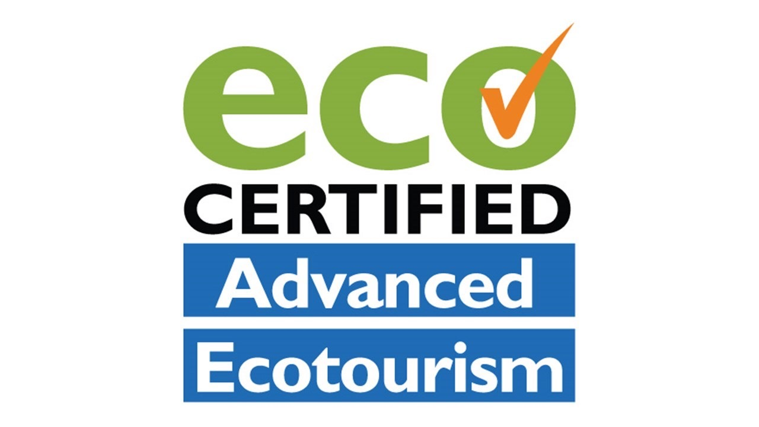

Certification and accreditation (optional)
Tourism business accreditation
Eco-tourism certification
Tour guiding certification
Supply Nation certification/registration
Notes:
There’s also optional accreditation for tourism businesses
Australian Tourism Accreditation Program - national program (each state has a contact person).
Process: register, pay an annual fee (prices start at $289 for 1-3 full time staff), & submit documents (business plans, marketing strategies, risk management plans etc) that are assessed. It can all be done on-line. Essentially they are assessing business Quality, Reliability, Professionalism, Accuracy in Advertising, Environmental Practices and Adherence to a Code of Ethics.
2. Eco-Tourism certification process and requirements are similar - with more detail required around sustainability and include a site visit. Annual costs are higher than with the ATAP program, and there’s an an initial registration cost. Also to note, there’s varying levels of certification to suit different types of tourism businesses e.g. tours; accommodation.
3. Tour Guiding certification is also optional and there’s a number of different qualifications and certifications in Australia. These include TAFE and organisations such as Guiding Organisation Australia (GOA) and Savannah Guides (who are the organisation who assess Ego-Guide certification).
4. Supply Nation is the Government endorsed Directory of Indigenous Businesses, from which both government and corporate procure in order to meet Indigenous Procurement targets. This can be a substantial so for urce sales for many types of products related to Cultural Tourism e.g. Corporate Cultural capacity development (or Cultural Awareness training); accommodation, transport
Registration is for businesses with 50% Indigenous ownership and Certification for 51% or more Indigenous owned. Both certification and registration are free.
(There’s links to all of the above in the Resource Kit)

