Slide 1
Cultural Tourism – Challenges and Risks
Notes:
What are the challenges and risks? How do you manage them?

Slide 2
Challenges of Indigenous Tourism
Cultural Intellectual Property (IP)
(Permission to share stories)
Notes:
Two of the key challenges for Indigenous Tourism providers are related to Cultural Intellectual Property.
Both making sure you have permission to share stories, and protecting them against having others used them as your cultural experience. (Cultural expression). Indigenous Lawyer Terry Janke is a world-leader in Cultural Intellectual Property, and experienced in working with Indigenous Tourism operators. She’s developed some great free resources that we recommend you check out – there’s a link in your resource kit. (next slide)

Slide 3

When working with Cultural Heritage ensure that you seek the permission of the right people.
Cultural Tourism advice from UNKYA Lalc
CEO, Michele Donovan.
Notes:
And of course you need to make sure you have permission to share stories. When we asked UNKYA LALC CEP “What advice do you have for NSW LALC members thinking of investing in Cultural Tours?” this was top of her list.
· “ When working with Cultural Heritage ensure that you seek the permission of the right people”

Slide 4
Challenges of Indigenous Tourism
Managing expectations
- Community, family and visitors
- Racism
Notes:
Community and family will have expectations – money coming into the community; family will hit you up for a loan; lots of visitors; jobs for everyone…
Visitor expectations are that the experience will be as described and that they will be treated well.
Racism is an issue all Indigenous people have to face, and it’s no different in tourism. e.g expectations we’ll be late E.g. “The Racial Time Keeper” – easiest to manage this though if you’re organised and don’t let it happen. Be early - it puts visitors offside (and you) on the back foot if you’re late or arrive after they do.
Also our stories challenge the colonial narrative. Preparedness – contextualisation of your stories with the colonial narrative – this allows the people telling stories (guides) to be authentic and confident, giving clarity and balance to their stories.

Slide 5
Risk examples
Not enough bookings to cover costs
Tour route, activity or venue – hazards
Injury/ loss of items
Bad reviews on Trip Advisor/social media
Notes:
With any Cultural Tourism business (actually – any business!), there are risks. Here’s a few of the real risks for Tourism Operators. You need to have a risk management plan in place for each of your products, as well as for your business. e.g. For school group bookings, you’ll need to provide teachers with a specific risk management plan for the tour or experience they are booking. Let’s break them down and look at risk management…

Slide 6
Risk example | Risk Management examples (tours)
Not enough bookings to cover costs | Marketing – know your visitors and target marketing and promotion accordingly
 | Ensure product excellence.
 | Limit scheduled departures.
 | Ensure minimum numbers and prices for private tours cover costs
Notes:
Not getting enough bookings to cover costs - There could any number of factors that result in not getting enough bookings to cover costs.
1. Marketing – are you doing it ‘right’? Knowing your visitors and targeting marketing and promotion accordingly is vital. E.g. if your market is back packers, brochures in 5 star hotels aren’t going to reach them.
2. Your product needs to be excellent – be clear about what what ‘excellent’ looks like and have quality control systems in place e.g. review visitor feedback and act on it; benchmarking against other operators, staff training and development all contribute to ensuring product excellence.
3. Scheduled departures can be ‘pressure points’ for a tourism business. Without scheduled departures, you won’t meet the ‘Indigenous Tourism Champion’ export ready criteria (and if you’re an Indigenous Tourism Operator not in the program, you not only miss out on the free marketing and promotion provided by Tourism Australia, but you’re competing against ‘Champions”). You don’t have to operate daily and there’s some days of the week/periods of the year when bookings will always be slow. Schedule wisely.
Examples – Poihākena tours – monthly departures; timing aligns with relevant events (e.g. history week); DSX daily departures – block out if no bookings and/or Guides undertake ‘concierge meet & greet” and drop off brochures if no one on tour.
4. For exclusive tours you need to look carefully at the minimum numbers/pricing combination (next slide)

Slide 7
Tour Pricing example - $50 a head
PAX | GST | 25% Commission | Guide | Catering | After costs
1 | 5.00 | 12.50 | 90.00 | 10.00 | - 62.50
2 | 10.00 | 25.00 | 90.00 | 20.00 | -35.00
3 | 15.00 | 37.50 | 90.00 | 30.00 | -7.50
4 | 20.00 | 50.00 | 90.00 | 40.00 | 0.00
5 | 25.00 | 62.50 | 90.00 | 50.00 | 22.50
10 | 50.00 | 125.00 | 90.00 | 100.00 | 135.00
15 | 75.00 | 187.50 | 90.00 | 150 | 248.00
20 | 100.00 | 250.00 | 90.00 | 200.00 | 360.00
25 | 125.00 | 312.50 | 90.00 | 250.00 | 472.50
Notes:
Going back to our example of $50 per head, group numbers over 5 will cover costs (just, but if you set the ‘minimum’ at 15, it’ll take the pressure off the costs of running a tour.
Note: you don’t have to be rigid in your implementation of minimum numbers e.g. If not commissionable, apply a discount for community groups

Slide 8
Risk examples | Risk Management examples
Tour route; activity – hazards | Tour operations minimise risk
 | Guide training (First Aid Certificates)
 | Emergency management plans in place
Notes:
There’ll be specific product hazards and risks that will need management plans
e.g. Accommodation/activity in fire-prone area – fire management plan, evacuation plans
For example (next slide)

Slide 9
Risk examples | Risk Management examples
Injury/ loss of items | Include in Terms and Conditions
 | Check for special needs/medical conditions at time of booking
 | Insurance
 | Risk management plans
 | Provide secure storage for items e.g. waterproof containers if kayaking
Notes:
Booking system
- Set up terms and conditions that are accepted as part of the booking process.
Booking system captures special needs and/or medical conditions that Guides need to be aware of – and operational procedures ensure that guides have access to this information. EG Booking system produces manifest that includes ‘special needs’/medical conditions’
(Refer also to insurance , licenses)

Slide 10
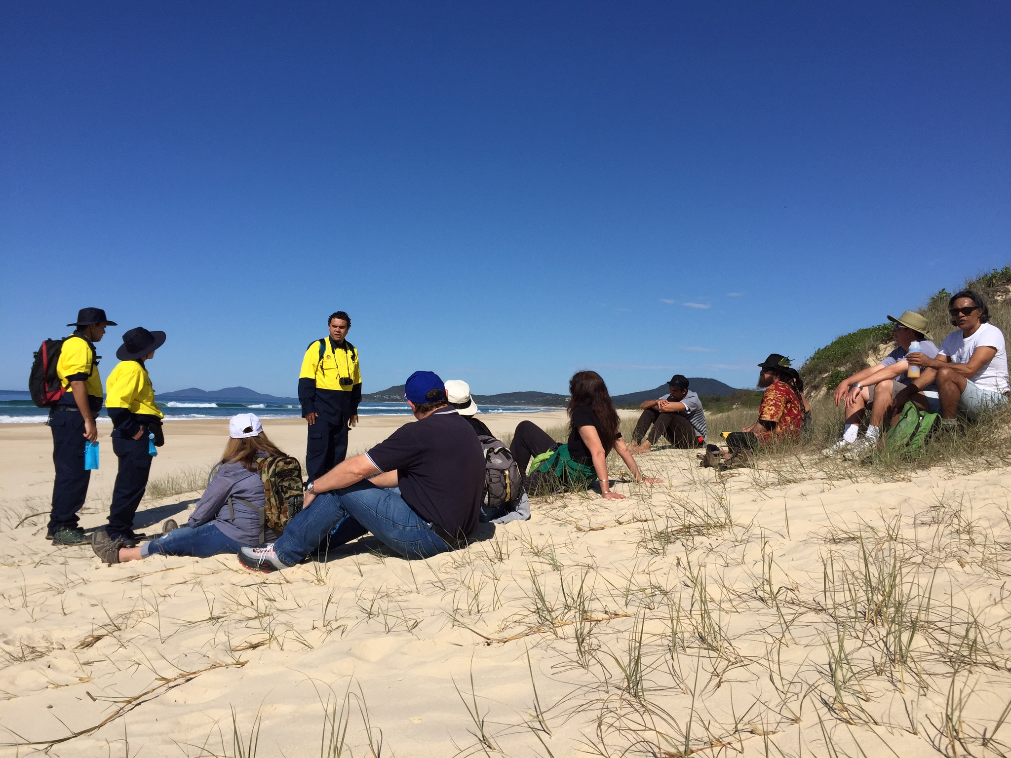
Gagaal Wanngaan National Park Tour
Notes:
Case study : Gagaal Wanngaan National Park Tour – tour (risk management includes
Terms and conditions
- Booking questions
Pre-tour - walk track (fallen trees/dangerous limbs)
Low tide tours only
4WD in case beach evacuation required
Guides hold first-aid certificates and carry a first aid kit
Tour route through bush via tracks
Photo: Unkya LALC Cultural Tours
Photo: credit: Kotahi Tourism

Slide 11
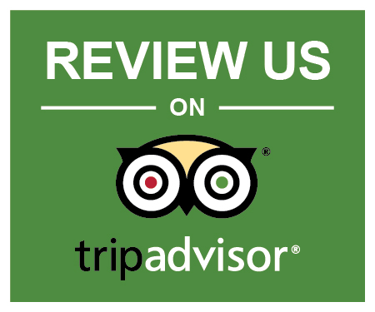



Risk examples | Risk Management examples
Bad reviews on Trip Advisor/social media | Deliver on promises
 | Review and act on visitor feedback
 | Encourage feedback from satisfied visitors
 | Guide training and development
Notes:
The best way to manage bad reviews is not to get any! How do you do that?
1. Ensuring visitor expectations, needs and wants are met (or exceeded) – deliver on the promises you make in your marketing
2. Have systems for inviting feedback/reviews – and a system for reviewing them. If you do get negative review and/or suggestions for improvement – consider actions to address issues to ensure this isn’t a ‘repeating complaint”. There’s lots of articles and advise on how to respond to bad review online, particularly on Trip Advisor, so have a read and plan a careful response.
3. Your systems should include encouraging feedback from all (hopefully) satisfied visitors, so if there is a ‘bad review’ there’s enough great ones to balance it.
4. 90% of excellent reviews mention a tour guide by name* - invest in Guide training and development (e.g. ‘How to get 100% excellent ratings for your tour’ workshop run for Dreamtime Southern X Guides) and empower Guides to be “world class’. Benchmarking is also important (next slide)

Slide 12
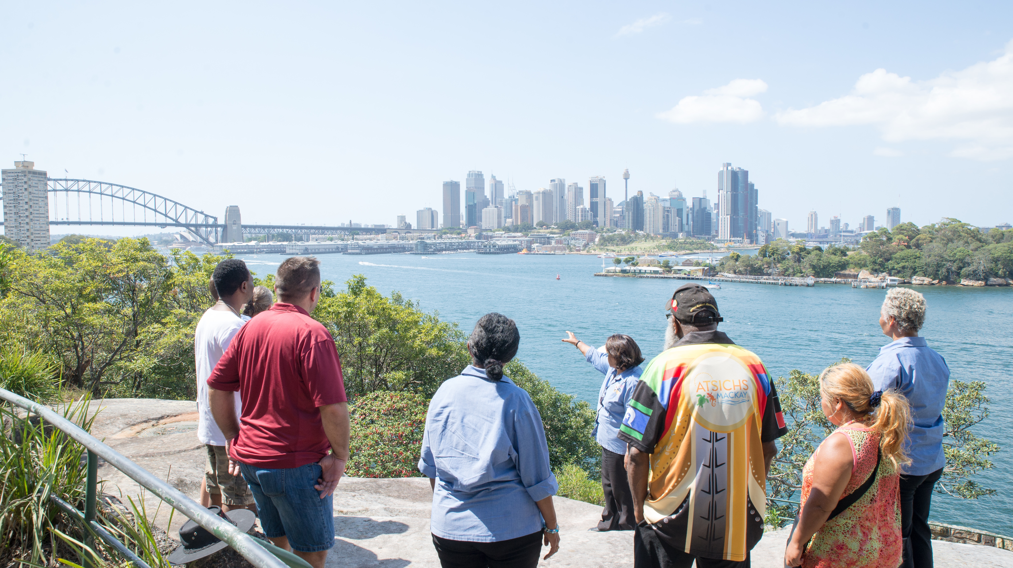
Be a visitor!
Notes:
A Cultural Tourism product in NSW is competing with Indigenous experiences in other parts of NSW, Australia and internationally, so it’s important to benchmark against these products. Know the competition – and pick up good ideas. Other benefit - gain experience from a visitor perspective (important for all front-line Tourism staff).
Anecdote: When ITCP (Indigenous Tourism Champion Program started, Tourism Australia organised a trip to NZ so emerging Champions could experience Indigenous product as an international visitor)
Photo: Aunty Margret Campbell with visitors - Wyanga Malu Tour (mini-coach tour)
Photo credit: Teowai Ratahi for Dreamtime Southern X

Slide 13
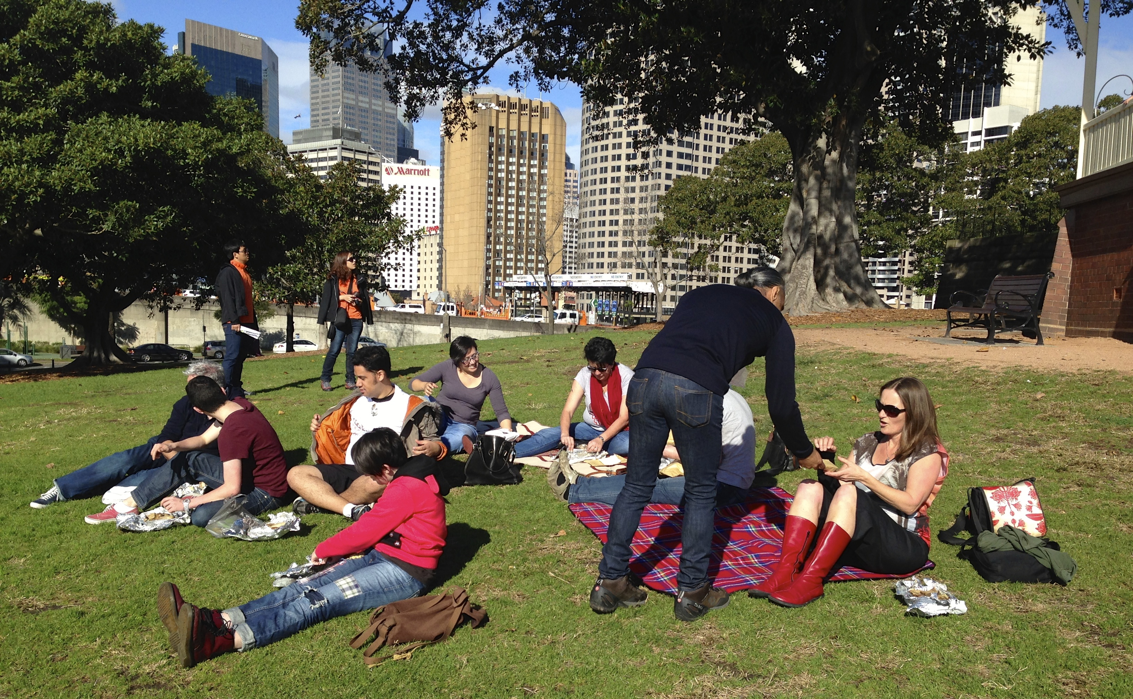
Creating an ‘excellent’ experience
Hospitality - taking care of visitors
Visitor comfort
Risk management
Delivering on promises
Engaging Interpretation
Notes:
So how do you create a Cultural Tourism experience that’s excellent or ‘world-class”. As you’ll find (or find if you’ve already experienced Cultural tourism product) it’s all in how you look after your visitors (Manaakitanga) and meeting your Visitors Needs, Wants and Expectations.
Visitor Comfort – e.g. Not too hot, too cold (Shelter)- not hungry, thirsty or needing a toilet
Risk Management – keep them safe. e.g. safe equipment, route, road crossings, ‘stranger danger’, first aid
Delivering on promises – provide the experience they are expecting from seeing your website or brochure – all inclusions, start and finish on time.
Make it engaging ..(next slide)

Slide 14

“The best interpretation comes from the heart and is laced with imagination, creativity, inspiration, relevance and personal commitment.” Tilden
Notes:
Interpretation is a term you’ll hear a bit in the Cultural Tourism Industry. It was coined by an American – Freeman Tilden (quoted in the slide) who wrote the first book about interpretation in 1957. Essentially interpretation is about how you tell your stories – the connection between visitors and your content or subject matter. If you’re operating a tourism product in a National Park you’ll need to supply an interpretation plan as part of your application for an eco-pass.
Also, if you’re applying for eco-tourism accreditation – even if you’re an accommodation provider.
Interpretation can be ‘Face to face’ (e.g. through cultural tours) – or maybe performance, cooking demonstration, multi-media, video, ap or signage (panels) – or a combination of any or many forms. Interpretation is a profession, there’s both national and international best practice standards in interpretation. Interpretation Australia is the Peak Body for interpretation in Australia and has good resources for members, and annual conferences – this year in Tasmania.
As Tilden describes though “the best…(quote).
Photo: Max Harrison III – Gulaga Creation Tour
Photo credit: Ngaran Ngaran Culture Awareness

Slide 15
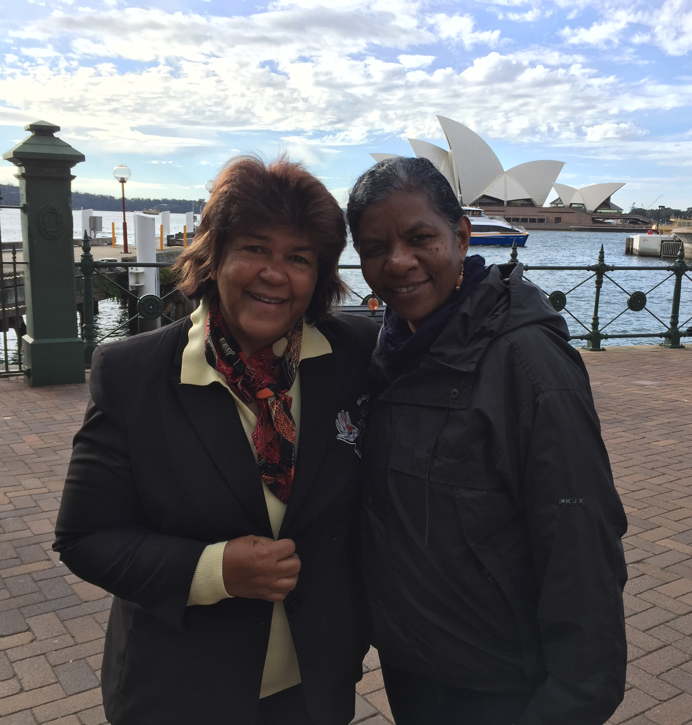
Indigenous Tourism – Signature Experiences
Criteria - export readiness
Financial support - IBA
Tourism Australia promotion
Obligations
Notes:
After at least 12 months operating in the Domestic market, Indigenous Tourism Operators have an opportunity to be listed as a ‘signature experience’ (formerly the Indigenous Tourism Champion Program. (To be listed as a “’signature experience, your business needs to be export ready (we’ll go into that in more detail with checklist in next slide).
Benefits of the program include:
- Tourism Australia promotion and a role within TA dedicated to promoting ITCP members to the Inbound Market.
Indigenous Business Australia support – some marketing and business development costs reimbursed e.g ATE – Australian Tourism Exchange (trade show). Financial support also now available for emerging tourism operators (not yet export ready – and those who prefer not to go into the whole commission-based ITO & Wholesaler market)
Being an Signature Experience may have quarterly reporting obligations and I’ve got a slide coming up that goes into more detail on what’s required.
Photo: Tourism Champion Aunty Margret Campbell, Dreamtime Southern X Managing Director with Guide Joanne Timor
Photo credit: Kotahi Tourism

Slide 16
Export Readiness Checklist
Booking system + provision for response to enquiries and booking requests within 24 hours | ✔
Scheduled departures | ✔
Rate Sheets | ✔
Marketing plan | ✔
Operations manuals (policies & procedures) | ✔
Risk Management Plan | ✔
Licenses and insurance | ✔
Minimum one year in operations - domestic sales | ✔
Notes:
What does “Export Readiness” look like? Here’s some of the criteria.
Note: ‘Rate Sheets’ – like an info sheet for Agents with net rates (not retails as you’d have on your website or a brochure).

Slide 17
Example of quarterly reporting
Business Profitability | Current Q2 Oct-Dec 17 | Prior Year Q2 Oct-Dec 16 | FY July 17 - June 18 | FY July 16 - June 17
Total revenue | $ | $ | $ | $
Total Profit (EBIT) | $ | $ | $
Any comments/explanations
Tourism Numbers | Current Q2 Oct-Dec 17 | Prior Year Q2 Oct-Dec 17 | FY July 17 - June 18 | FY July 16 - June 17
Total visitors
Breakdown Domestic Visitors
Breakdown International Visitors
Notes:
Quarterly reporting was one of the requirements of participation in the former Indigenous Tourism Champions Program (ITCP) – visitor number, visitor breakdown, annual & previous quarter comparisons. EBIT – earnings before interest and taxes. And it’s still to be confirmed but most probably is still required by TA and/or IBA. It’s important to make sure you’re capturing the information that you’ll need to report on from day one e.g. on booking form or in a visitor survey

Slide 18
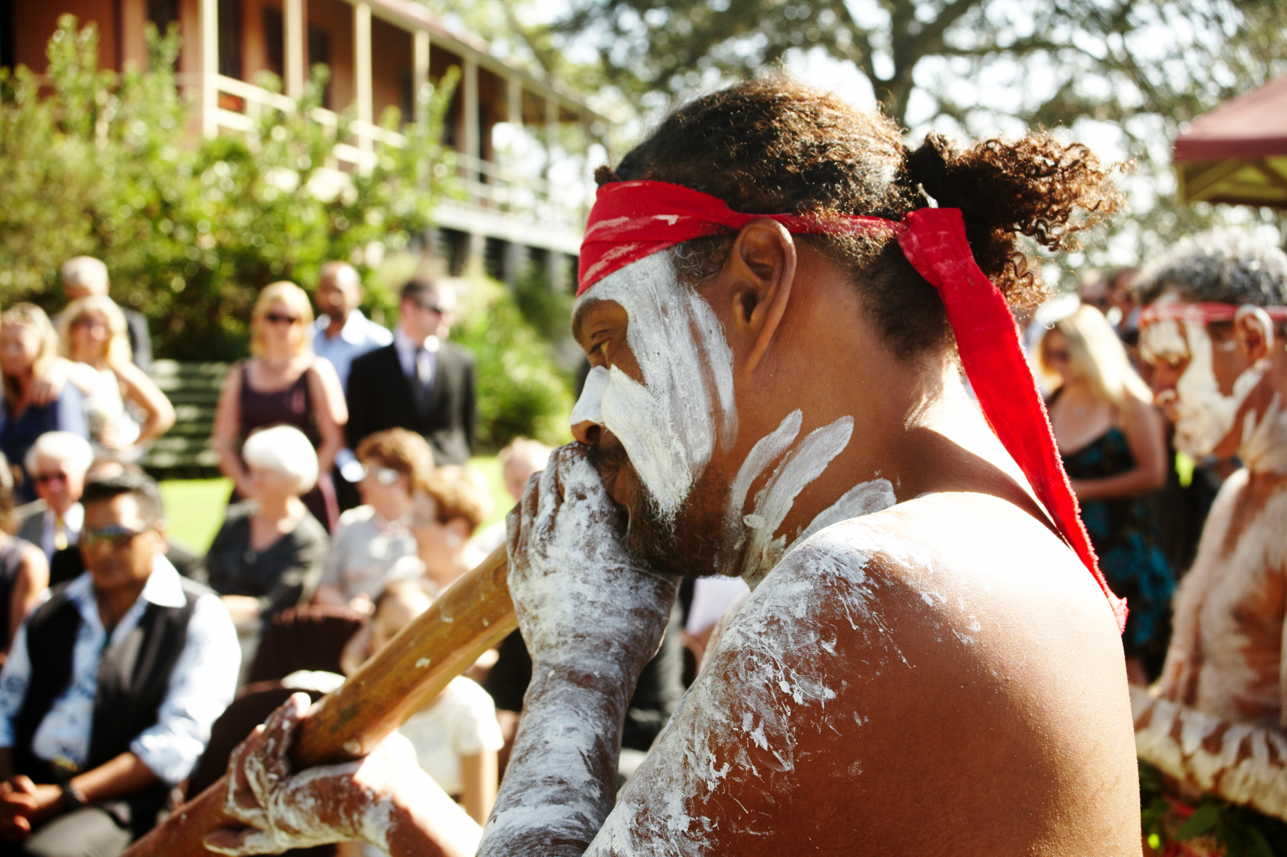
Are you suited to tourism?
Notes:
A final point on Cultural Tourism – before you make any big decisions, we suggest you take the Destination NSW test – ‘Are you suited to Tourism?”
(Hand-out - if time allows, take a few minutes to complete test)
Test from: http://www.destinationnsw.com.au/wp-content/uploads/2014/03/Tourism-Business-Toolkit-VOL1-Chapter6.pdf)
Photo: Tribal Warrior Association – Rodney, Rodd Island, Sydney Harbour
Photo credit: Alfonso Calero

