Slide 1
Cultural Tourism
Examples and case studies
Notes:
That’s about it for an overview of what’s required for running a Cultural Tourism business and how the industry works. Let’s take a look now at some examples and case studies, starting off with a kayak trip with Ingan Tours on Jirrbal Country in the rainforest near Tully, Queensland. This is an example of a mainstream tourist activity that’s also a Cultural experience. (Mel’s heard Managing Director Sonja speak at a Global Eco-Tourism conference in 2012 – inspiring!). They’ve been running since 2009 and are established Indigenous Tourism Champions.

Slide 2
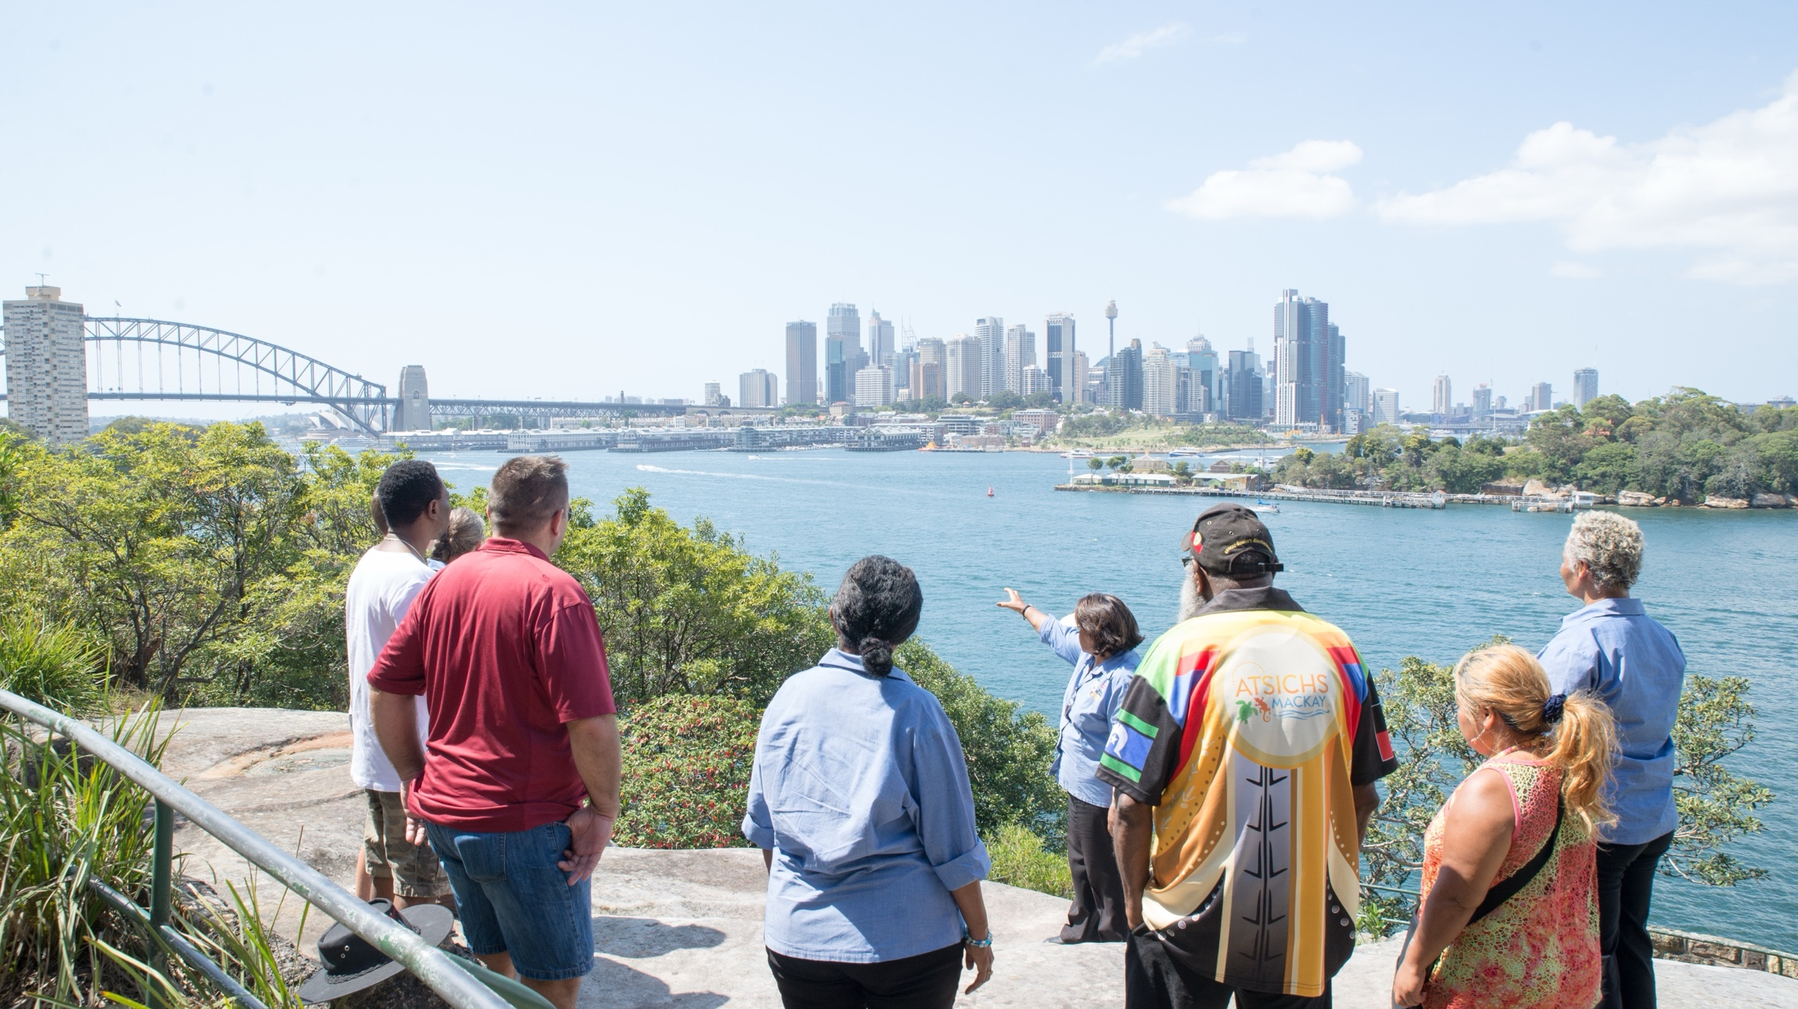
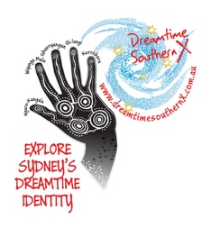
Cultural Tours & Education
Dreamtime Southern X
Notes:
As Destination NSW has recently announced, NSW has overtaken Queensland recently in numbers of visitors experiencing Indigenous Tourism Product. Let’s look now at some of the product within the NSW. Dreamtime Southern X was founded and is run by Aunty Margret Campbell (Djungutti - Jerringa). The Rocks Dreaming Aboriginal Heritage Tour is DSX’s main tour, based in The Rocks, Sydney on Gadigal Country –established post-Sydney Olympics in response to an increasing awareness of Aboriginal Culture and demand for Aboriginal tourism product in Sydney.
.
Business Models
Sole Operator - Aunty Margret developed and originally ran the tour as the first Indigenous tourism operator in the area after Sydney Olympics (a time that opened the eyes of the world to Indigenous Culture - tourists wanted to know about our Culture).
Govt partnership - 2006 – 2014 licensed The Rocks Dreaming Aboriginal to Sydney Learning Adventures the Authority’s education unit.
100% Indigenous owned and operated December 2014 - current
Photo: Aunty Margret Campbell with visitors - Wyanga Malu Tour (mini-coach tour)
Photo credit: Teowai Ratahi for Dreamtime Southern X

Slide 3

Notes:
DSX has 5 main products:
Ngaru-Kungala – Cultural Awareness
Wyanga Malu – Mini-bus tour
Ghurryangun – “Welcome to Sydney” – Acknowledgement of Country and brief cultural awareness (aimed at international visitors )
Ill-langi – The Rocks Dreaming Aboriginal Heritage Tour
Korrobora – Dreamtime Philosophy Dinner (This was a partnership with a local restaurant. Just had last booking this month and no longer available due to venue change for the restaurant – more this later.
Clear key message/tag line – “Explore Sydney’s Dreamtime Identity”

Slide 4
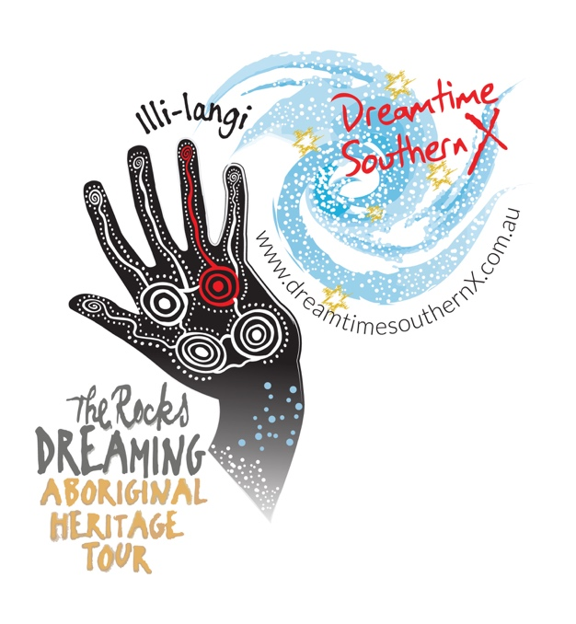
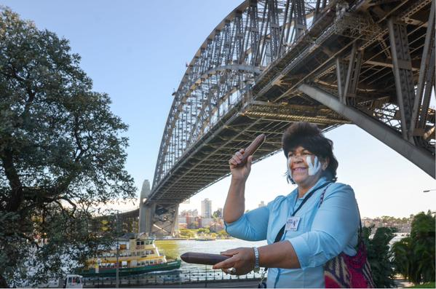
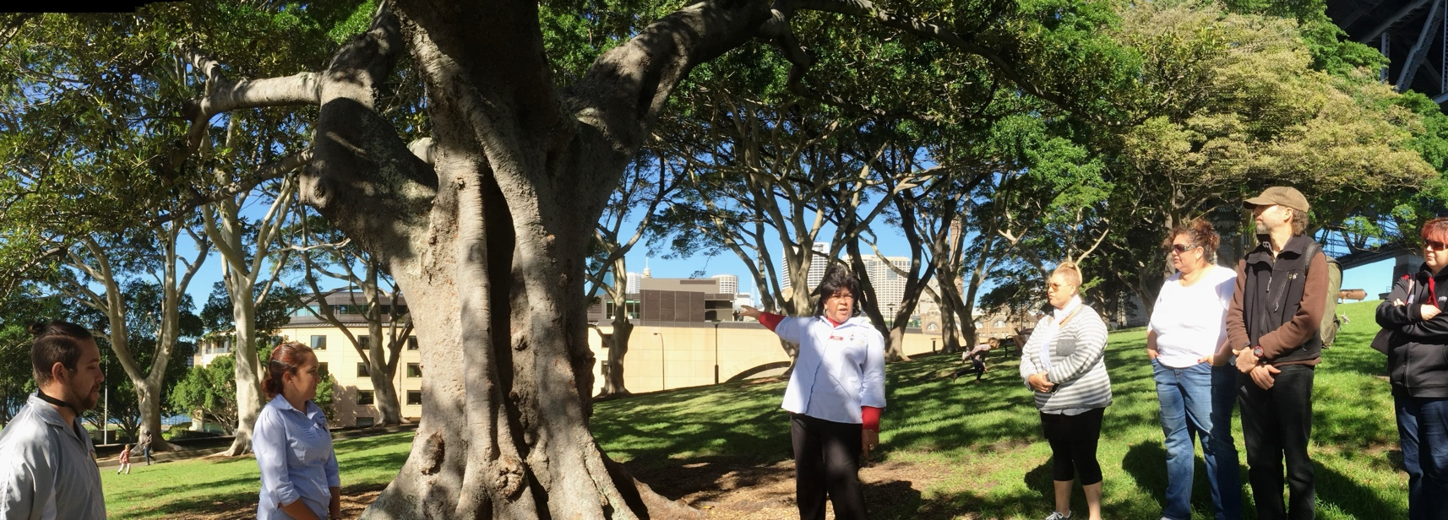
Notes:
The Rocks Dreaming Aboriginal Heritage Tour is DSX main product running since 2000; and these days is sold as 3 products
Scheduled tour with daily departures (10.30am-12)
School groups – anytime. Minimum 20 pax.
Exclusive/private tours – Minimum 15 pax
For more information about The Rocks Dreaming Aboriginal Heritage Tour: www.dreamtimesouthernx.com.au
You can also view The Rocks Dreaming Aboriginal Heritage Tour and other Sydney Aboriginal experiences on Sydney Weekender – there’s a link in your resource book.
Photo credit
Top Right – Dreamtime Southern X. Photographer Teowai Ratahi.
Bottom: Destination NSW

Slide 5
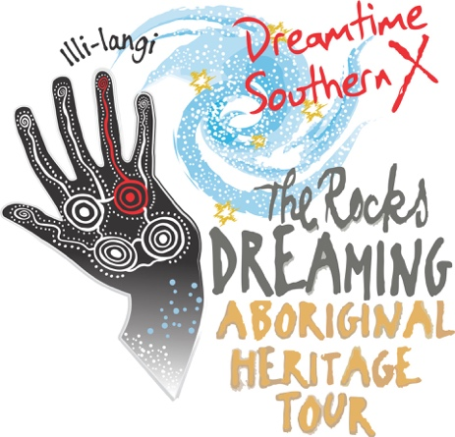
The Rocks Dreaming Aboriginal Heritage Tour
Dreamtime Southern X – Sydney
Notes:
The Rocks Dreaming Aboriginal heritage Tour is run as 3 different types of tours or ‘products’ (i.e. school groups, private tours and scheduled departures. School groups support visitation in the low and shoulder seasons, exclusive groups allow a ‘high end’ experience for those wanting ‘exclusivity; and also suit special interest groups as well Cultural (often booked to support ‘in house’ Cultural Awareness capacity building)
The breakdown indicted in the graph is approximate, based on % of revenue bookings from each of the 3 ‘versions’ of The Rocks Dreaming Aboriginal Heritage Tour.

Slide 6
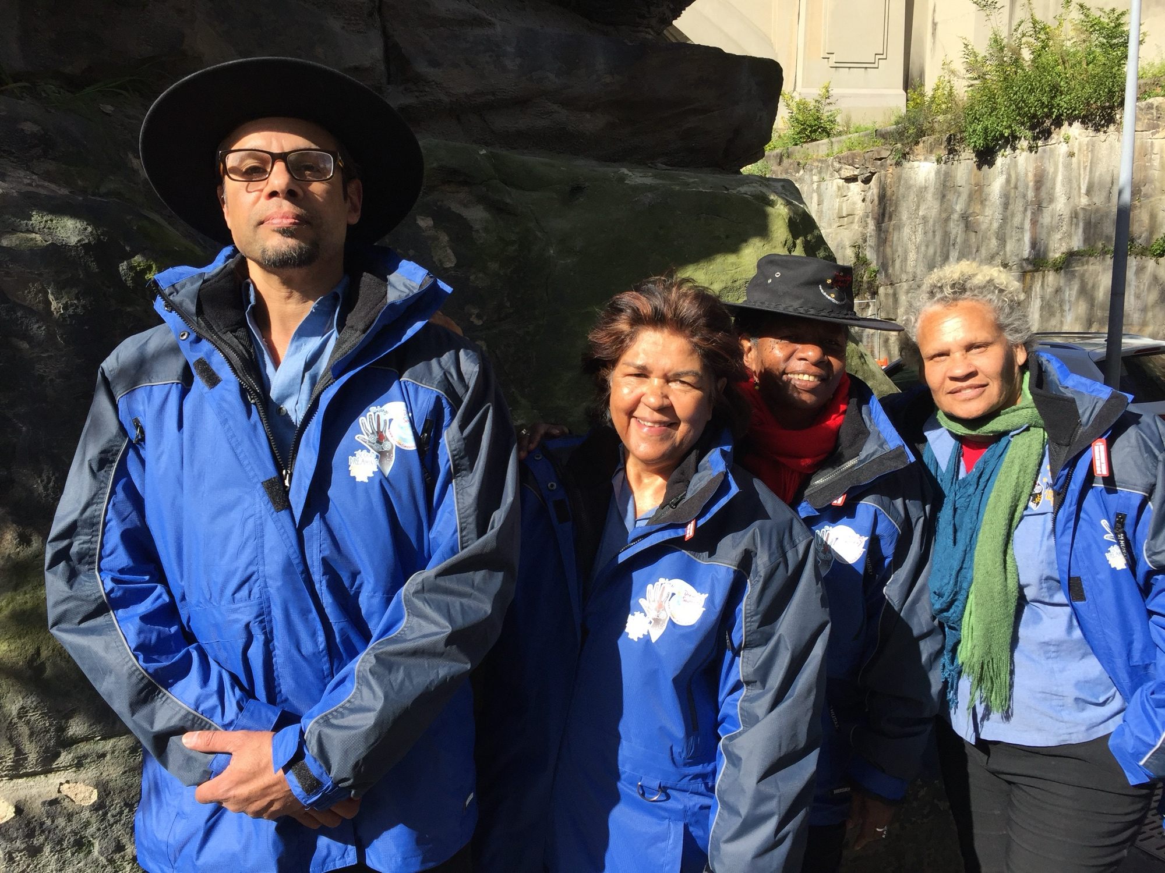
If you were starting your Cultural Tourism business again, what would you do differently?
Dreamtime Southern X Managing Director, Margret Campbell and Guides
Notes:
We asked Aunty Margret– what would you do differently if you were staring up Dreamtime Southern X again?
Photo: Dreamtime Southern X Managing Director, Margret Campbell and Guides in The Rocks, Sydney
Photo credit: Kotahi Tourism

Slide 7

Have enough money to get everything that’s needed at the start.
Cultural Tourism advice from Dreamtime Southern X
Managing Director, Margret Campbell
Notes:
Q: What would you do differently if you were start your business over again?.
A. Have enough money to get everything that’s needed at the start e.g good quality marketing collateral, uniforms for Guides

Slide 8
Make sure partners understand the expectations of tourism industry
Cultural Tourism advice from Dreamtime Southern X
Managing Director, Margret Campbell
Notes:
Q: What would you do differently if you were start your business over again?
A. Make sure partners understand the expectations of tourism industry
Example of lessons learned - Dreamtime Philosophy Dinner (discontinued from July due to venue closing)
Note: Partnering with others adds complexity to bookings and operations - requires excellent communication between partners.

Slide 9
Protect your Cultural IP
Cultural Tourism advice from Dreamtime Southern X
Managing Director, Margret Campbell
Notes:
Q&A with DSX Founder and Managing Director, Margret Campbell
Q. What advice do you have for NSW LALC members interested in starting up or investing in Cultural Tourism?
Protect your Cultural IP

Slide 10
Work with rather than compete with other Aboriginal Cultural Tourism Operators
Tourism tips from Dreamtime Southern X
Managing Director, Margret Campbell
Notes:
Q&A with DSX Founder and Managing Director, Margret Campbell
Q. What advice do you have for NSW LALC members interested in starting up or investing in Cultural Tourism?
Work with local Aboriginal Operators rather than compete

Slide 11
Be patient – it takes a time to build international tourist market.
Cultural Tourism advice from Dreamtime Southern X
Managing Director, Margret Campbell
Notes:
Q&A with DSX Founder and Managing Director, Margret Campbell
Q. What advice do you have for NSW LALC members interested in starting up or investing in Cultural Tourism?
It takes time to build the international market - be patient
Examples of successes -with AOT Inbound – initially small numbers (1 or 2 a month) to regular large group bookings

Slide 12
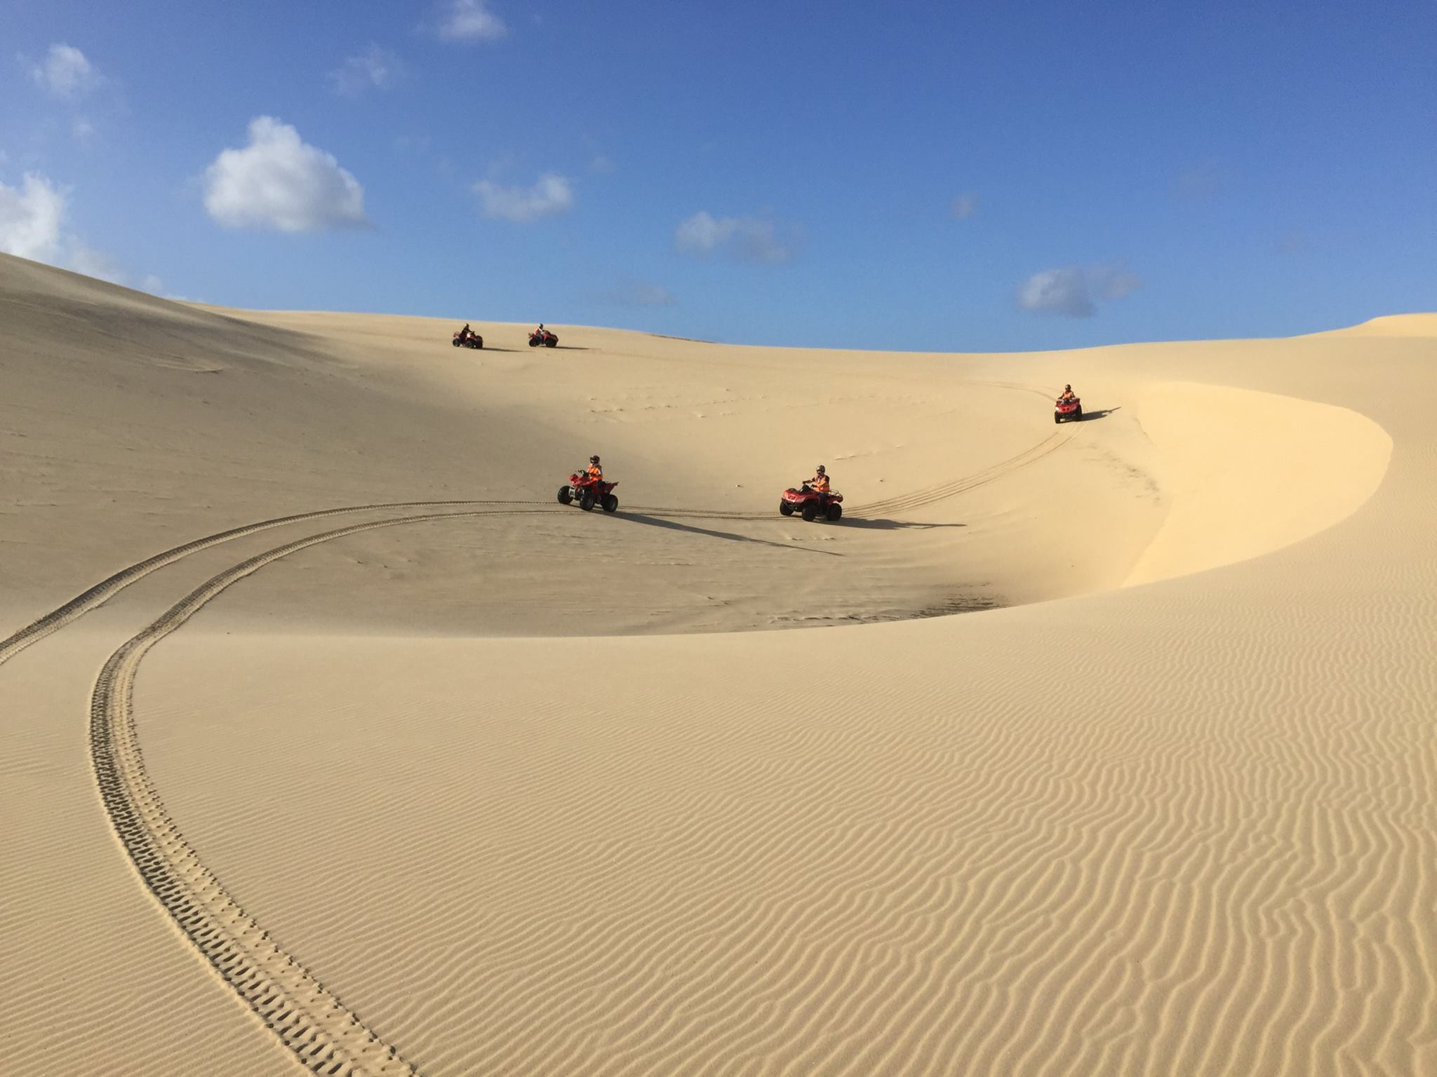
Mainstream tourism
Indigenous operated & content
Notes:
Taking a look now at a Mainstream Tourism Indigenous owned and operated business, based a couple of hours north of Sydney - Sand Dune Adventures.
Photo: Sand Dune Adventures
Photo credit: Sand Dunes Adventures

Slide 13

500 K+ Visitors
Owned and operated by Worrimi LALC
Indigenous Tourism Champions
Tourism Award winners
Notes:
Owned and operated by Worrimi LALC
Indigenous Tourism Champions
Tourism Award winners
Outstanding Trip Advisor Reviews.
Advertisement: Sand Dune Adventures

Slide 14


Mainstream products – Indigenous owned & operated (Māori)
1. Nature Reserve Interpretation – government contract
Boat – transport to and from Island
Tour + catering
Accommodation + catering + night-tour
* International Tourism Awards
Notes:
Mainstream tourism – Indigenous owned and operated
Māori owned – multi-faceted business, developed in stages
Won tender for interpretation at Nature Reserve – trained guide team
Bought a boat – got skippers license
Set up tours with lunch – north end
Set up accommodation, introduced kiwi-spotting night tours
Notes: Key point of this example is working with DOC – in NSW context, NPWS. Particularly in Jointly Managed Parks.

Slide 15
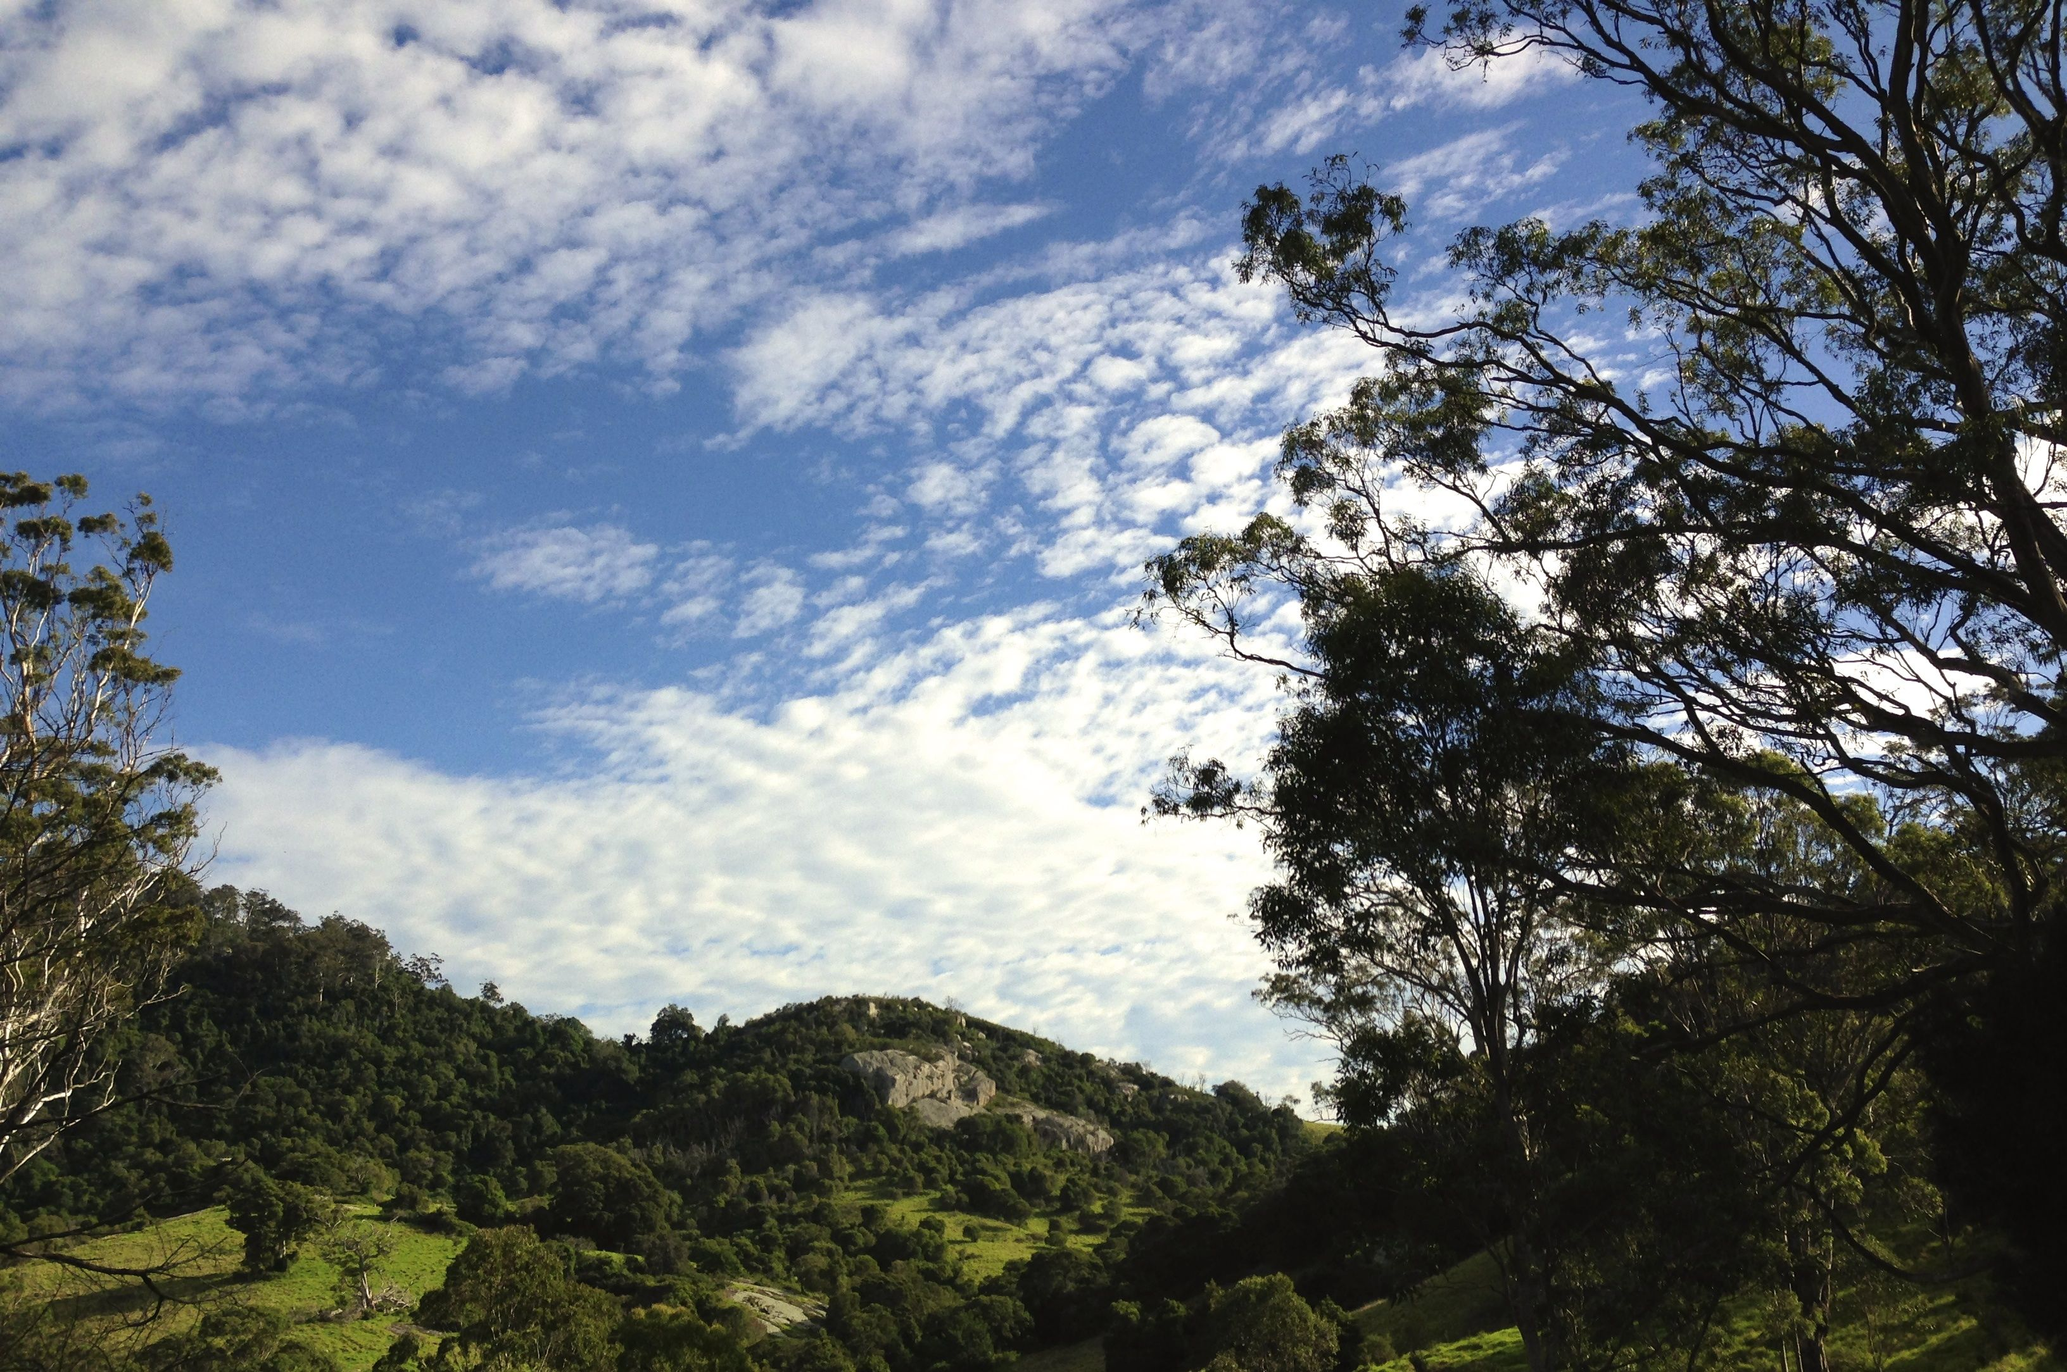
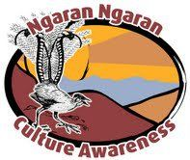
Multi-day experience
Tour + accommodation+ catering + performance
Gulaga Creation Tour - NSW South Coast
Notes:
Back to NSW – this time on Yuin Country on the South Coast. Gulaga Creation Tour was founded by Yuin Elder, Uncle Max Dulumunmun Harrison and now run by one of his Grandsons. The 2 night (40 hour) experience includes 2 nights accommodation, performance, ceremony, meal, guided tour and facilitated ‘reflections’. Uncle Max’s Grandson, Dwayne set up ‘Ngaran Ngaran Culture Awareness’ to run the tours, is now an Indigenous Tourism Champion. There’s been some tweaks to fit the inbound market (e.g. better food, private accommodation options – and a price increase to allow for commissions), however in general the experience hasn’t changed since Uncle Max used to take groups up years ago.
Ngaran Ngaran Culture Awareness: http://www.ngaranaboriginalculture.com/

Slide 16
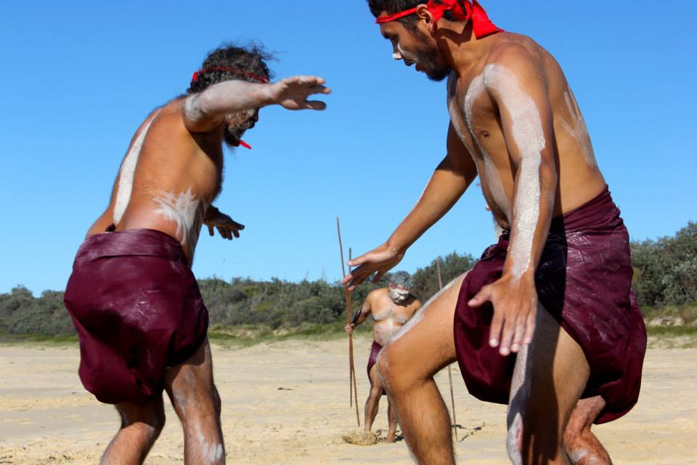
Gulaga Creation Tour - NSW South Coast
Notes:
Some components of the product on Gulaga Creation Tour are ‘out-sourced”
- Local dance group (Gulaga Dancers ) perform welcome dances on Friday nights
- Accommodation is at the Island View Camp Ground – this brings it’s own challenges as their pricing is seasonal whereas tourism product, when selling to the inbound market, needs to be consistent year around.
- Large groups (more than 12) – transport is included (otherwise guests need their own car), provided by local bus-owner
- Additional components added to various tours e.g Artists; and bush tucker cooking demonstrations (next slide)
(Introduce Fred from Freds Bush Tucker – dancer on left)

Slide 17
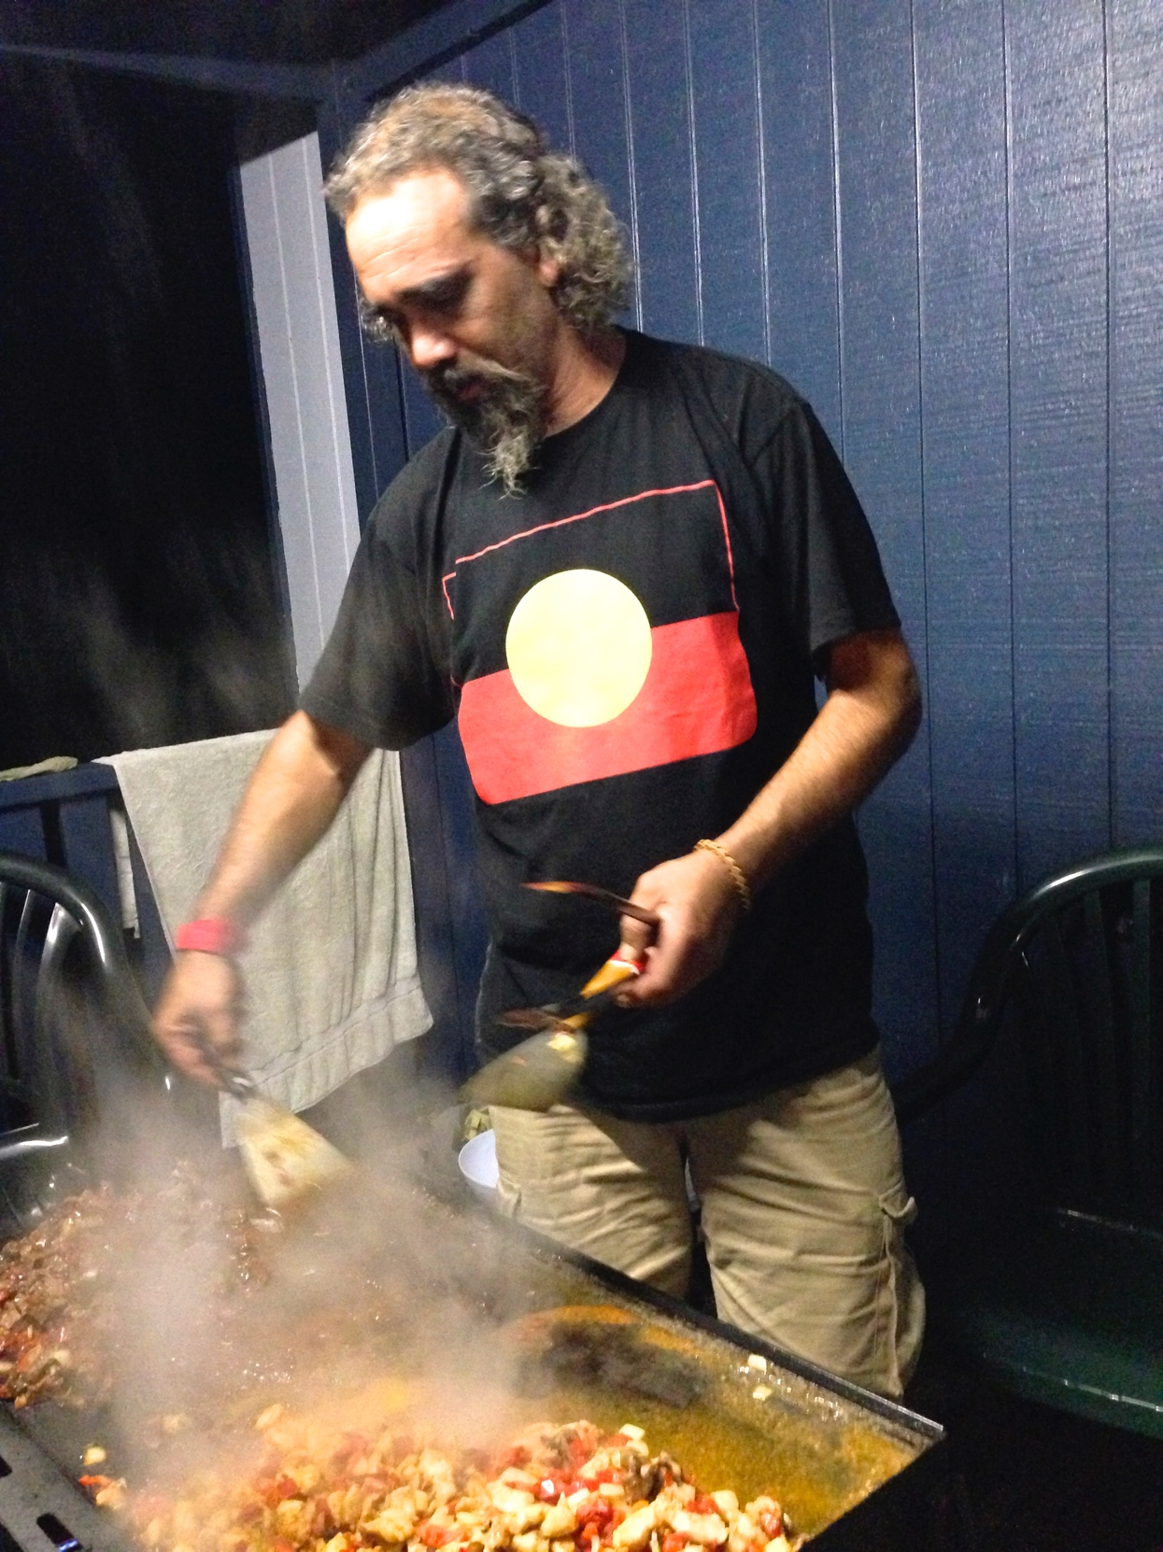
Fred’s Bush Tucker
Catering
Notes:
Fred’s Bush Tucker – Catering and cooking demonstrations at events and festivals. Run by Lindsay Adams (also known as ‘Fred), who started the business after participating in a Tafe small business course.
Photo: Fred’s Bush Tucker cooking demonstration on Gulaga Creation Tour, Narooma.
Photo credit: Kotahi Tourism
Website: http://www.fredsbushtucker.com.au/

Slide 18
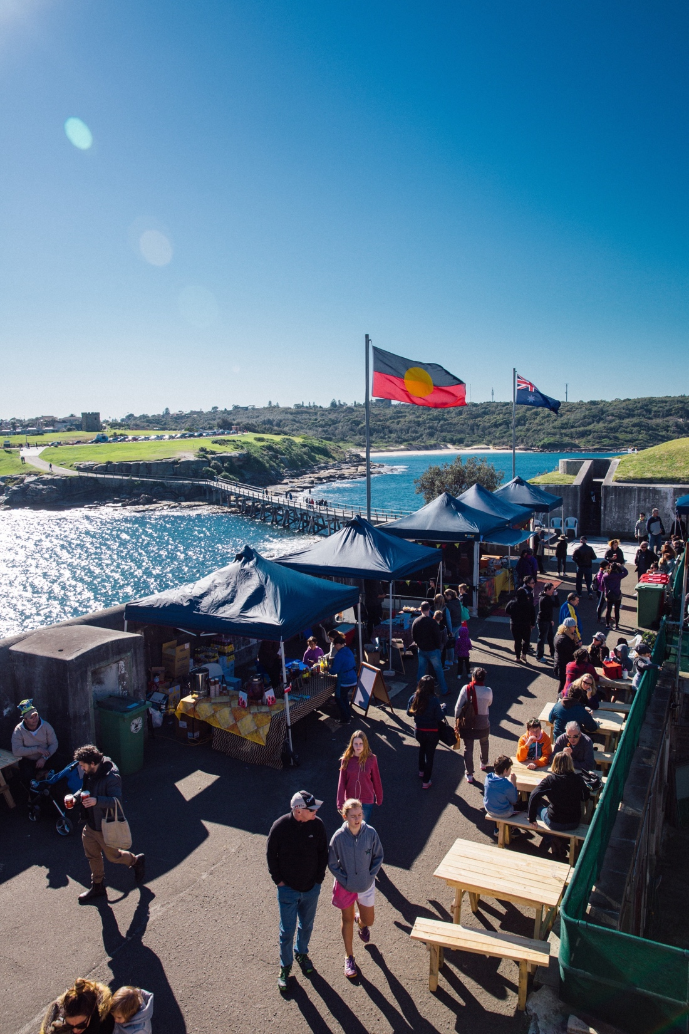
Blak Markets
Events
Image credit: Destination NSW
Notes:
You’ll often find Fred’s Bush Tucker at the Blak Markets in Sydney. Originally run on Bare Island, La Perouse (NPWS land), the markets now also operate at Barangaroo on occasions through-out the year. Operated by non-profit organisation,
A show-case for Indigenous art, performance, craft and food, Markets generate income for small business owners and are also an opportunity to promote other Cultural Tourism products e.g; a stall promoting tours, accommodation etc.
Photo: Blak Markets
Photo credit: Destination NSW
Blak Markets: https://www.blakmarkets.com/

Slide 19
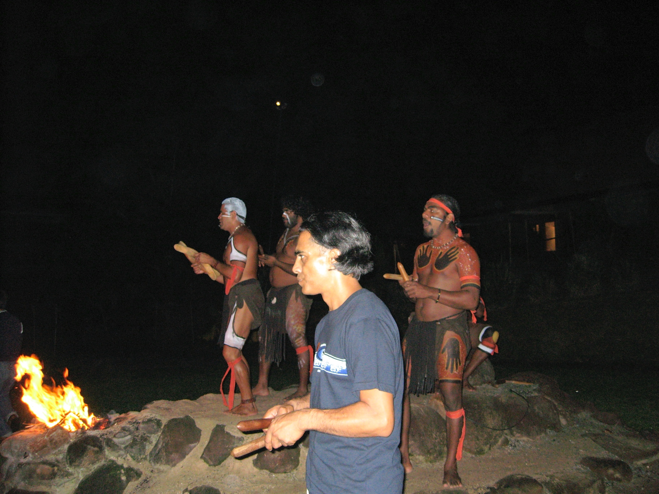
Cultural Center – Tjapukai
Multi-media + Performance + Catering + Retail
Notes:
Back to Queensland for an example of a Cultural Center, Tjapukai is probably one of the best known in Australia. Initially run as a performance at the Kuranda markets (North QLD); Tjapukai moved to a purpose built Cultural Center on the outskirts of Cairns the 1990’s. the Center is set up with dining, performance, retail, multi-media and education facilities. There’s a variety of products on offer including popular evening sessions that begin with a multi-media show, then outside performance followed by dinner then exit via the Shop. Daytime activities are also provided.
Photo: Tjapukai At Night – Tjaukai Performers staff and Kotahi Tourism Director, Hohepa Ruhe
Photo credit: Kotahi Tourism

Slide 20
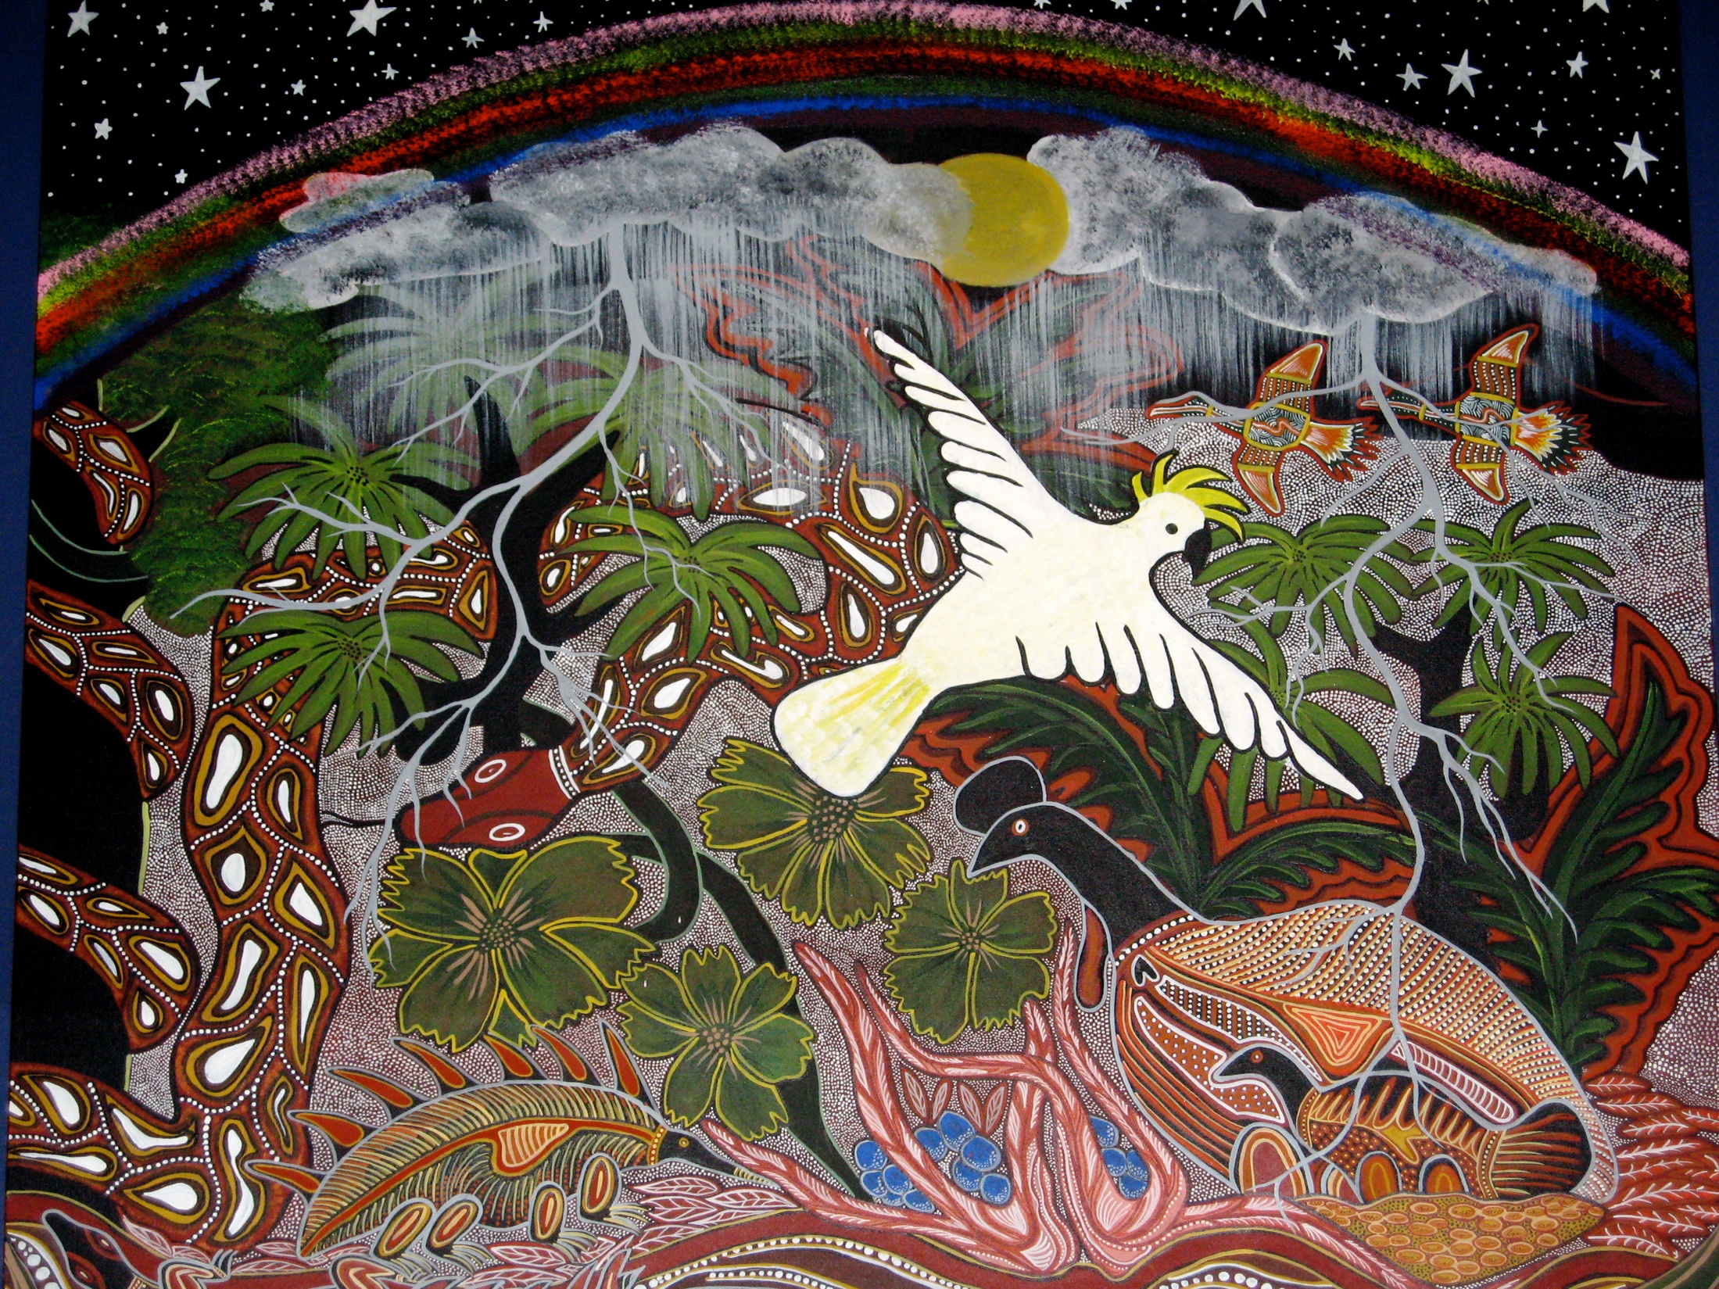
Tjapukai
Notes:
Tjapukai is popular with the many conferences held in Cairns, with the retail area used for drinks/nibbles, pre-show. (business tourism).
(Discuss “Would you like fries with that”? – cultural tourism retail e.g branded merchandise, art, bush food )
Photo: Art work on walls on area at Tjapukai used for multi-media.
Photo credit: Kotahi Tourism

Slide 21
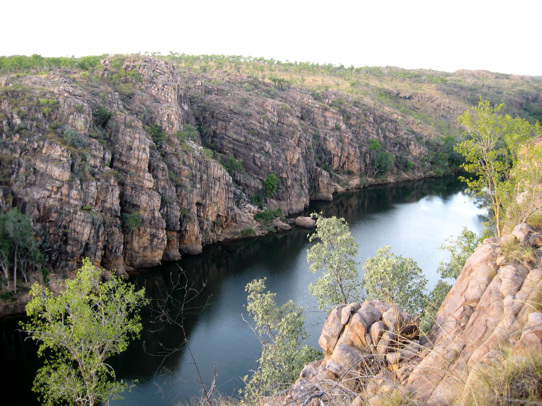
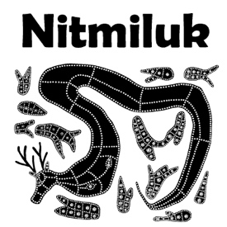
Accommodation +
Visitor Centre
Tours
Cruises
Flights
Catering
Retail
Notes:
Accommodation ranges from camping to 5 star and everything in between. For an example of Indigenous Operated accommodation though, let’s head up to Nitmuluk in the Northern Territory.
Jointly managed National Park since 1989. The Jaeowyn Association initially bought a share in Katharine Gorge Cruises then bought them out and established Nitmuluk Tourism Pty Ltd. Now expanded to land-based tours, a variety of cruises, kayaking, helicopter flights & accommodation – including Cicada Lodge (upmarket) and campground (cabins, safari tents, campsites).
“Our vision is to create authentic and unforgettable holiday experiences, sharing and sustaining the ancient cultures and stories of the Jawoyn people”
Source: Nitmuluk Tours website www.nitmuluktours.com.au
Photo: Nitmuluk - “Katharine Gorge” 2007. (no photos of the tour as didn’t want to get camera wet).
Photo credit: Kotahi Tourism

Slide 22
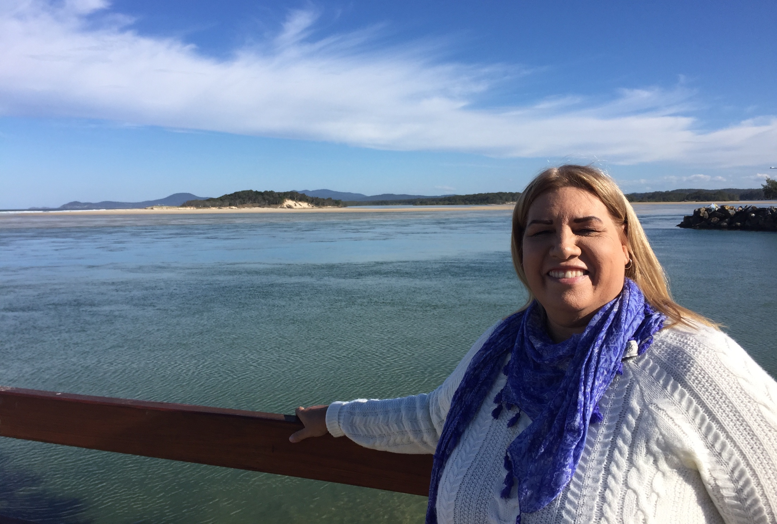
If you were starting your Cultural Tourism business again, what would you do differently?
UNKYA Lalc CEO, Michele Donovan – Unkya Lalc Cultural Tours
Notes:
We’ve covered a lot of info - cultural tourism product, tourists, tourism organisations, product development… so let’s finish today with input from Michele - Unkya Lalc CEO. We asked Michele – what would you do differently if you were staring up Unkya Lalc Cultural Tours again?

Slide 23
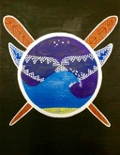
Keep the Cultural Tourism business separate from LALC operations.
Cultural Tourism advice from UNKYA Lalc
CEO, Michele Donovan.
Notes:
If you were starting your Cultural Tourism business again, what would you do differently?
“Keep the Cultural Tourism business separate from LALC operations.”

Slide 24
Have staff qualified to run the business.
Cultural Tourism advice from UNKYA Lalc
CEO, Michele Donovan.
Notes:
If you were starting your Cultural Tourism business again, what would you do differently?
“Have staff qualified to run the business” i.e. Cultural Tourism Business.

Slide 25
Establish a separate Board with business acumen.
Cultural Tourism advice from UNKYA Lalc
CEO, Michele Donovan.
Notes:
If you were starting your Cultural Tourism business again, what would you do differently?
“Establish a separate Board with business acumen.”
Also:
Have a thorough business plan, financials, marketing plan and promotional material from the start
Projection of where we would be in five (5) years time..
Consolidated support from partners and people in the same industry.
Have the majority of these things in place and consolidated.
Training in Small Business for staff.

Slide 26
Ensure your product is authentic.
Language is important to use with your Cultural Product (if you can use it).
Cultural Tourism advice from UNKYA Lalc
CEO, Michele Donovan.
Notes:
We also asked Michelle “What advice do you have for NSW LALC members thinking of investing in Cultural Tours? “
With regard to Cultural Content, Michele’s advice includes “Ensure your product is Authentic
She also “Language is important to use with your Cultural Product (if you can use it)” – language adds a level of authenticity.
(“You have to sing it to keep it alive” – Uncle Max Harrison.

Slide 27
Ask for help if you don’t know. Mentoring is a great way to get the assistance your business needs.
Cultural Tourism advice from UNKYA Lalc
CEO, Michele Donovan.
Notes:
“What advice do you have for NSW LALC members thinking of investing in Cultural Tours? “
“Ask for help if you don’t know (there are people out there that can help you and your business) Mentoring is a great way to get the assistance your business needs.”

Slide 28
Financial Management is crucial to the success of your business.
Cultural Tourism advice from UNKYA Lalc
CEO, Michele Donovan.
Notes:
What advice do you have for NSW LALC members thinking of investing in Cultural Tours?
“Financial Management is crucial to the success of your business” – that’s very true. There’s all sorts of book-keeping systems these days that work well with various booking systems. We agree with Michele – you need to be organised with finances and ensure timely cash flow.
A summary of all Michele’s advice is included in your resource kit. We’d like to add a final bit of advice…

Slide 29
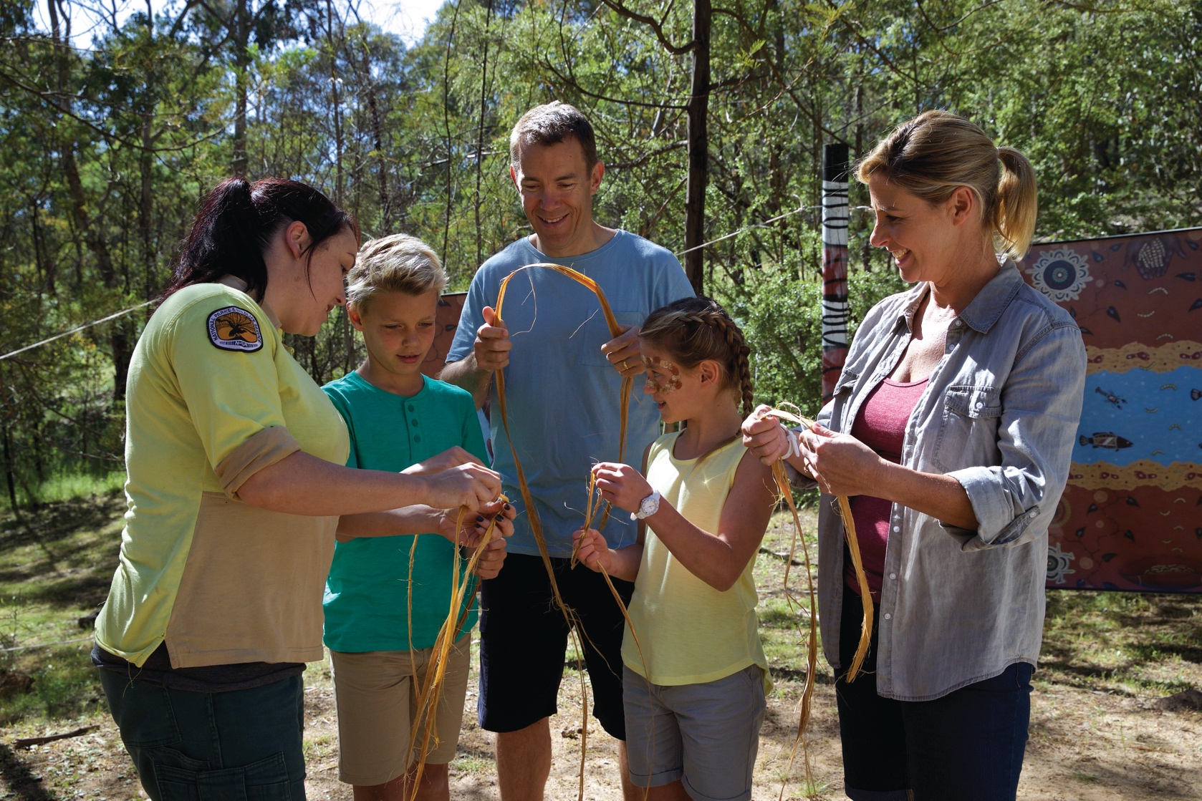
“At the end of the day people won’t remember what you said or did, they will remember how you made them feel” - Maya Angelou
Photo credit: Destination NSW
Notes:
While all aspects of operating a Cultural Tourism business are important, always keep the visitor experience at the heart of your business if you want it to succeed. You can have the best business practices, a world class location and an encyclopaedic knowledge of your subject matter, but in the words of Maya Angelou ‘“At the end of the day people won’t remember what you said or did, they will remember how you made them feel” - and that’s the essence of what Cultural tourism is about.

Slide 30
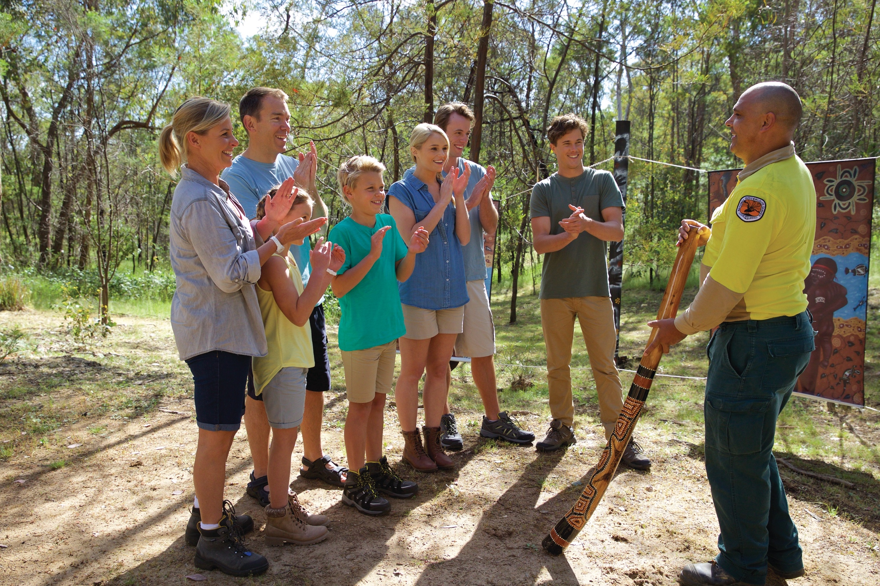
Any questions?
Photo credit: Destination NSW

