Slide 1




Introduction to Economic Development
“Building the Economic Base”
Gary Gabbitas - Senior Economic Development Advisor
alc.org.au

Slide 2
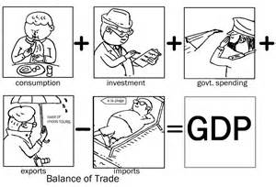
What is Economic Development?
Not just about big corporates and economic growth – Gross Domestic Product (GDP).

Slide 3
What is Economic Development?
Governments get fixated on GDP – It is a broad brush measure that informs them that the economy is growing (or not) but it doesn’t mean that everyone is prospering!
For example both Australia and UK have positive GDP figures. It tells them that their economies are growing, but at the same time both countries have growing economic inequalities!
Economic growth (GDP) is just a piece of the economic development picture but not the full picture!

Slide 4
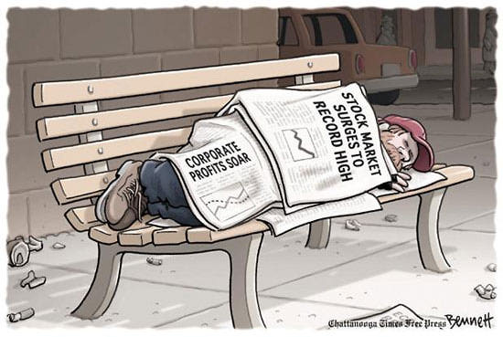
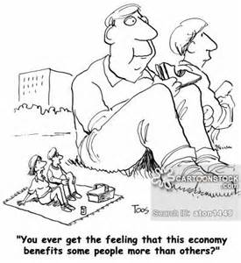
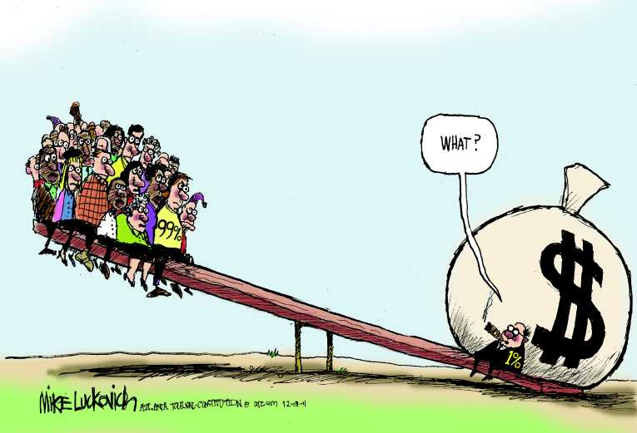
What is Economic Development?
“Not just a GDP story”

Slide 5
What is Economic Development?
No strict definition of Economic Development.
It is not an exact science because it is people focused!
All communities have differences, and this will affect the way they apply their economic development interventions.

Slide 6
What is Economic Development?
Goal of Economic Development is to improve the economic wellbeing of a community through efforts that may include:
  Job creation & retention;
  Business development & retention;
  Tax and business incentives; and
  Enhancements to quality of life.

Slide 7

Economic Development
Economic development needs to be sustainable
Notes:
Notes:
Finite resources
Economy is a product of society and the ecological systems of the planet

Slide 8
What Sustainable Economic Development looks like
Bottom up approach
Community focus and benefits
Environmental / Social / Cultural outcomes are just as important as the Economic outcomes
Not compromise the planet’s future
Social-Cultural
Environ-mental
Sustainability
Economic

Slide 9
A Sustainable Approach
Asset Based Community Development
Economic development based on what we have in our area. Assets!
  People
  Skills
  Relationships with others
  Land / buildings etc
  “Self determination approach”
  Not a needs based approach.
  Always looking to fill a deficit
  “Dependency approach”

Slide 10
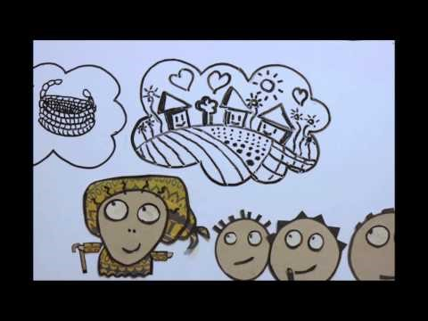
Asset Based Community Development

Slide 11
Developing Sustainable Businesses
Social Enterprise: Profit Conscious Business:
  Business operates and makes profit to achieve social, environmental, cultural outcomes for the wider community. Social Enterprises have a purpose and trade to deliver social impact.
  Compared with “For Profit Maximising Businesses” – corporates and multinationals. Profit is created and maximised for individual shareholders only

Slide 12
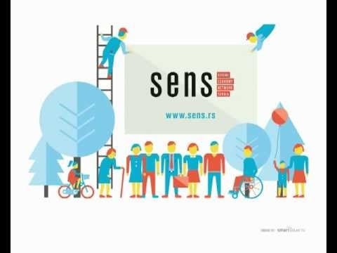
Social Enterprises

Slide 13
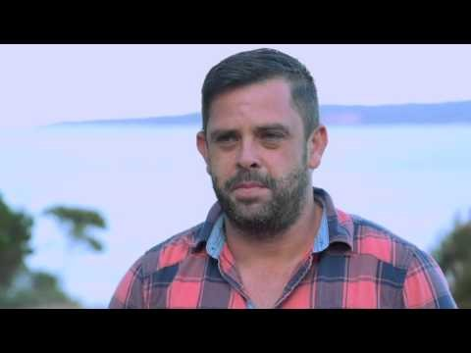
Eden LALC

Slide 14
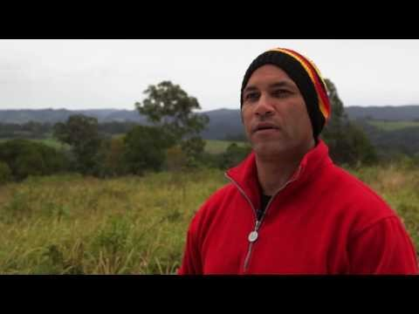
Ngulingah LALC

Slide 15
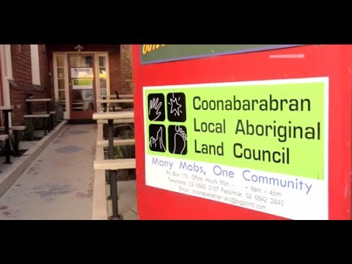
Coonabarabran LALC

Slide 16
What does your CLBP tell us?

Slide 17
Any questions?

