Slide 1

Business Start-up Gary Gabbitas Senior Economic Development Advisor

Slide 2
How to start up in business
There are a number of basic questions you should answer before doing a business plan
If you cannot answer one of the questions then the business will not work – it will have a fatal flaw
This approach will help you screen out bad ideas

Slide 3
Who are my customers?
You do not need a product or service to know this!
List 10 groups of people you know well and understand
These people are not just the people you identify with or like!
What is a business without customers? A hobby!

Slide 4
Why will these people buy something from me?
There are two reasons why people buy stuff
Two motivators –Passions and Fears not Wants and Needs
Passions – logic doesn’t work here! It excites them
Seven Deadly Sins!
Examples: Food and Drink, Sports etc
Go to a restaurant to have a superb meal and experience– Rothwell Fish and Chips Restaurant Doncaster UK - The best in the town! Not just me saying this - Trip advisor 4.5 stars
Prefer Heinz baked beans to home brand because Heinz tastes great.
Support a footie club cos they win, buy their shirt and subscribe to cable to watch them!

Slide 5
Why will these people buy something from me?
Fears
Examples Insurance, Lawyers, Homelessness etc
People buy health insurance because they fear becoming sick and fear worsening ill health due to public health waiting lists
People buy house insurance through fear of losing this important asset and not having the capital to rebuild it
My old house - 17 Frederick St, Neyland, Wales – built 1856 by renowned Isambard Kingdom Brunel’s Great Western Railway for railway workers’ families - still standing and in good order – House Insured for fire, flood etc for 169 years! FEAR

Slide 6
What products and services will have a direct immediate appeal to the fears and passions of customers?
Don’t “mind the gap” but “find the gap”
Successful businesses are observers of people - understand their passions and fears - create product and services that fills a gap

Slide 7
How do I reach my customers?
If you know your customers you know how to reach them
Teenagers – Online - peer to peer – it’s cool!
Microbiologists – Readers- show me the evidence!
Women 70 plus – Traditional advertising, word of mouth – “Hilda swears by brand x”

Slide 8
Who are my competitors?
 | Direct | Indirect
Actual Competitor | Target your market with same product / service | Target your market with a different product / service
Potential Competitor | Competitor who can come into your market with your product / service | Competitor that makes your product / service obsolete

Slide 9
Who are my competitors?
Gary’s Burger Bar | Direct | Indirect
Actual Competitor | Pete’s Burger Bar in neighbouring street | Oh My Cod Fish and Chips take away around the corner
Potential Competitor | McDonald’s Restaurant at present nearest is 10 km away | McDonald’s home delivery business announced

Slide 10
Who are my competitors?
 | Direct | Indirect
Actual Competitor | “The Enemy!” | Substitutes
Potential Competitor | Big Box / Corporates | Obsolete -
Notes:
Substitutes : Caroline St Cardiff Wales known as Chip Alley (Cluster of fast food shops popular with people on the town on a night out – a destination! Main customers FE and Cardiff University students and 16 to 30 year old workers, out for a night out on the town drinking, secondary customers daytime Hayes and market shoppers from Cardiff and the Valleys heading for Dorothy’s café – destination Collaboration?
Big Box – cannot compete why not approach and JV or franchise with them because you know the industry?
Obsolete - Keep abreast of future changes. 15 years ago DVD rental shop all the rage. Obsolete now. Quit while your ahead – sell on refocus.

Slide 11
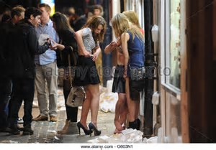
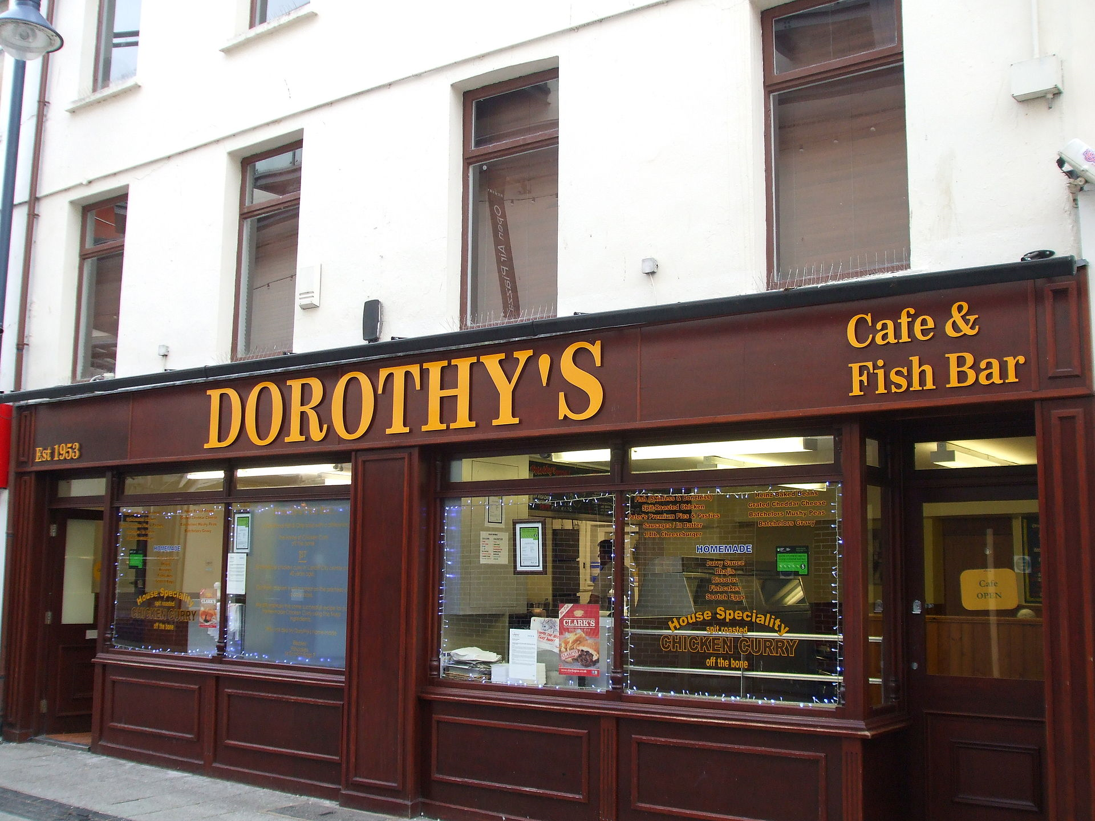
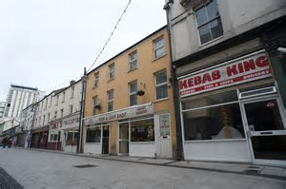
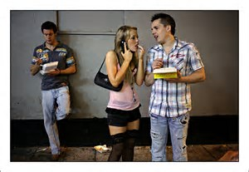
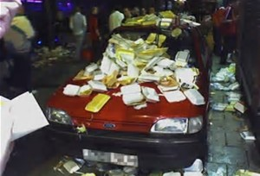
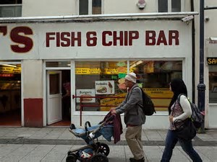
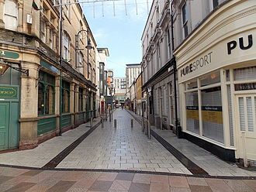
Chip Alley Cardiff, Wales Sglodion Ali Caerdydd, Cymru
Notes:
A humourous example of understanding your market and competitors
Chip Alley – Caroline St, Cardiff, Wales. Built in Georgian period and named after George IV wife. Originally high end housing and shops!
Market leader Dorothy’s and destination
Curry sauce and chips –signature dish
Target markets – young adults and students at night, and shoppers in daytime. Attracts tourists too! They’ve heard of Chip Alley and its notoriety!
Is it lush?

Slide 12
What is my competitive advantage?
What sets you out from the crowd?
Define this
It may be your product and service offering?
It may not be your products and services though
It may be who you are
Location of business
Great staff
An undefinable emotion – “I feel comfortable here” “ A great atmosphere”

Slide 13
Who should be on the management team or partner with?
First define what are the essential functions of your business.
The core essentials: 4 or 5 tasks that need to be done well to succeed. You must do these!
Second can you do these essential tasks?
Yes – you don’t need a partner
No – you do need a partner

Slide 14
Who should be on the management team or partner with?
What about the non-essential activities?
These are what you should never do or very seldom!
Delegate them!
e.g. Accountant to do the books
Staff / contractors tasked with delivery of these

Slide 15
Where do I get the money from to do this?
Generally two places where the money comes from
Customers revenue – Paying for products and services
Owners capital invested in business – your back pocket!
Need to get to a break-even point – enough revenue to pay the bills
Build equity in the business as quickly as possible
Longer it takes to reach break even the more it takes from your back pocket.
Once at this point potential for other investors such as Angel investors etc. Showing success

Slide 16
What are the risks involved with the business?
Your risk profile must define your business legal structure
High risk business needs a limited liability company to protect your personal assets
Liability insurance – protect your business assets
Golden Rule: “Do not do business with crazy people!”

Slide 17
Any questions?

